Slide 1





1
2
Module 3
Managing a bank account online
3
3
4
5
6
Funded by the European Union. Views and opinions expressed are however those of the author(s) only and do not necessarily reflect those of the European Union or the European Education and Culture Executive Agency (EACEA). Neither the European Union nor EACEA can be held responsible for them. Project number: 2023-1-RO01-KA220-ADU-000157797

Slide 2








Asociatia Four Change, Rumania
PARTNERS
Zavod IZRIIS, Eslovenia
E-SENIORS: INITIATION DES SENIORS AUXNTIC ASSOCIATION, Francia
GUnet, Grecia
Asociatia Niciodata Singur – Prietenii Varstnicilor, Rumania
Fundació Gesmed Fundació de la Comunitat Valenciana, España

Slide 3

Modules
1. Basic digital literacy skills
2. Security & Prevention
4. Online solutions for receiving and sending money
5. Using a Credit Card to Purchase from Online Goods and Services
6. Processing online payments for taxes and bills
3. Managing a bank account online

Slide 4

Unit 1
Introduction
Objectives
On completion of this unit, you will be informed about
The learning objectives and training content of this module
The training methodology used and the duration of this module
Image by vectorjuice on Freepik

Slide 5

Competences
3
Managing a bank account online
After completing this module, you will know how to:
Set up and access an online bank account
  know the steps to set up an online bank account in your application
  know how to get the access code to the account
  know how to verify your identity and create your own username and password
Manage an online bank account:
  know how to identify and access the services offered by your online account
  know how to make transfers and pay bills
  know how to consult your available balance
  know how to consult movements

Slide 6

Training content
3
Managing a bank account online
Introduction: duration, objectives, content and methodology
Difference between bank accounts
Advantages and challenges of online banking
How to install a mobile banking application
Obtaining the identification and access code
Online transfers
Account balance monitoring
View messages and alerts
Tips and exercises
What does it mean...? Explanation of basic banking concepts

Slide 7

Unit 1
Training methodology and duration
3
Managing a bank account online
Methodology
Active and participative
Face to face training:
  Dialogue ✓ Role playing ✓ Teamwork
Online Training:
  Videos
  Exercises on activities completed in class
  Collaborative Work
  Simulations
Duration: 4 hours
  Face to face session:2 hours
  Online training: 2 hours
  The course is implemented at a higher or lower level depending on the technological knowledge of the participants.

Slide 8

Unit 2
How to set up and access an online bank account
Objectives
On completion of this unit, you will be …….
… understand the difference between traditional and online bank accounts
… be aware about the advantages and challenges of online banking
… know how to install and access a mobile banking application.
Image by vectorjuice on Freepik

Slide 9
Types of bank accounts
3.2 Set up and access an online bank account
Differences between traditional bank accounts and online bank accounts:
“Traditional banking relies on the customer who uses a savings book and cash and travels to bank branches, whereas the digital customer uses the latest technology and does not need to travel to make transactions.” (Fuente Iebschool)
Traditional Banking | Online Banking
Banking operations require going to a branch and communicating in person for any transaction. Thanks to the ATM it is possible to withdraw money in person, but it is still necessary to travel. | Online banking services are usually not very different from traditional banking services, but they have the special feature that they can be performed remotely via an app or the bank's own website.

Slide 10


Advantages and challenges of traditional and online banking
3.2 Set up and access an online bank account
Traditional Banking
Online Banking
Advantages
  Personal Attention: Direct contact with the bank teller
  Ample availability of ATMS
  Additional services (security boxes, insurance services)
Disadvantages
  Limited opening hours
  Waiting time of each visit
Advantages
  Convenience: 24/7 access without travel
  Time-saving: no waiting in lines
  Less commissions
  Easy management: real-time balance tracking
Disadvantages
  No reference person for direct contact
  Small network of ATMs

Slide 11

How to install a mobile banking app
3.2 Set up and access an online bank account
What do we need to create and access an online account?
  Device with internet access (smartphone, tablet, PC)
  Bank account
  Online banking login details
  ID and access code for online banking services
Request your access data from your bank
  directly at the branch or via your bank's website
With these details go to your bank's website and log in with your username and your password (PIN).
click
Here you find a video with the necessary steps to download the app of the BBVA bank: https://youtu.be/PI9g7k9mc_I

Slide 12
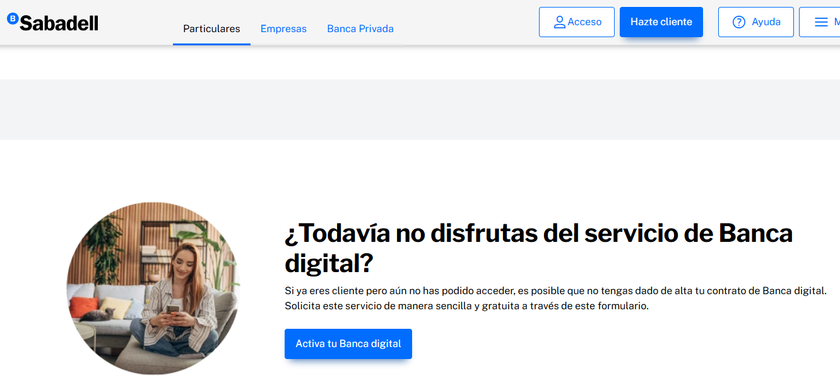
Steps to access the online account for the first time (1/2)
3.2 Set up and access an online bank account
The steps to access online banking for the first time are usually the same for all banks:
Visit your bank's website and look for the ‘Online Banking’ or ‘Customer Access’ option.
Click on ‘Register’ or ‘Create an account’ to begin registration.
Fill in the requested information, such as your account number, date of birth and other personal data
Create a username and a secure password that you can remember.
Click here!
Image by Banco Sabadell

Slide 13
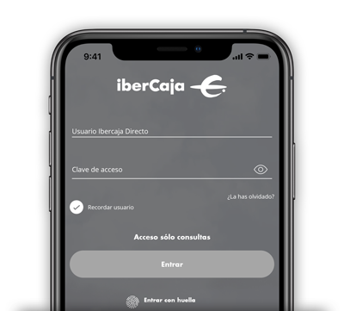
Steps to access the online account for the first time (2/2)
3.2 Set up and access an online bank account
Verify your identity by following the bank's instructions, which may include sending a verification code to your phone or email.
Once your identity has been verified, you will be able to access your online banking account with your username and password.
Remember to keep your login information secure and do not share it with anyone !
Image by IberCaja

Slide 14
Unit 3
Basic use of an online bank account
Objectives
On completion of this unit, you will be …….
… able to make a bank transfer
… monitoring your account balance
… view online messages and alerts about your account
Image by vectorjuice on Freepik

Slide 15
How to make a bank transfer? (1/2)
Realize bank transfers
In the case of a bank transfer, money is transferred from one account to another.
Once a transfer has been authorised, it can no longer be cancelled.
Have all the information you need at hand. You will find most of the information on the invoice you want to pay (name of the recipient, IBAN, amount and payment reference).
click
Additional information
Have a look at this video on how to make a bank transfer:
https://youtu.be/7tAHoJAGtn0

Slide 16
How to make a bank transfer? (2/2)
The typical bank transfer screen consists of the following fields:
  Sender account: where the money comes from
  Amount: the amount you want to transfer
  Balance: Money, you have on your account
  Recipient: the name you put on the invoice
  IBAN: 24-digit international bank account identification number
  BIC: Identifies the destination bank
  Payment reference: the reason for this payment
  Date of execution: The date of the transfer

Slide 17
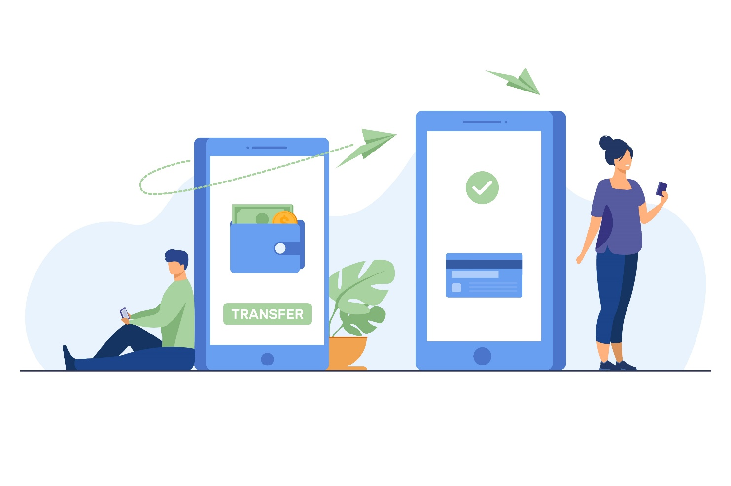
Advantages of making a bank transfer online
3.3 Basic use of an online bank account
… instead of carrying cash or paying at your bank counter:
You don't need to carry banknotes from one place to another, so they can't be stolen or lost. In return, the money is protected by the security system of the online bank account.
A transfer from one account to another at the same bank is free of commission and will be available in the other account immediately.
There is no need to fill in the transfer order by hand at the bank and you can save the details of the destination account in the app so that you don't have to take these details out for the next transfer.
Image by Freepik

Slide 18
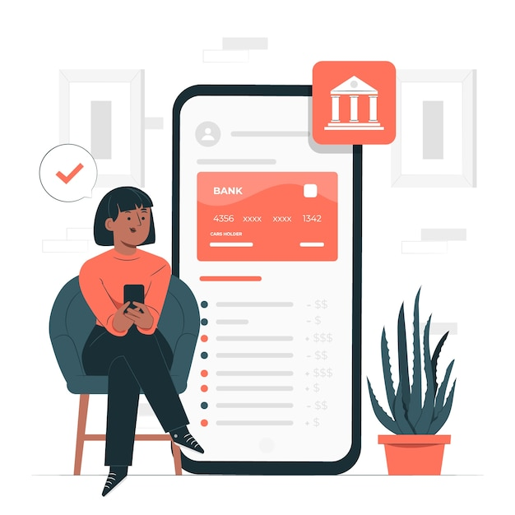
Monitoring of account balance (1/2)
3.3 Basic use of an online bank account
How can I consult the movements of my account online?
There are several ways of accessing the information on your bank transactions:
  You can consult the details of the movements online from the ‘Transactions’ menu by clicking on the specific movement you are looking for and the information will be displayed. You can directly download the receipt for that movement.
  If you are looking for the receipt of a supply, consult the ‘Direct debits’ menu.
  If you are looking for a transfer or a transfer, select Transfers > Received/Emitted from the menu and use the search engine.
Image by Freepik

Slide 19
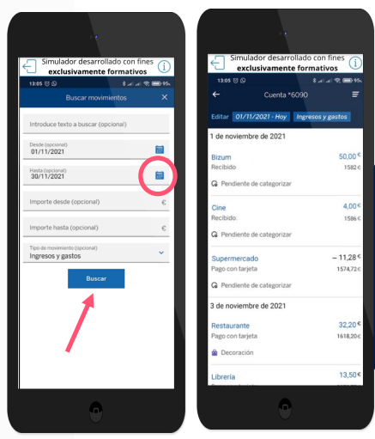
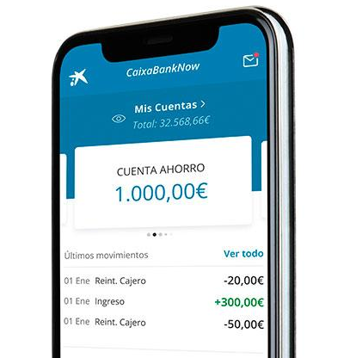
Monitoring of account balance (2/2)
3.3 Basic use of an online bank account
Examples of queries for a specific movement
Image by CYLDIGITAL Diapositiva 32
Image by CaixaBank

Slide 20
Messages and alerts
3.3 Basic use of an online bank account
The app sends alerts and messages via:
push notifications
emails, or
messages within the app itself.
The most important messages and alerts that can be consulted in the online account include:
Transaction alerts
Safety alerts

Slide 21
Common transaction alerts
3.3 Basic use of an online bank account
Transaction alerts:
  Deposits: Notification of incoming money
  Withdrawals or purchases: Confirmation of card payments or transfers, withdrawals from ATMs.
  Account movements: Notification of transfers, cheque payments, etc.)
  Account balance and activity alerts:
  Low balance
  Balance available

Slide 22
Common safety alerts
3.3 Basic use of an online bank account
Safety alerts:
Access not authorized: Alerts about suspicious access attempts
Password change: Warnings when password or login details are changed
Fraud alerts: Messages alerting to unusual activity
Two-factor authentication: Confirmation of security authentication when logging in or performing a transaction

Slide 23
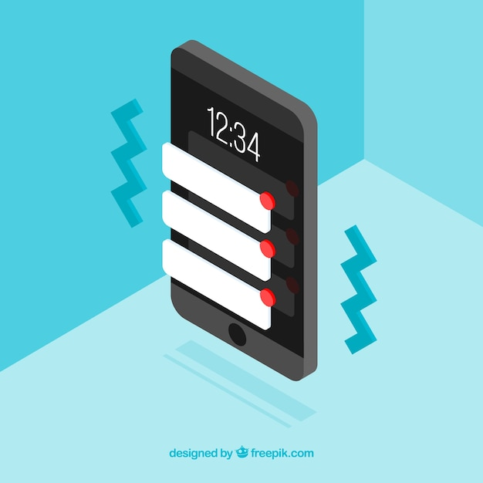
View messages and alerts (1/2)
3.3 Basic use of an online bank account
In addition, messages and alerts can be viewed with the following steps:
Log in to the online banking app
Access the main menu or the home screen
  Messages and alerts can be viewed in the following sections:
    Notifications or Alerts (with a little bell or similar icon).
    Messages o Message centre (an envelope icon or chat bubble)
    Profile o Settings
Image by Freepik

Slide 24
View messages and alerts (2/2)
3.3 Basic use of an online bank account
View alerts or notifications:
Tap the notifications icon to access your alert history.
Read the details of each alert by clicking on it.
If the bank has an internal messaging system, go to the Messages or Message Centre section.
Image by Freepik

Slide 25

Time to
practise!
Image by vectorjuice on Freepik

Slide 26
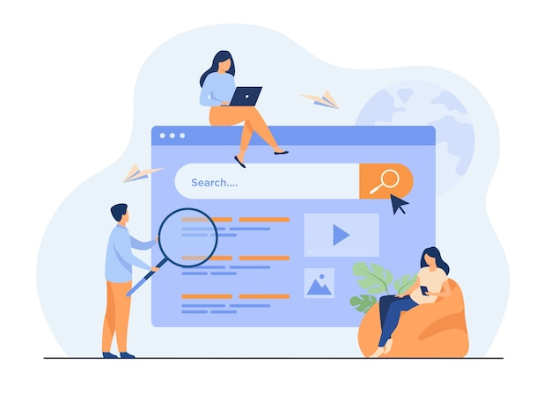
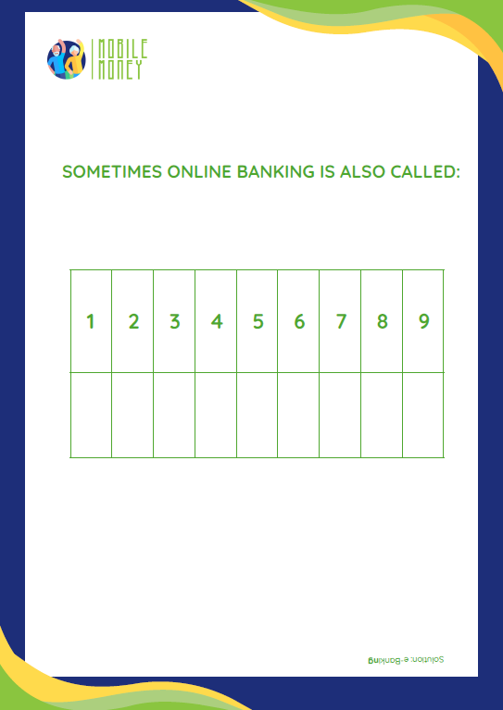
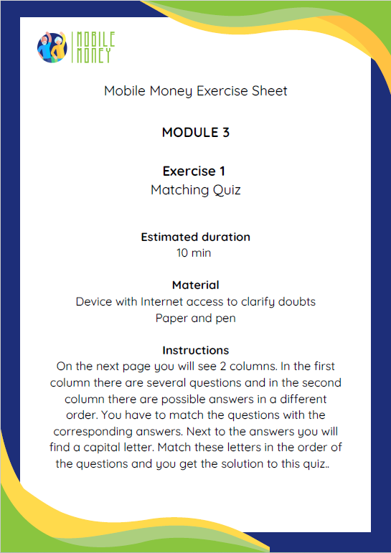
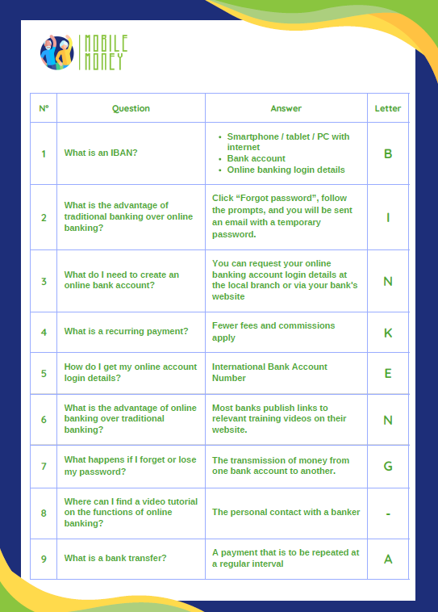
Learning activity 1: Match questions & answers and obtain the keyword

Slide 27
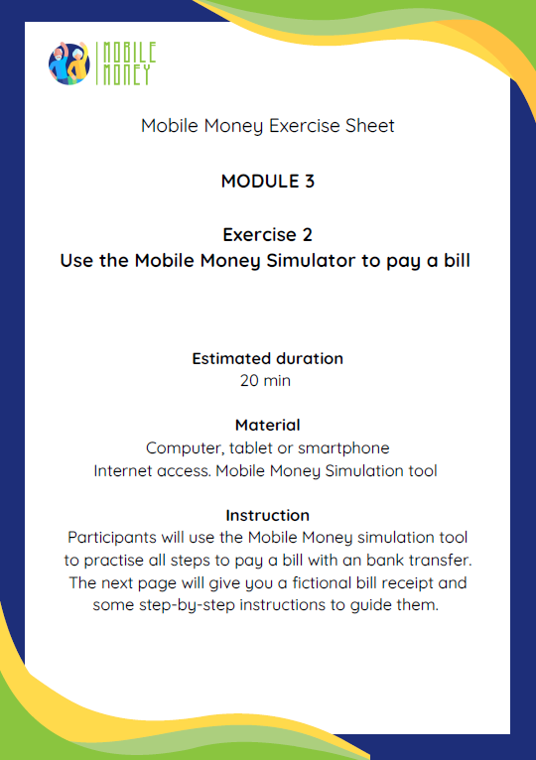
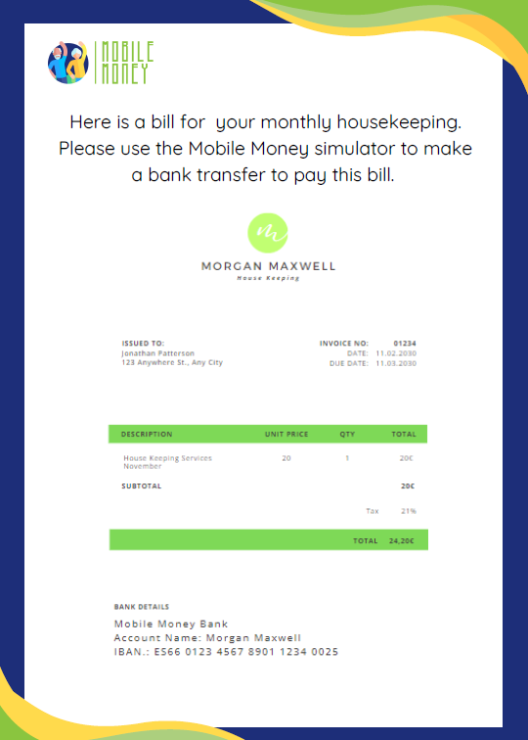
Learning activity 2:
Use the Mobile Money app to practice the payment of a bill

Slide 28
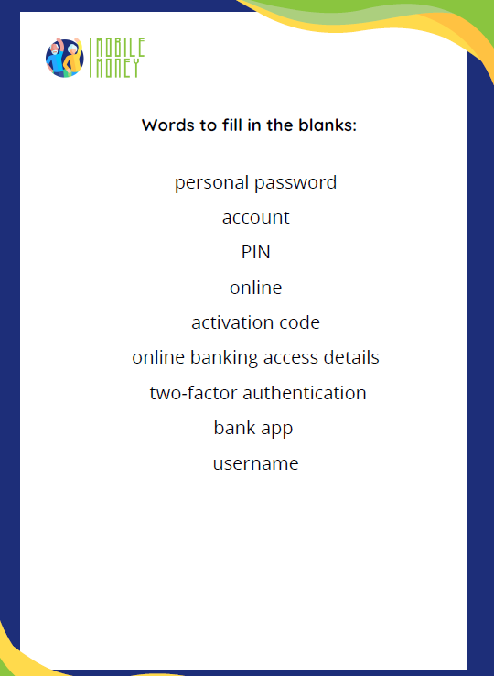
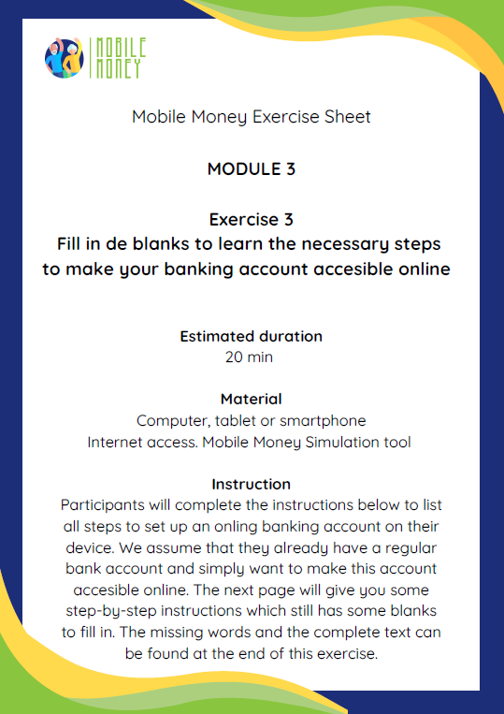
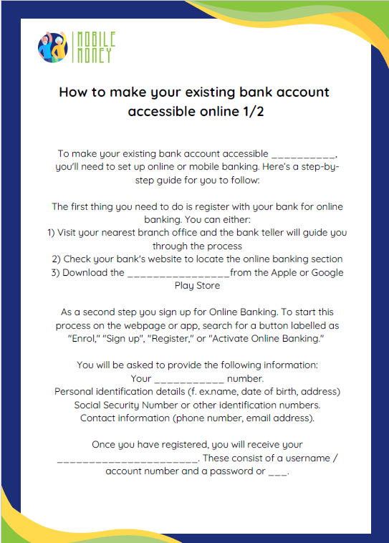
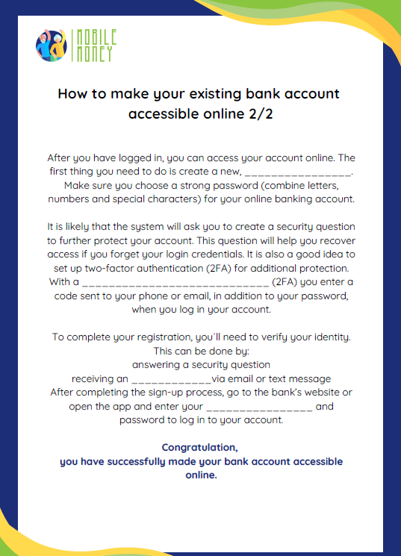
Learning activity 3:
How to convert your bank account in an online bank account

Slide 29
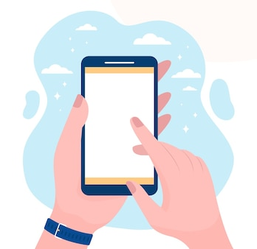
What is online banking?
Only one answer is correct!
A.
A bank that only works online
B.
A way to pay for a service online
C.
A platform offered by your bank to have access to banking services online
Image by pch.vector on Freepik

Slide 30
What is an IBAN?
Only one answer is correct!
A. Incredible Bug Accounting Network
B. Instant Bill Advice Notebook
C. Invisible Bank Account Number
D. International Bank Account Number

Slide 31
What is a PIN?
Only one answer is correct!
A. Poor Income News
B. Something to eat
C. A personal identification number / a personal password
D. A hair accessories

Slide 32
Match the columns
Match the columns !
How can I withdraw cash from an online account?
An IBAN (International Bank Account Number)
What is a periodic payment?
By means of an ATM
What do we need to make an international bank transfer?
A payment that will be repeated at a regular interval.

Slide 33
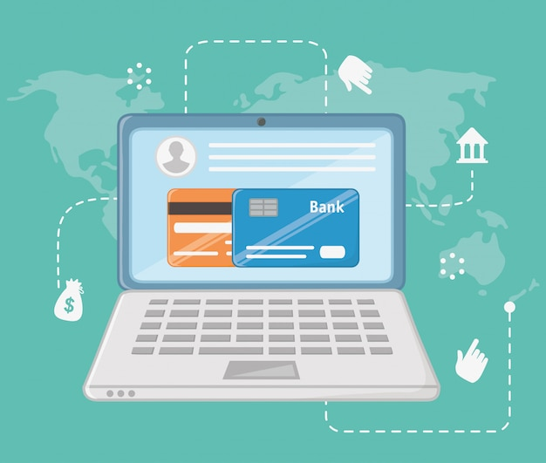
Frequent terms used in online banking
What does it mean...? Explanation of basic banking concepts
Account Holder: The owner of the money in the bank account.
Direct debit: To direct debit means to instruct that specific charges and payments be debited from the account (e.g. costs of telephone, electricity, gas).
Overdrawn: ‘To be overdrawn’ means to have an insufficient balance in the bank account.
BIC (Bank Identifier Code) or SWIFT code: identifies the destination bank of a transfer.
PIN: The ‘Personal Identification Number’ together with the user number are your access data for your online banking.
Image by Freepik

Slide 34
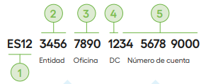
Frequent terms used in online banking
What does it mean...? Explanation of basic banking concepts
IBAN (International Bank Account Number):
A 24-digit set of two letters and 22 numbers:
Country: The letters identify the country and are linked to two check digits (DC) which serve to validate the entire IBAN
Entity: The first four digits are assigned by the Bank of Spain and identify the bank.
Branch: The next four digits identify the specific branch where the customer holds the account
DC: Again, 2 control digits.
Account number: The last 10 digits form the last 10 digits
Fuente: Finanzasparatodos

Slide 35


Congratulations!
You have successfully completed this module!
Funded by the European Union. Views and opinions expressed are however those of the author(s) only and do not necessarily reflect those of the European Union or the European Education and Culture Executive Agency (EACEA). Neither the European Union nor EACEA can be held responsible for them. Project number: 2023-1-RO01-KA220-ADU-000157797

