Slide 1
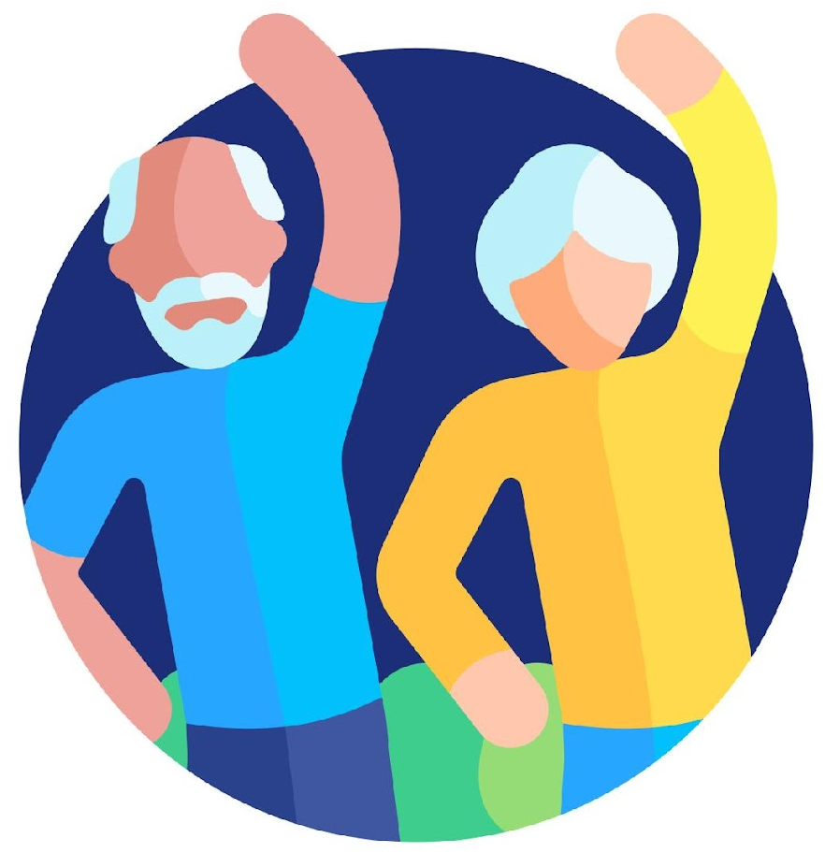

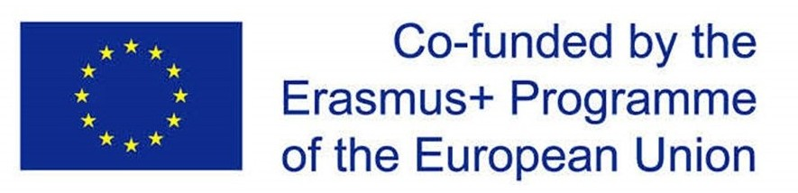


1
2
Module 4
Receiving and sending money
3
4
5
6
Funded by the European Union. Views and opinions expressed are however those of the author(s) only and do not necessarily reflect those of the European Union or the European Education and Culture Executive Agency (EACEA). Neither the European Union nor EACEA can be held responsible for them. Project number: 2023-1-RO01-KA220-ADU-000157797

Slide 2
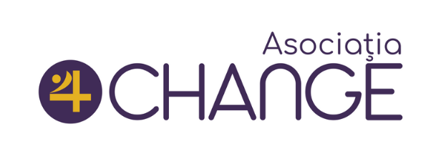







Asociatia Four Change, Romania
Partners
Zavod IZRIIS, Slovenia
E-SENIORS: INITIATION DES SENIORS AUXNTIC ASSOCIATION, France
GUnet, Greece
Asociatia Niciodata Singur – Prietenii Varstnicilor, Romania
Fundació Gesmed Fundació de la Comunitat Valenciana, Spain

Slide 3

Modules
1. Basic digital literacy skills
2. Security & Prevention
3. Managing a bank account online
4. Online solutions for receiving and sending money
5. Using a Credit Card to Purchase from Online Goods and Services
6. Processing online payments for taxes and bills

Slide 4
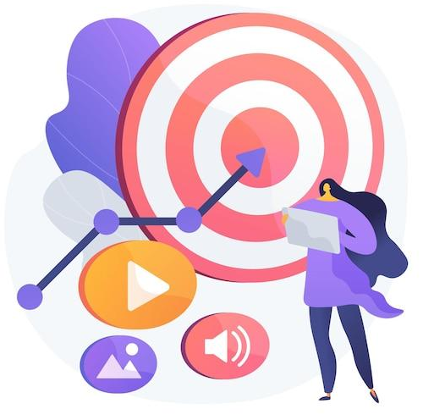
Unit 1
Introduction
Objectives
On completion of this unit, you will be informed about
The learning objectives and training content of this module
The training methodology used and the duration of this module
Image by vectorjuice on Freepik

Slide 5

Competences
4
Receiving and sending money
After completing this module, you will:
Understand and Perform Digital Transactions
  Identify the necessary information for sending money.
  Know what IBAN stands for and how to use it.
  Understand the purpose of a username.
  Know when and why to use phone numbers.
  Add clear payment details.
Navigate Security Steps Confidently
  Understand how PINs protect your account.
  Use passwords effectively and safely.
  Recognize SMS codes as an added layer of security.
  Avoid sharing sensitive details with others.
  Identify signs of secure connections (e.g., padlock icons).

Slide 6

Training content
4
Receiving and sending money
Introduction to Digital Money Transfers: Overview of basic digital skills needed for mobile money transfers.
Understanding Forms and Required Data Fields: IBAN, username, phone number, and payment details in forms.
Apps for Sending and Receiving Money: Overview of commonly used apps for money transfers, their features, and how to install them.
Identifying and Avoiding Common Scams: Recognizing phishing attempts and securely handling personal details to prevent fraud.
Accessing and Understanding Transaction History: Viewing past payments, sender details, and maintaining records using mobile apps.
Tips & Practical exercises

Slide 7
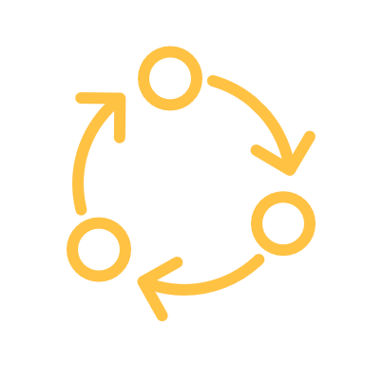
Training methodology and duration
4
Receiving and sending money
Methodology
Active and participative
Face to face training:
  Dialogue ✔ Role playing ✔ Teamwork
Online training:
  Selected or own produced videos
  Practical implementation of some tips agreed in the classroom
  Some collaborative work
  Simulation
Duration: 4 hours
  Face to face session:2 hours
  Online training: 2 hours

Slide 8
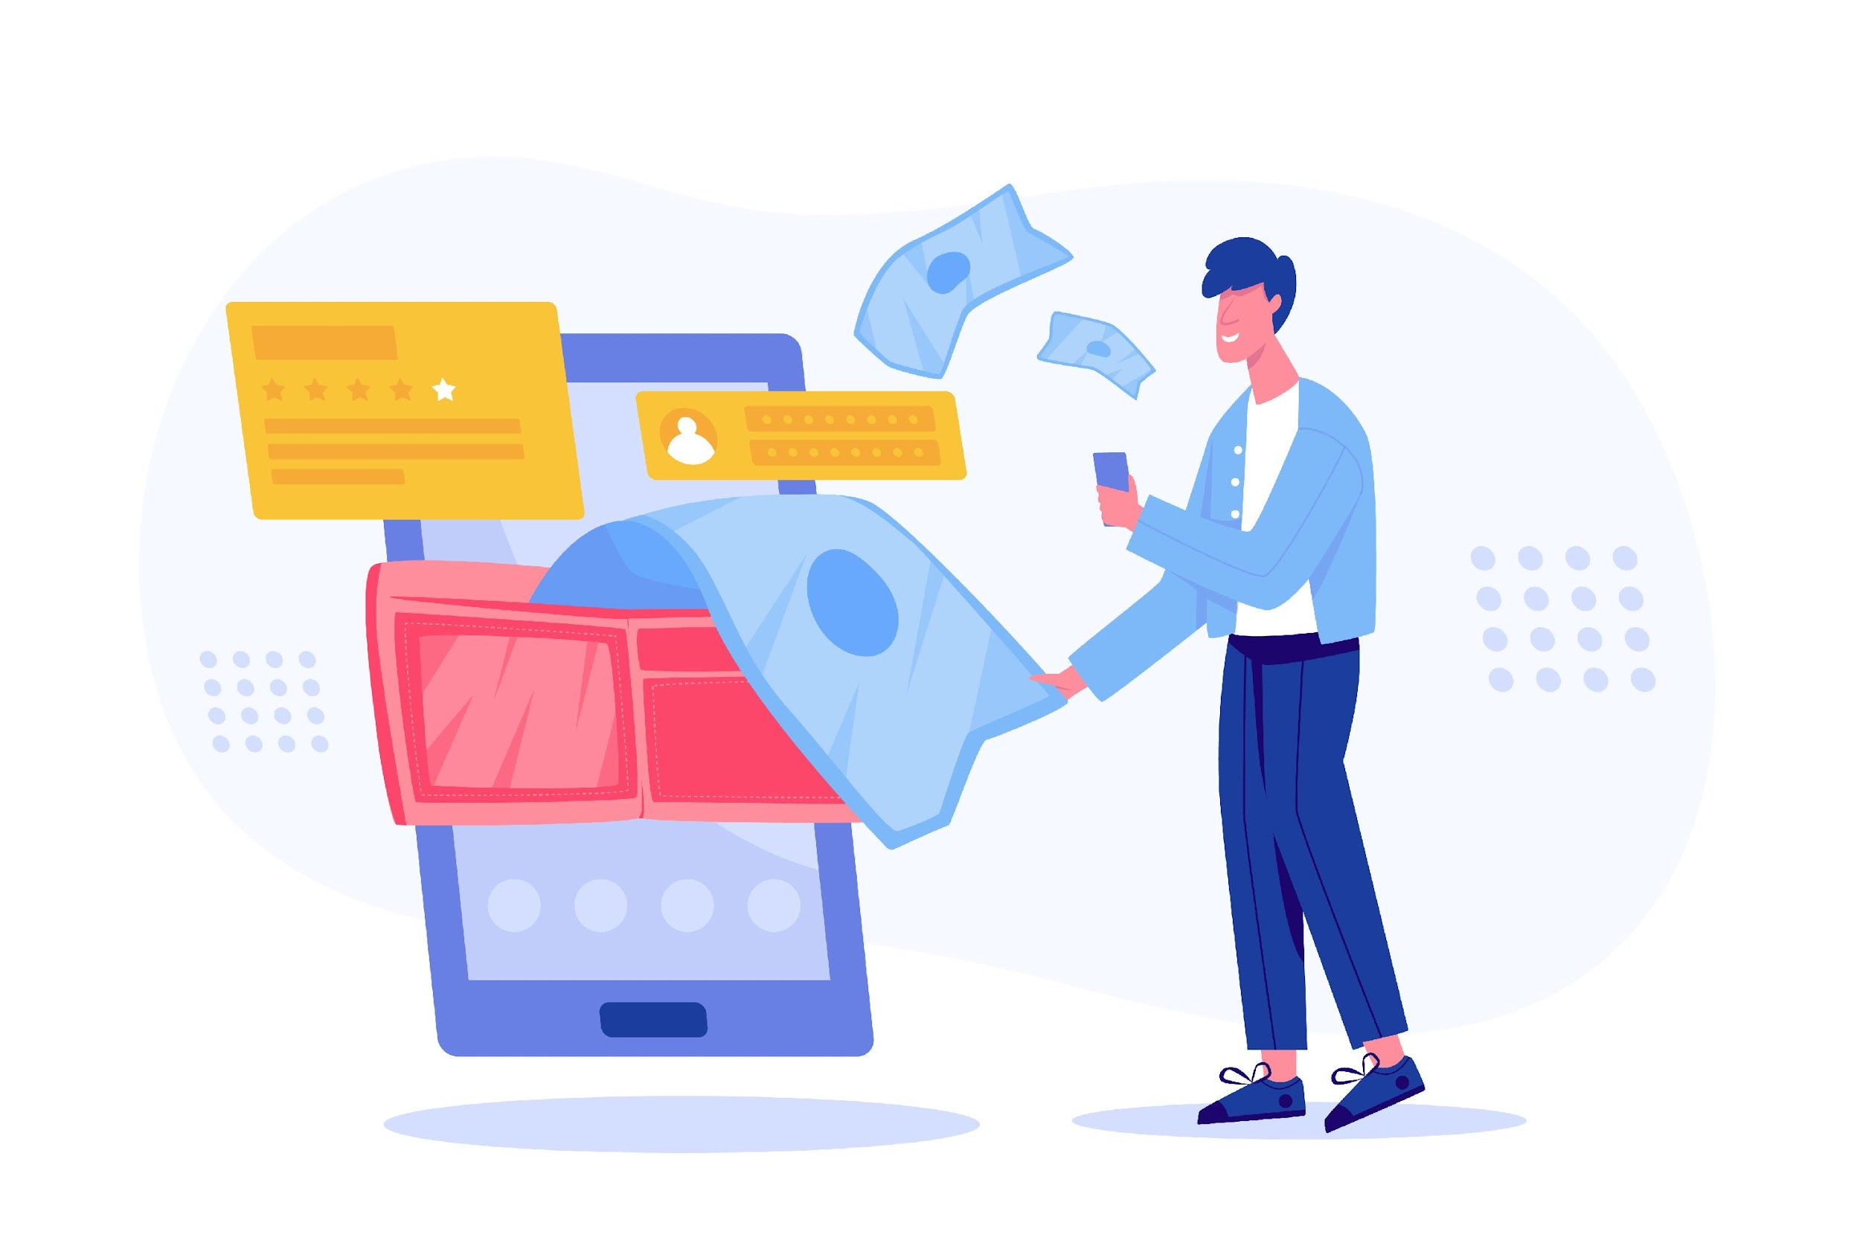
Unit 2
Introduction to Digital Money Transfers
4
Receiving and sending money
Objectives
On completion of this unit, you will know:
Understand the Role of Digital Money Transfers
Identify Basic Digital Skills
Recognize the Importance of Digital Tools
Build Trust in Using Technology
Image by jcomp on Freepik

Slide 9
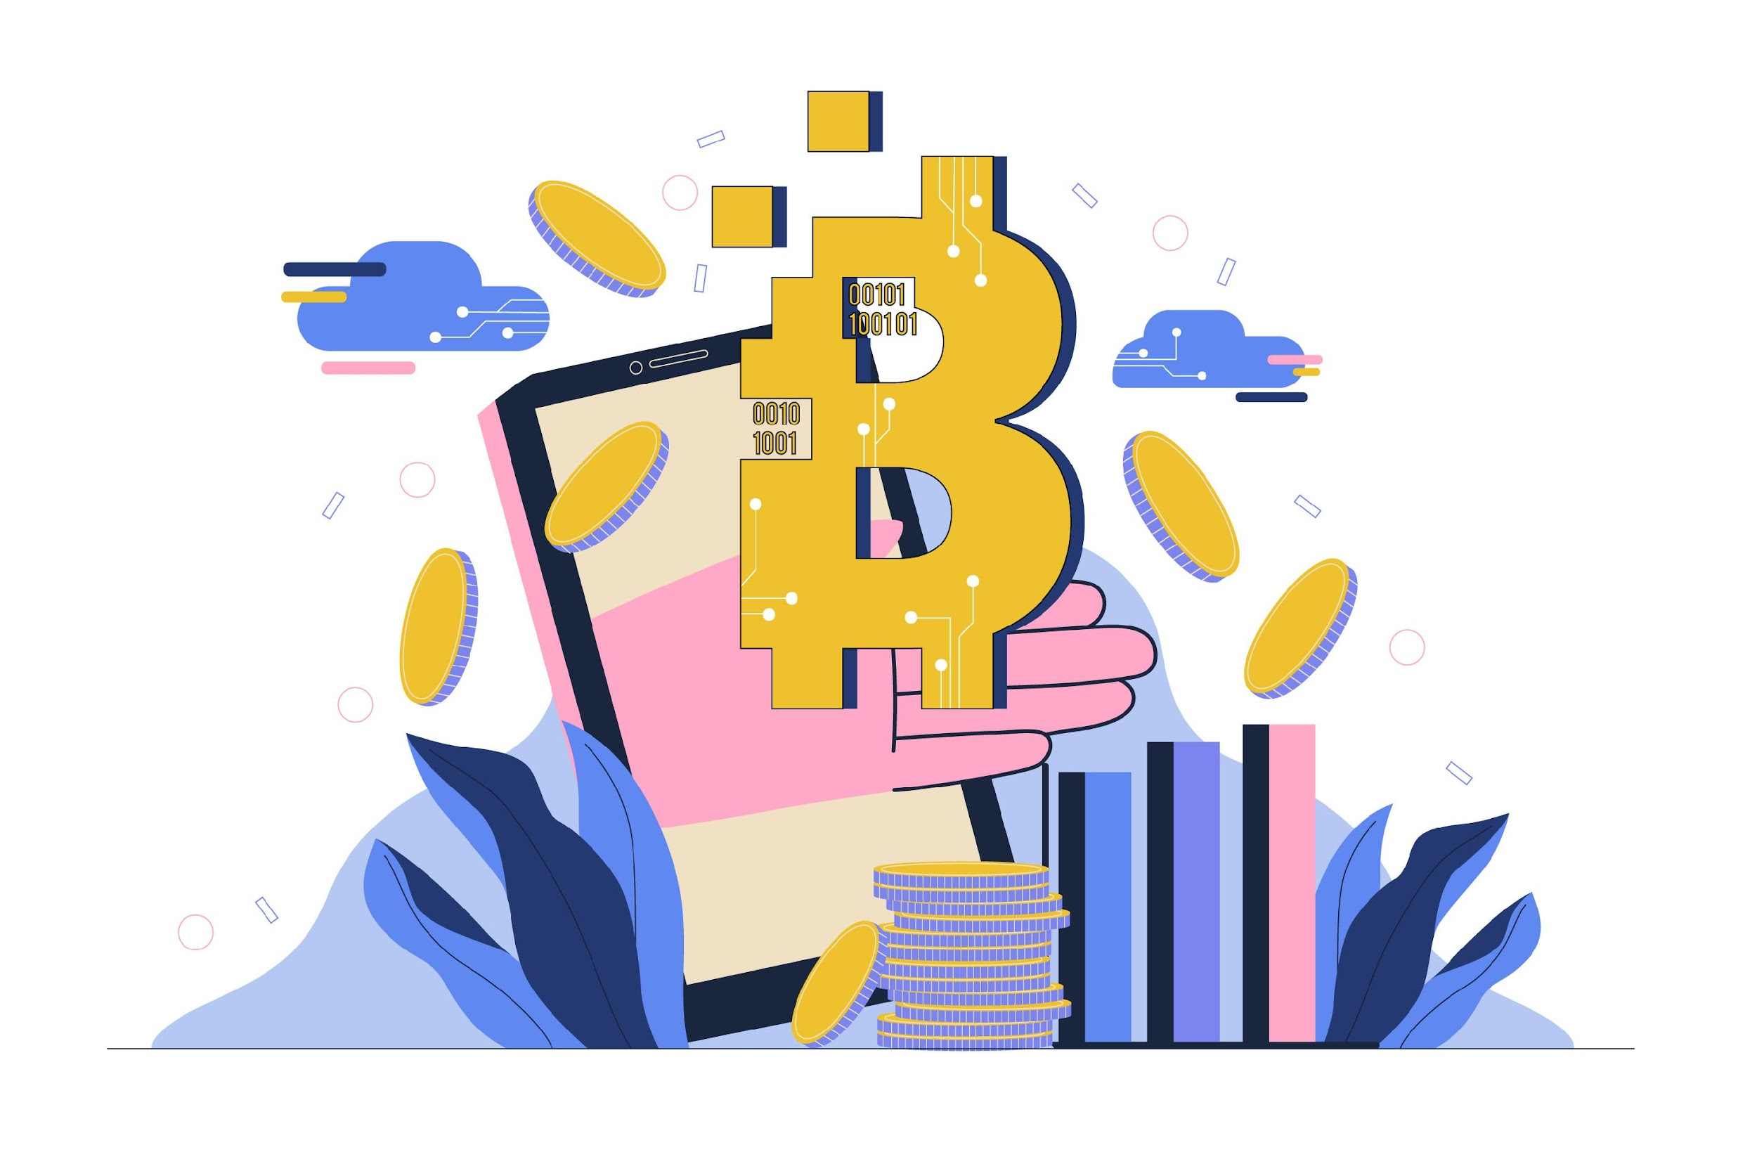
What is Digital Money Transfer?
4.2 Introduction to Digital Money Transfers
A digital money transfer is a way to send or receive money electronically using mobile apps or online platforms, without needing cash or checks.
How It Works: You provide details like the recipient's IBAN or username, and the money is transferred securely through your bank or app.
Image by Freepik

Slide 10
4.2 Introduction to Digital Money Transfers
Role of Digital Money Transfers
Digital money transfers revolutionize the way individuals manage their finances by offering secure, efficient, and fast solutions for sending and receiving money. They replace the need for physical cash, reducing the risks of theft or loss, and enable users to perform transactions from the comfort of their homes.. Moreover, they provide detailed records for every transaction, ensuring easy tracking and verification for financial accountability.
Key Benefits of Digital Money Transfers:
  Convenience: Perform transactions anytime, anywhere.
  Speed: Immediate or near-instant money transfers between accounts.
  Security: Multi-step authentication and encryption safeguard funds.
  Record Keeping: Access detailed transaction histories for better financial management.
  Cost Efficiency: Lower fees compared to traditional methods like bank drafts or money orders.

Slide 11
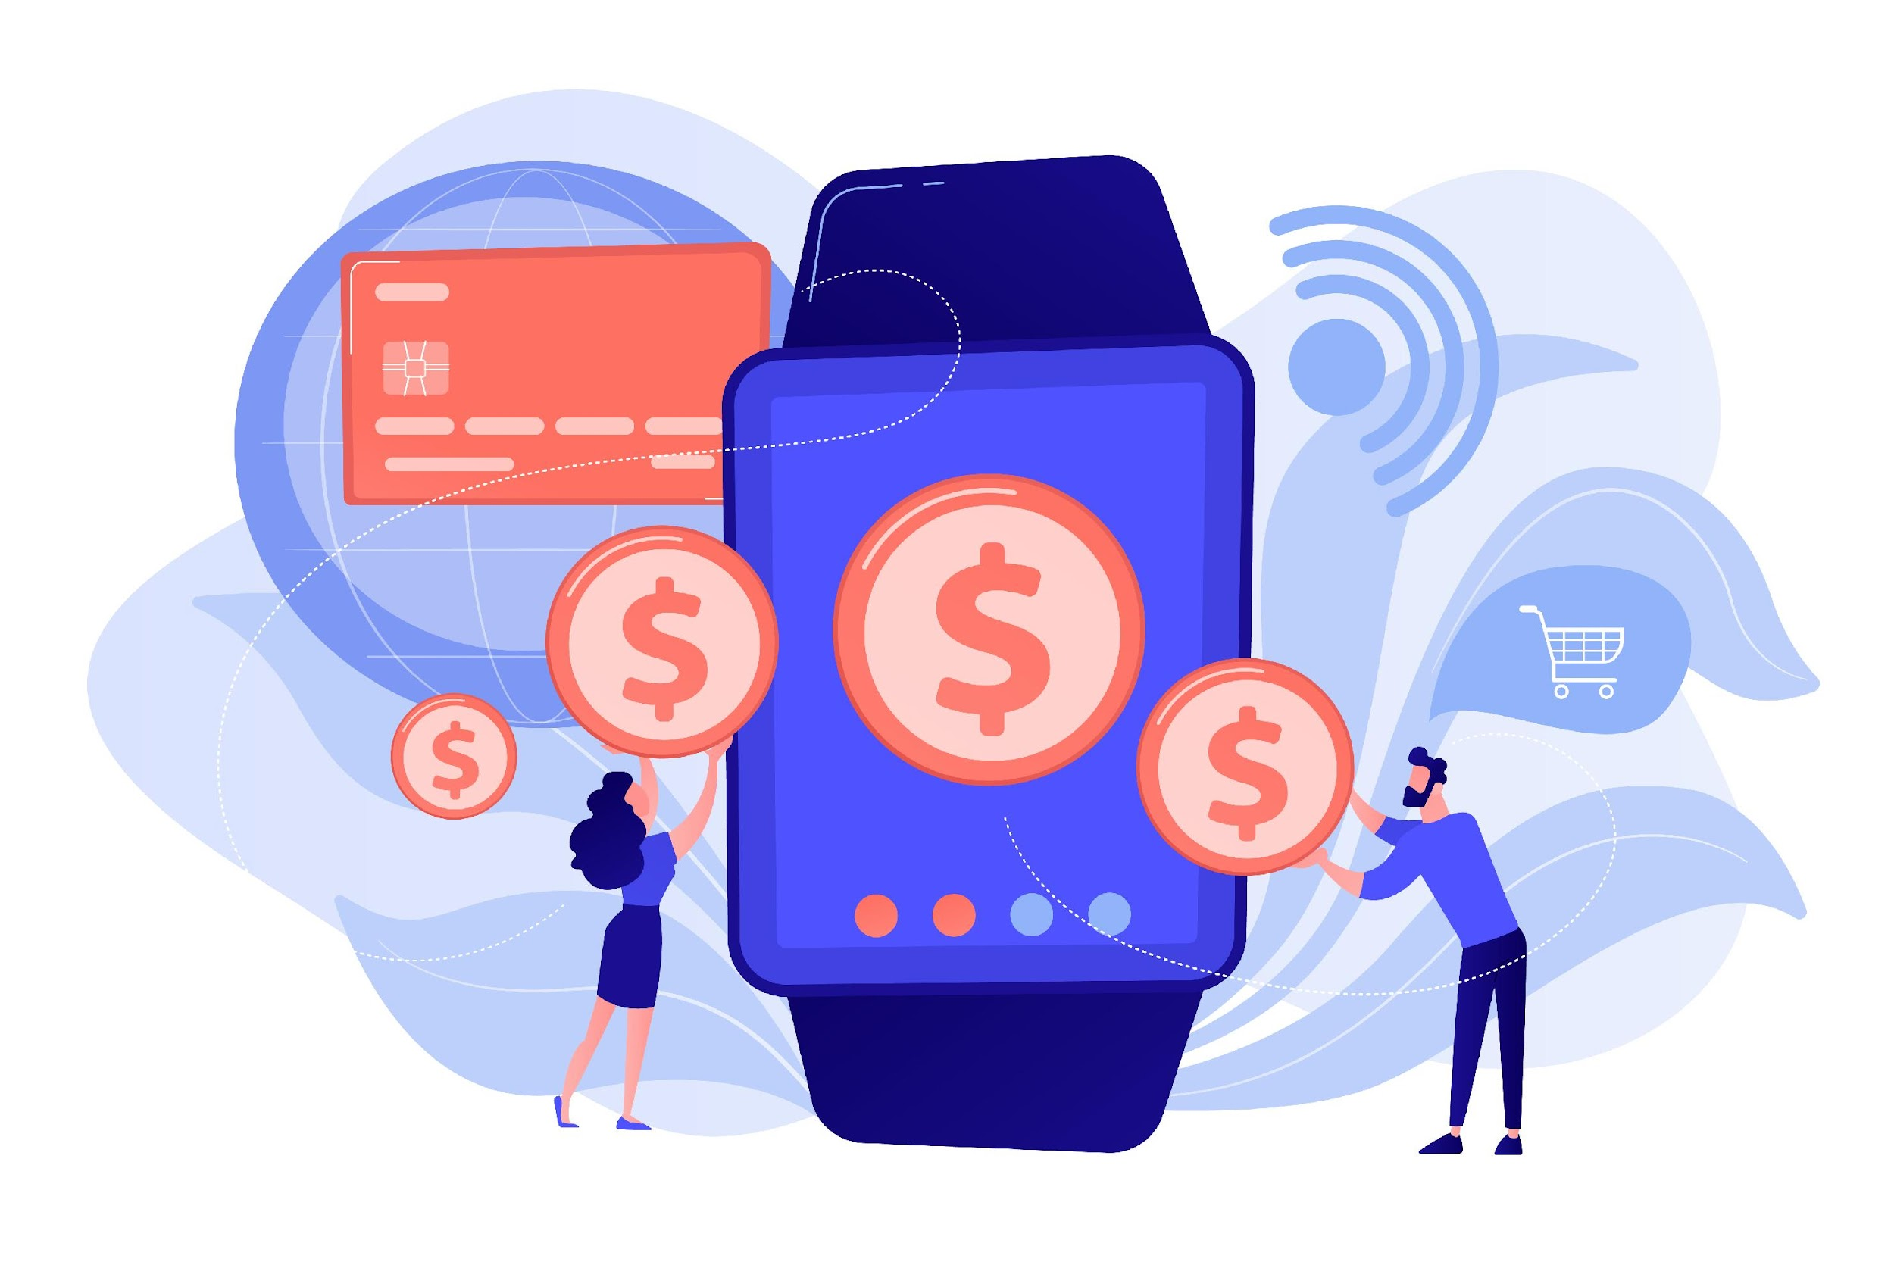
Examples of Digital Money Transfers
4.2 Introduction to Digital Money Transfers
Sending Money to Family or Friends
Paying for Services
Receiving Pension or Financial Support
Shopping Online
Splitting Bills with Friends
Donating to Causes
Image by vectorjuice on Freepik

Slide 12
Basic Skills Needed for Digital Money Transfers (1/2)
4.2 Introduction to Digital Money Transfers
Using a Mobile Device or Computer: Know how to operate a smartphone, tablet, or computer for accessing apps or websites.
Filling Out Forms: Enter required details like IBAN, recipient's name, and payment amount accurately.
Navigating Apps or Websites: Learn how to open, log in, and explore money transfer apps or banking websites.

Slide 13
Basic Skills Needed for Digital Money Transfers (2/2)
4.2 Introduction to Digital Money Transfers
Understanding Security Steps: Use PINs, passwords, and SMS codes for secure transactions.
Checking Transaction History: Locate and review past transactions to confirm payments or receipts.
Communicating Information Clearly: Provide and request accurate details, such as IBAN or transaction references, to avoid errors.

Slide 14

What Could Go Wrong with Digital Money Transfers?
4.2 Introduction to Digital Money Transfers
Entering Incorrect Information
Falling for Scams
Weak Security Practices
Internet Connectivity Issues
Using Outdated Apps or Software
Misunderstanding Fees or Exchange Rates
Image by storyset on Freepik

Slide 15
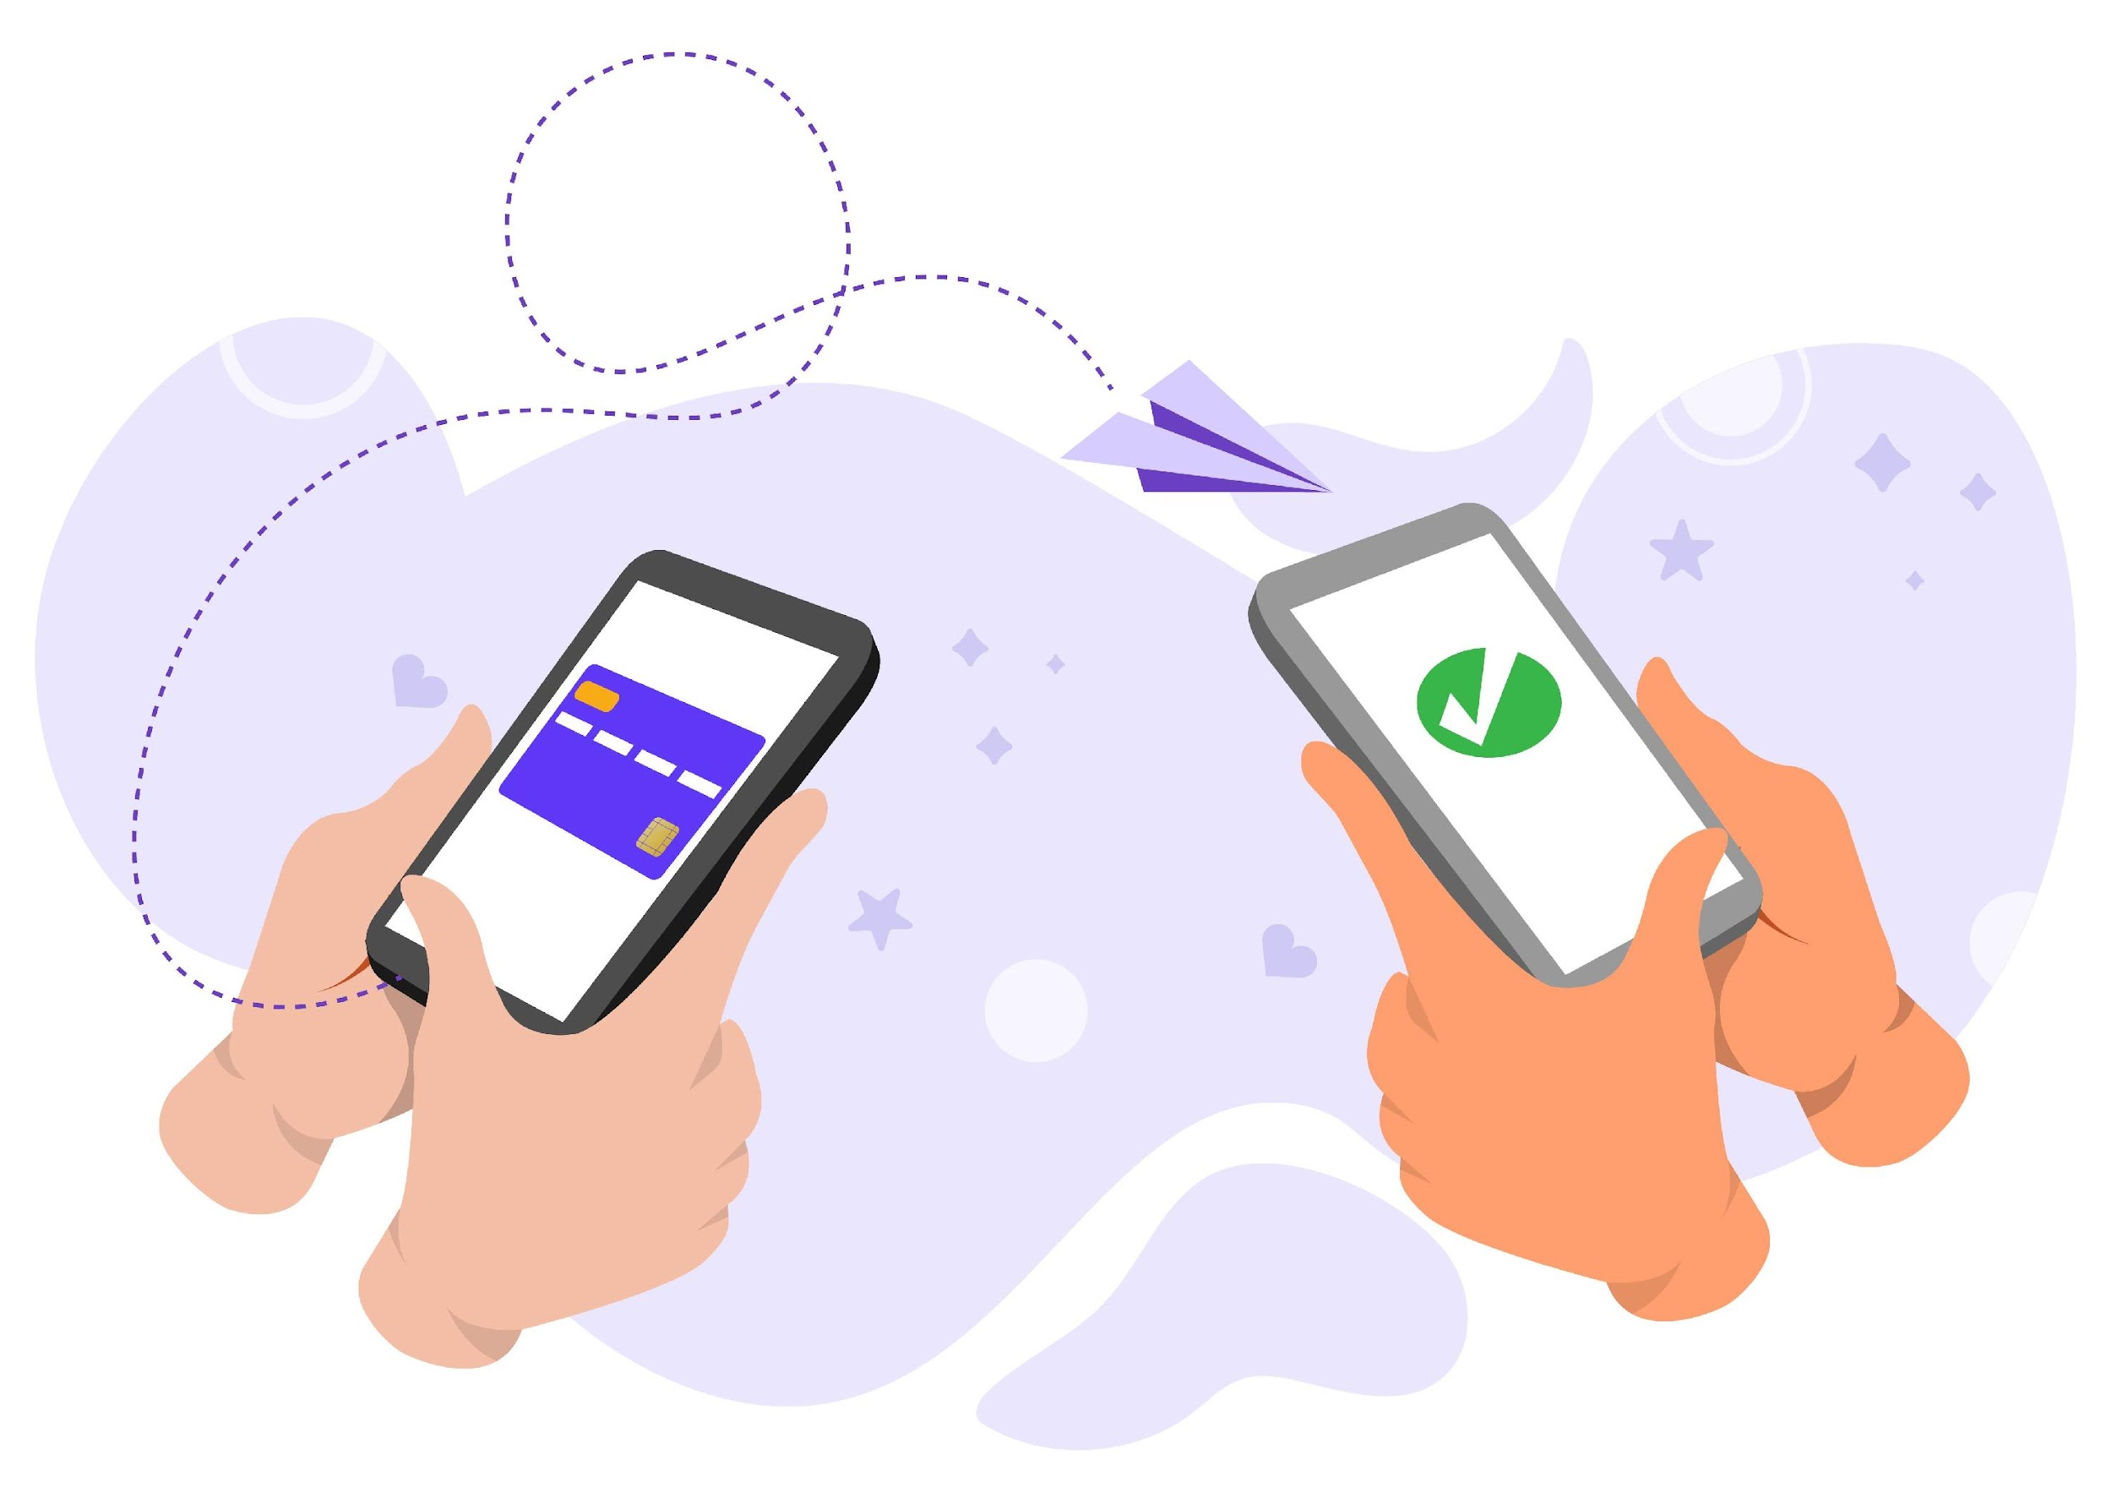
Unit 3
Understanding Forms and Required Data Fields
Objectives
On completion of this unit, you will know:
Identify Key Data Fields
Ensure Accuracy
Recognize Mandatory vs. Optional Fields
Verify Information Provided by Others
Image by chanwity281 on Freepik

Slide 16
Key Data Fields
4.3 Understanding Forms and Required Data Fields
IBAN (International Bank Account Number)
  A unique code that identifies the recipient's bank account.
  Essential for ensuring the money reaches the correct destination.
Username or Name
  The name or app username of the person receiving the money.
  Helps confirm the identity of the recipient.
Phone Number
  Used for certain payment apps or as an additional verification step
  Ensures secure and accurate transactions
Payment Details
  A short note describing the purpose of the transfer (e.g., "Gift for grandson")
  Helps both sender and recipient keep track of the transaction.

Slide 17
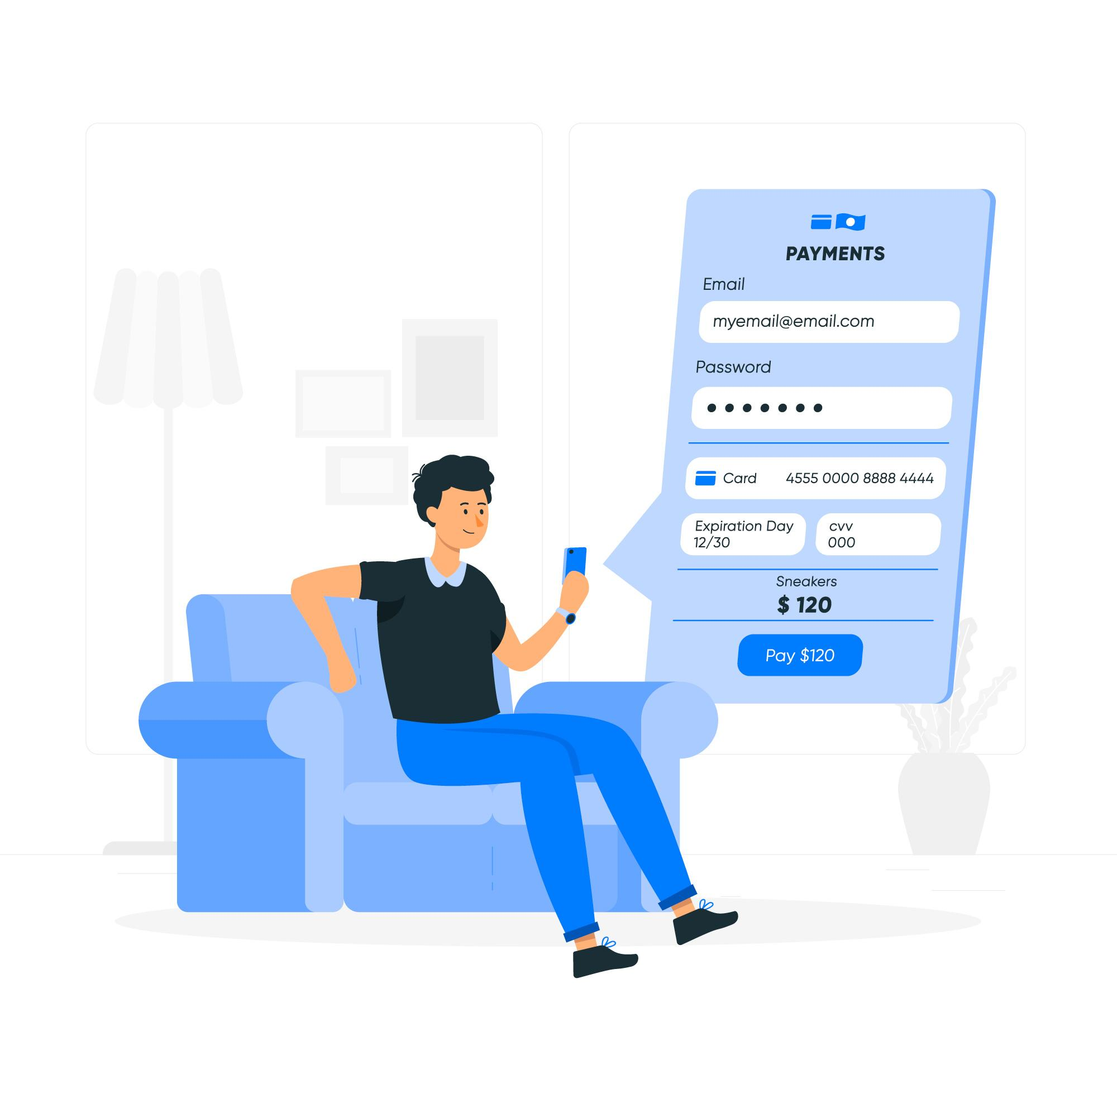
Tips for Ensuring Accuracy in Digital Money Transfers (1/2)
4.3 Understanding Forms and Required Data Fields
Do not use public Wi-fi
  Use secure networks or mobile data to prevent unauthorized access to your information.
Double-Check All Information
  Verify IBAN, username, phone number, and payment details
  Even a small typo can send money to the wrong account
Cross-Verify with the Recipient
  Ask the recipient to confirm the details, especially for new transactions.
  Save verified details for future use in a secure way
Image by storyset on Freepik

Slide 18
Tips for Ensuring Accuracy in Digital Money Transfers (2/2)
4.3 Understanding Forms and Required Data Fields
Take Your Time
  Avoid rushing while entering details.
  A calm approach reduces the chance of errors
Use Auto-Fill Carefully
  Ensure saved information is correct before using auto-fill features
  Update outdated details in your app or account.
Review the Confirmation Screen
  Check the final summary of the transaction before submitting
  Pay attention to the recipient’s name and amount to be sent.
Image by storyset on Freepik

Slide 19
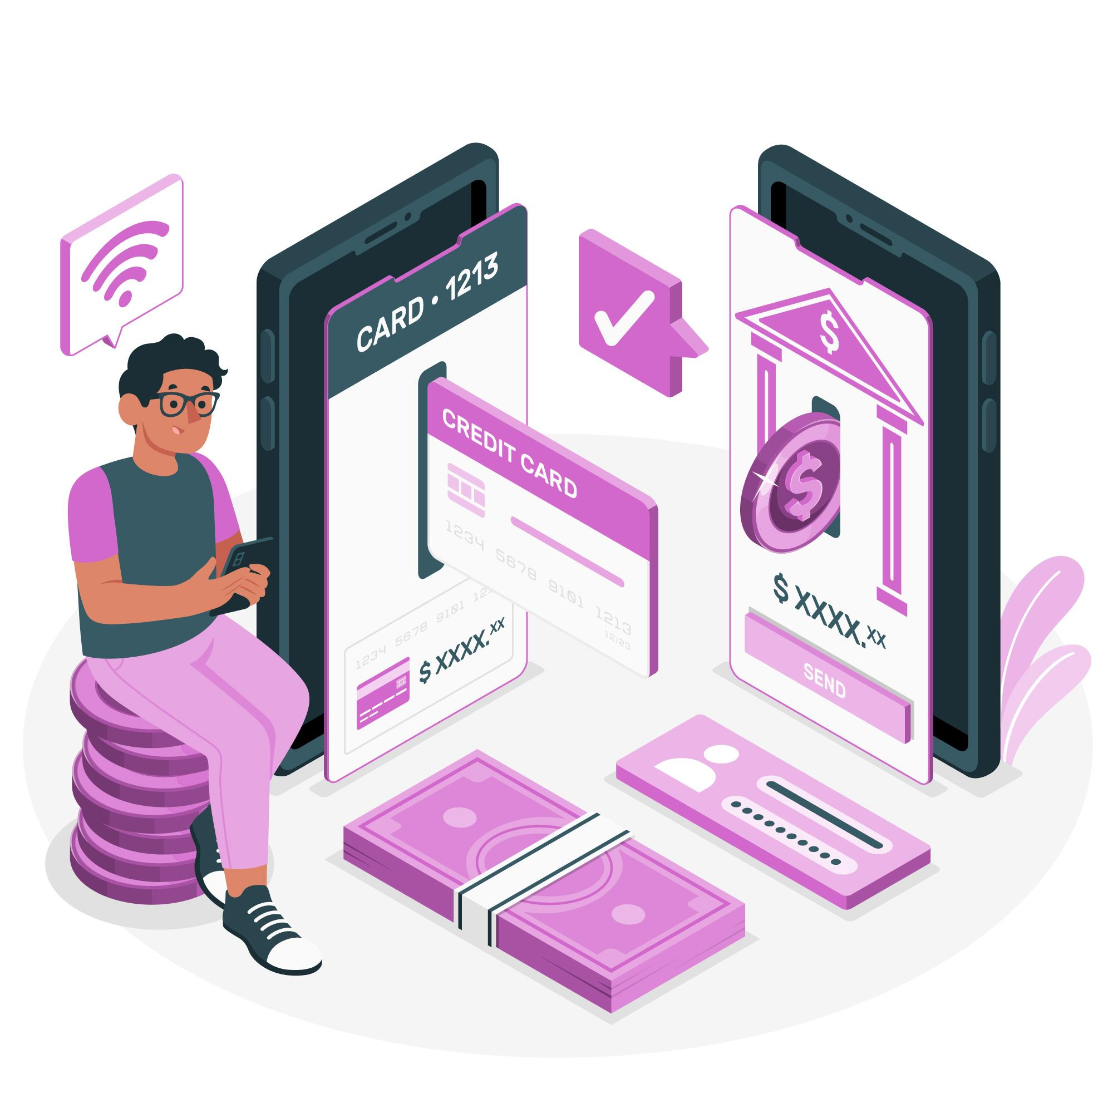
Unit 4
Apps for Sending and Receiving Money
Objectives
On completion of this unit, you will know:
Recognize Commonly Used Apps
Understand App Features
Install and Set Up Apps
Compare App Options
Image by storyset on Freepik

Slide 20
Commonly Used Apps for Sending and Receiving Money in Romania (1/2)
4.4 Apps for Sending and Receiving Money
George by BCR - Developed by Banca Comercială Română (BCR), George is Romania's first intelligent banking platform, offering a user-friendly interface for managing accounts, payments, and savings. It has over 1.15 million active users and is highly rated in app stores.
ING Home'Bank - Provided by ING Bank, this app allows users to perform various banking operations, including payments, transfers, and account management, with features like 'Favorite Payments' for recurring transactions.
BT Pay - Offered by Banca Transilvania, BT Pay serves as a digital wallet, enabling users to make payments, transfer money, and manage accounts directly from their smartphones.
Revolut - A global financial app popular in Romania, Revolut provides services like international transfers, currency exchange, and budgeting tools, with over 16 million users worldwide.

Slide 21
Commonly Used Apps for Sending and Receiving Money in Romania (2/2)
4.4 Apps for Sending and Receiving Money
Raiffeisen Smart Mobile - This app from Raiffeisen Bank offers comprehensive mobile banking services, including payments, transfers, and account management, with a focus on security and user experience.
PayPal - A globally recognized platform for online payments and money transfers. Many Romanians use PayPal for online shopping and receiving payments from abroad.
Western Union - Offers both online and physical locations for money transfers. Western Union is trusted in Romania for sending and receiving funds, especially from international sources.

Slide 22
Install and Set Up Money Transfer Apps
4.4 Apps for Sending and Receiving Money
Choose the Right App: Identify which app suits your needs (e.g., Revolut or PayPal, or the app from your bank).
Download the App: Go to the App Store (iPhone) or Google Play Store (Android). Search for the app by name and click “Install.”
Create an Account: Open the app and follow the sign-up process. Provide details like your name, email, phone number, a secure password or other details provided by the bank. Usually, to setup an internet banking account, you must visit the bank first.
Link Your Bank Account or Card: For some apps, enter your IBAN or card number securely. Complete any verification steps required (e.g., SMS or email code).
Set Up Security Features: Enable PIN, password, or biometric authentication (fingerprint/face recognition). Turn on two-factor authentication for extra protection
Practice Navigating the App: Explore the interface to find features like sending money, viewing transactions, and updating details. Familiarize yourself with help or support options in case of issues.

Slide 23
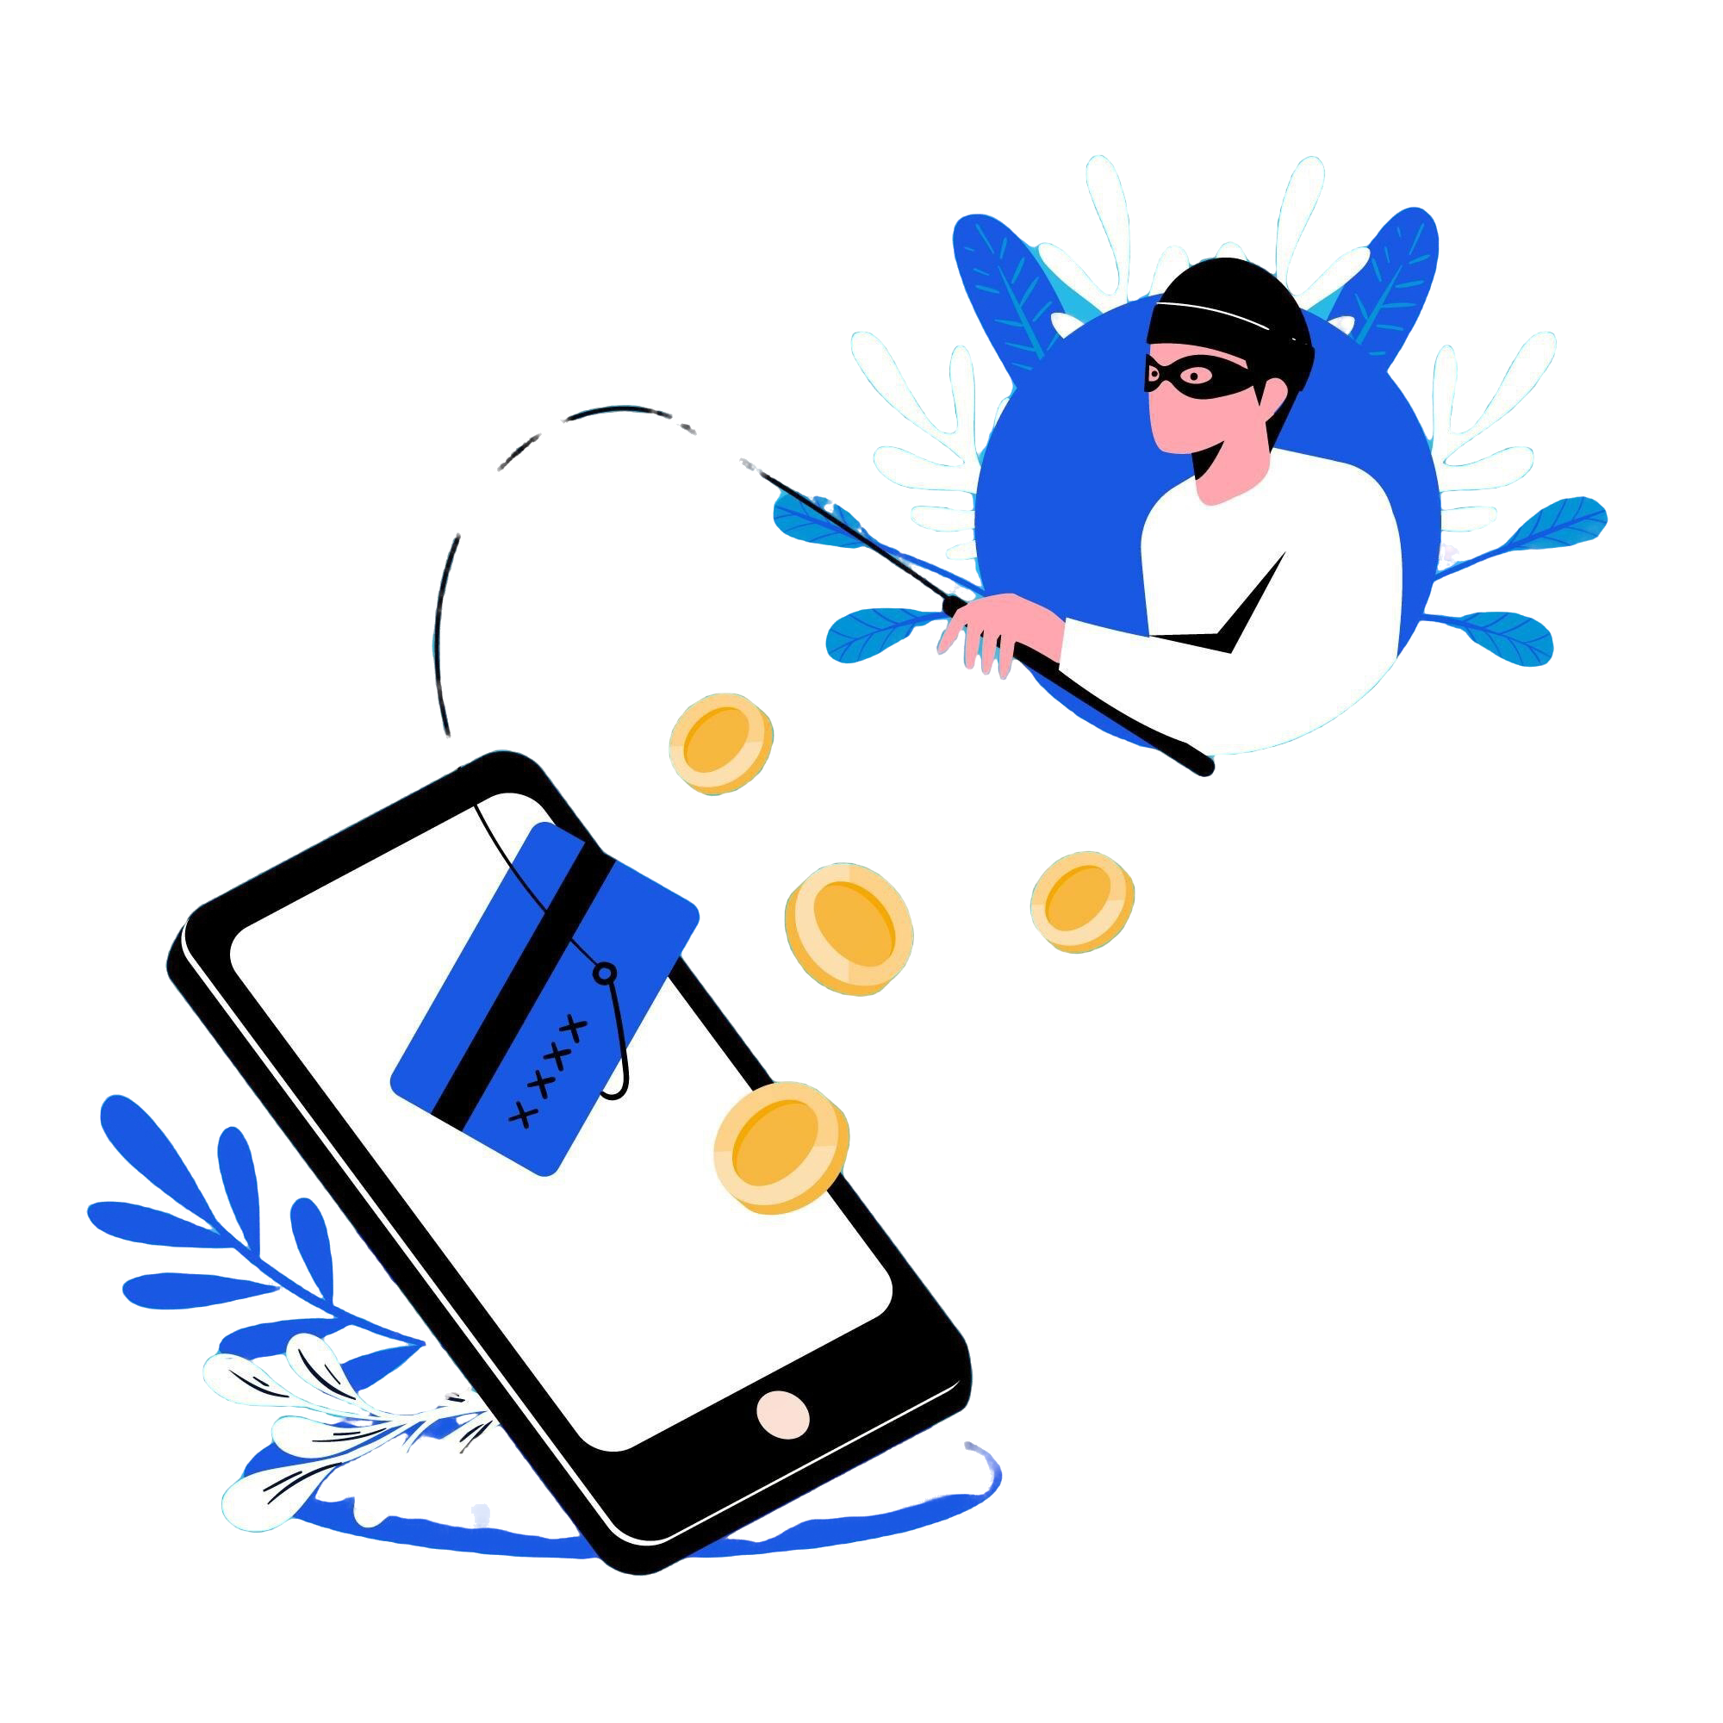
Unit 5
Identifying and Avoiding Common Scams
Objectives
On completion of this unit, you will know:
Recognize Phishing Attempts
Understand Safe Sharing Practices
Verify Legitimate Requests or Offers
Identify Secure Communication Channels
Image by Freepik

Slide 24
What Are Phishing Attempts?
4.5 Identifying and Avoiding Common Scams
Phishing is a scam where attackers try to trick you into sharing personal or financial information through fake messages, emails, or websites.
How It Works:
  Scammers pose as trusted institutions (banks, government agencies, or service providers).
  They send messages asking you to click a link, provide login details, or confirm a transaction.
Common Signs of Phishing
  Urgent language like "Your account will be blocked!“
  Unfamiliar email addresses or phone numbers.
  Poor spelling and grammar in the message.
  Requests for sensitive information like PINs or passwords.
  Suspicious links that don’t match the official website.
Examples of Phishing
  Fake emails pretending to be your bank asking for account verification.
  SMS with a link to "fix" a problem with your account.
  Calls claiming you’ve won a prize and asking for payment information.

Slide 25
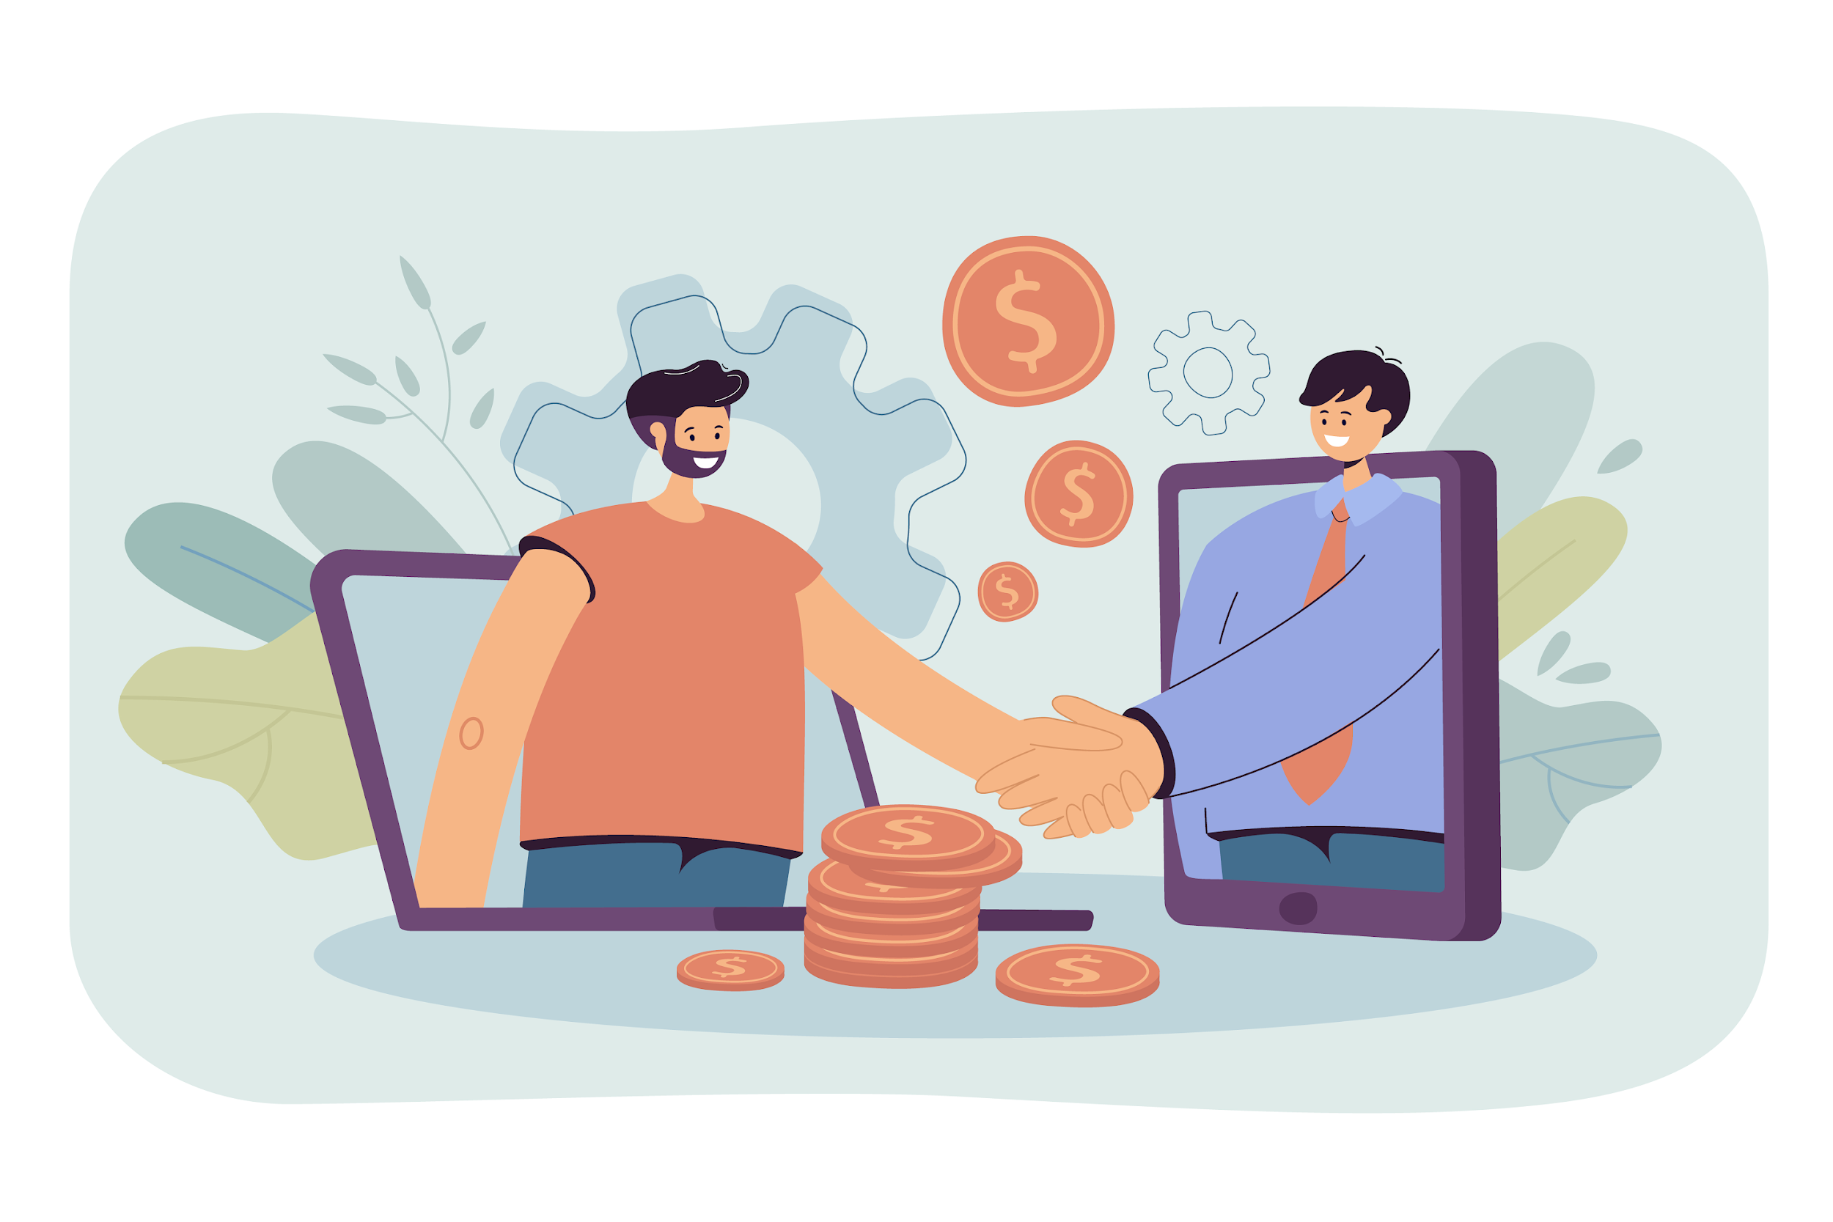
Safe Sharing Practices
4.5 Identifying and Avoiding Common Scams
  For Sending Money
                Double-check recipient details (e.g., IBAN, username) before confirming
  Share only verified and accurate information to avoid errors
  Avoid sharing sensitive details, like passwords or security codes, with others
  Notify the recipient once the transfer is complete to ensure they are informed
  For Receiving Money
  Provide clear and correct account details (e.g., IBAN or phone number)
  Use secure channels (trusted apps or official communication) to share account information
  Confirm receipt of funds and notify the sender if any discrepancies occur
  Check transaction notifications and reports to ensure the funds were correctly deposited.
Image by pch.vector on Freepik

Slide 26
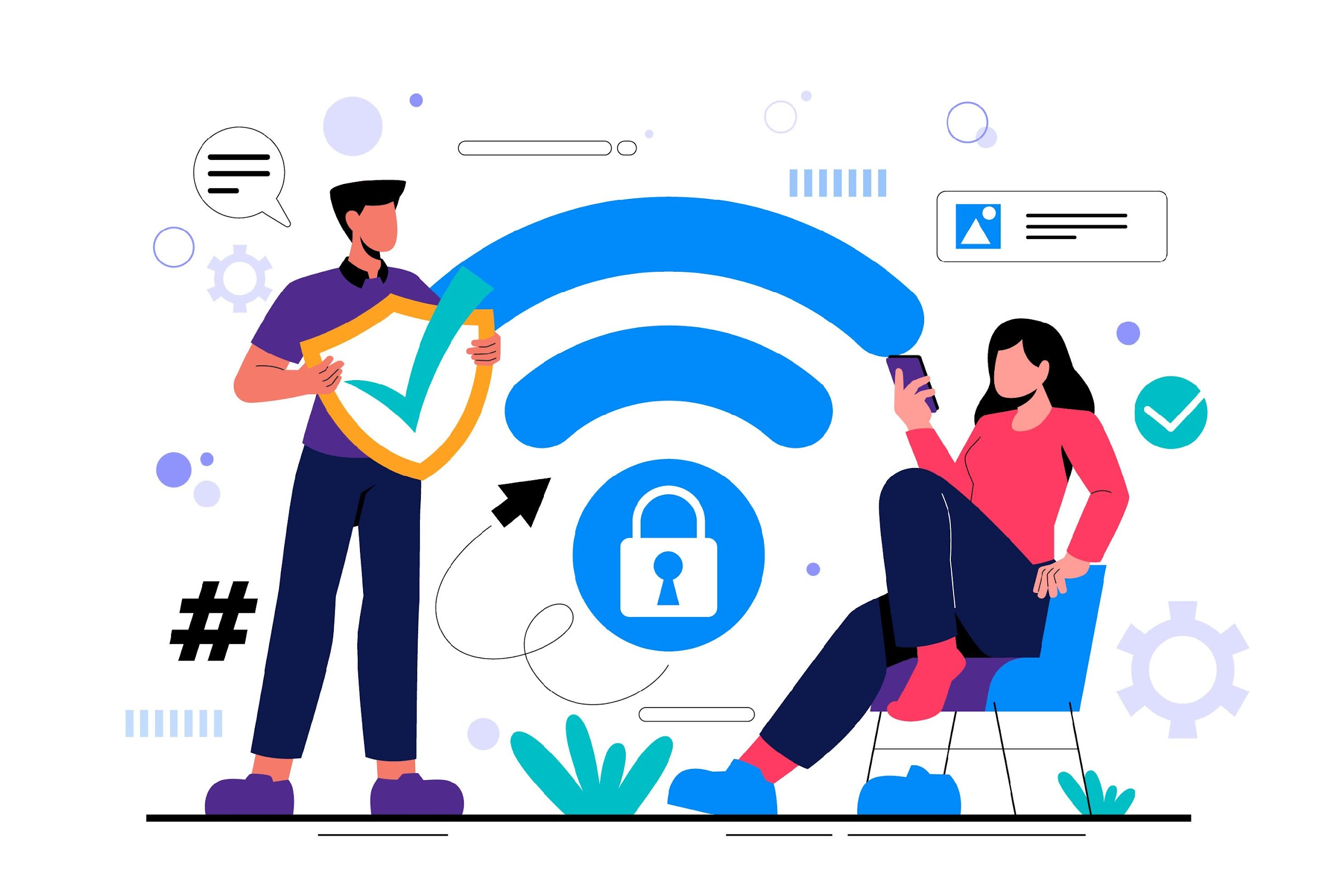
What is Multi-Factor Authentication?
4.5 Identifying and Avoiding Common Scams
Multi-Factor Authentication (MFA) is a security method that requires two or more verification steps to confirm your identity during a login or transaction.
How MFA Works:
  First Step
    Enter your password or PIN.
  Second Step:
    Complete an additional verification, such as:
      Receiving a one-time code via SMS.
      Using a fingerprint or face recognition.
      Generating a code through an authenticator app.
Image by pikisuperstar on Freepik

Slide 27
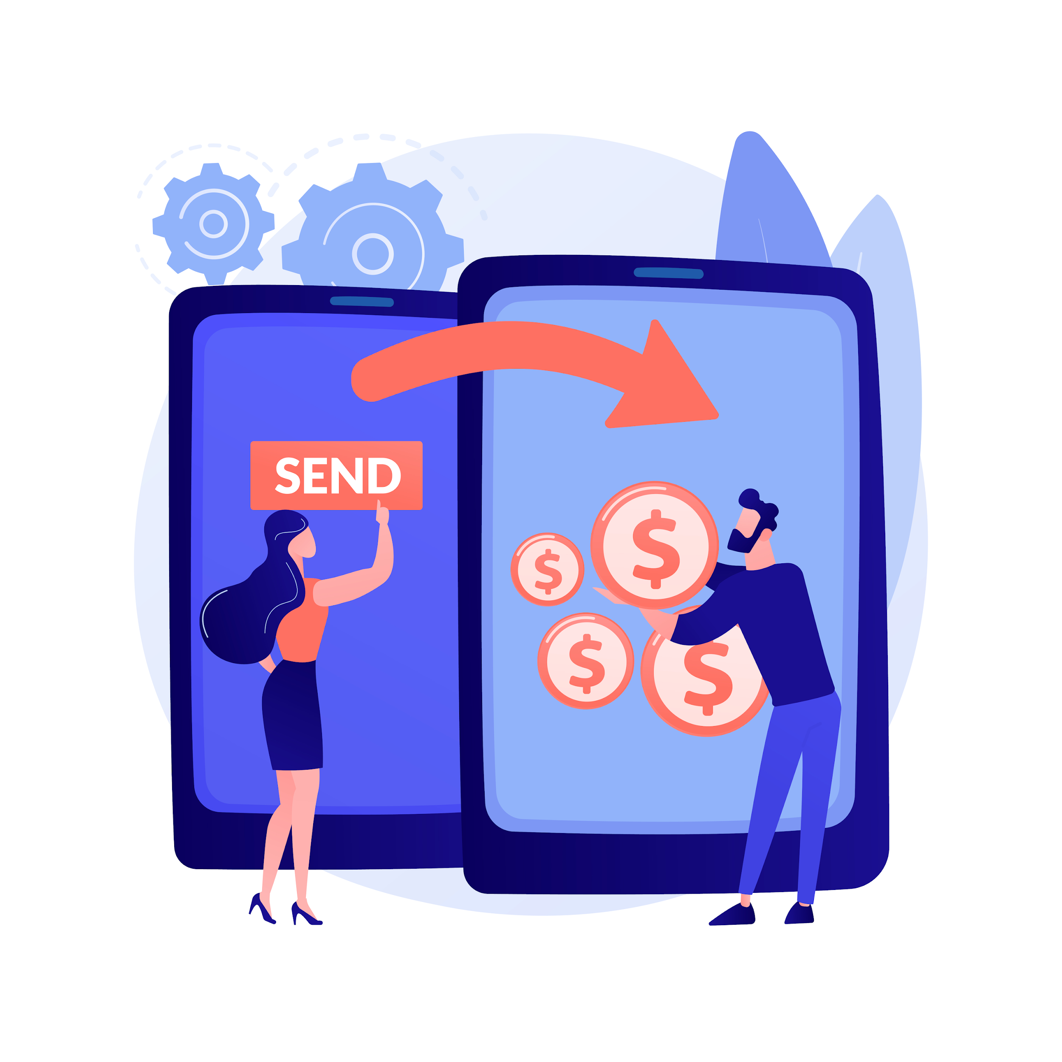
Unit 6
Accessing and Understanding Transaction History
Objectives
On completion of this unit, you will know:
Navigate to Transaction History
Understand Key Details in a Transaction Report
Verify Payments and Receipts
Download and Manage Records
Image by vectorjuice on Freepik

Slide 28
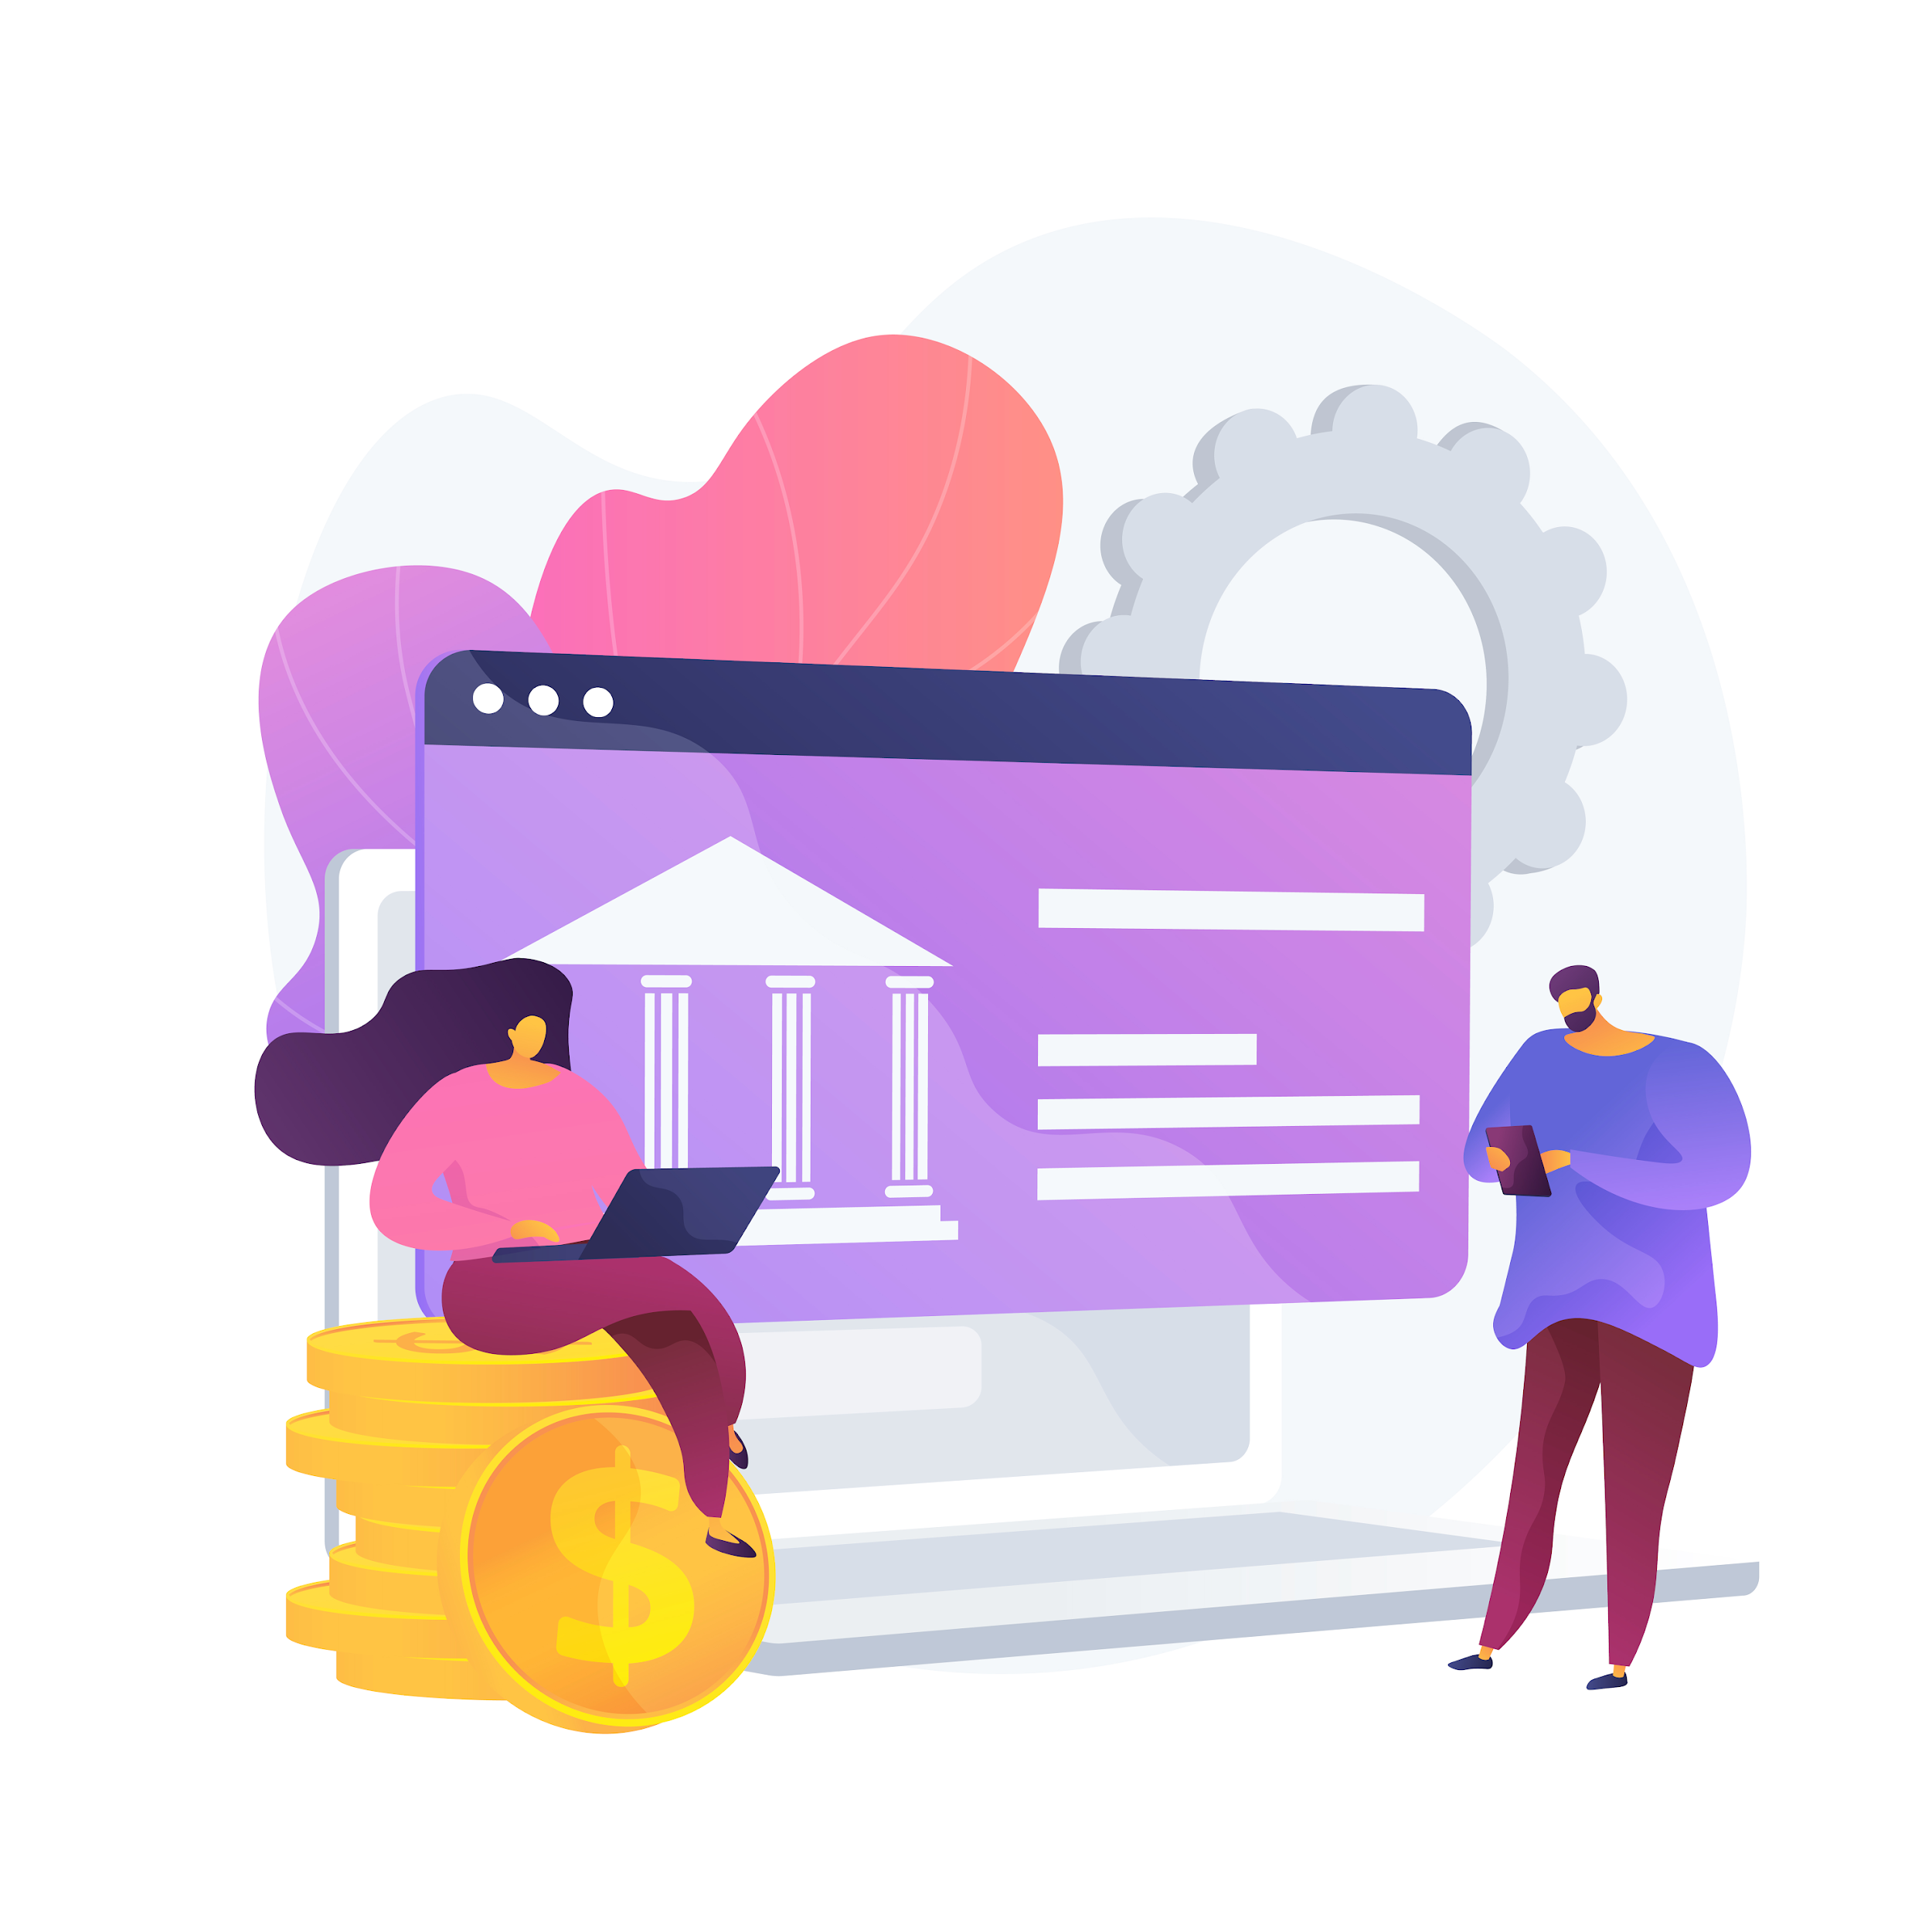
Navigate the transaction history (1)
4.6 Accessing and Understanding Transaction History
Open the App or Website
  Log in to your banking app or money transfer platform using your credentials.
  Locate the Transaction Section: Look for tabs or menus labeled “Transaction History,” “Activity,” or “Payments.” These are often found on the home screen or in the main menu.
Filter Your Search
  Use available filters like date, amount, or type of transaction to find specific records. For example, select “Sent” or “Received” to narrow down results.
Image by vectorjuice on Freepik

Slide 29
Navigate the transaction history (2)
4.6 Accessing and Understanding Transaction History
View Details
  Click or tap on a transaction to see full details, including sender, amount, and reference number.
  Verify that the information matches your expectations.
Save for Future Use
  If needed, download or print the transaction details for personal records or proof of payment.
Image by vectorjuice on Freepik

Slide 30
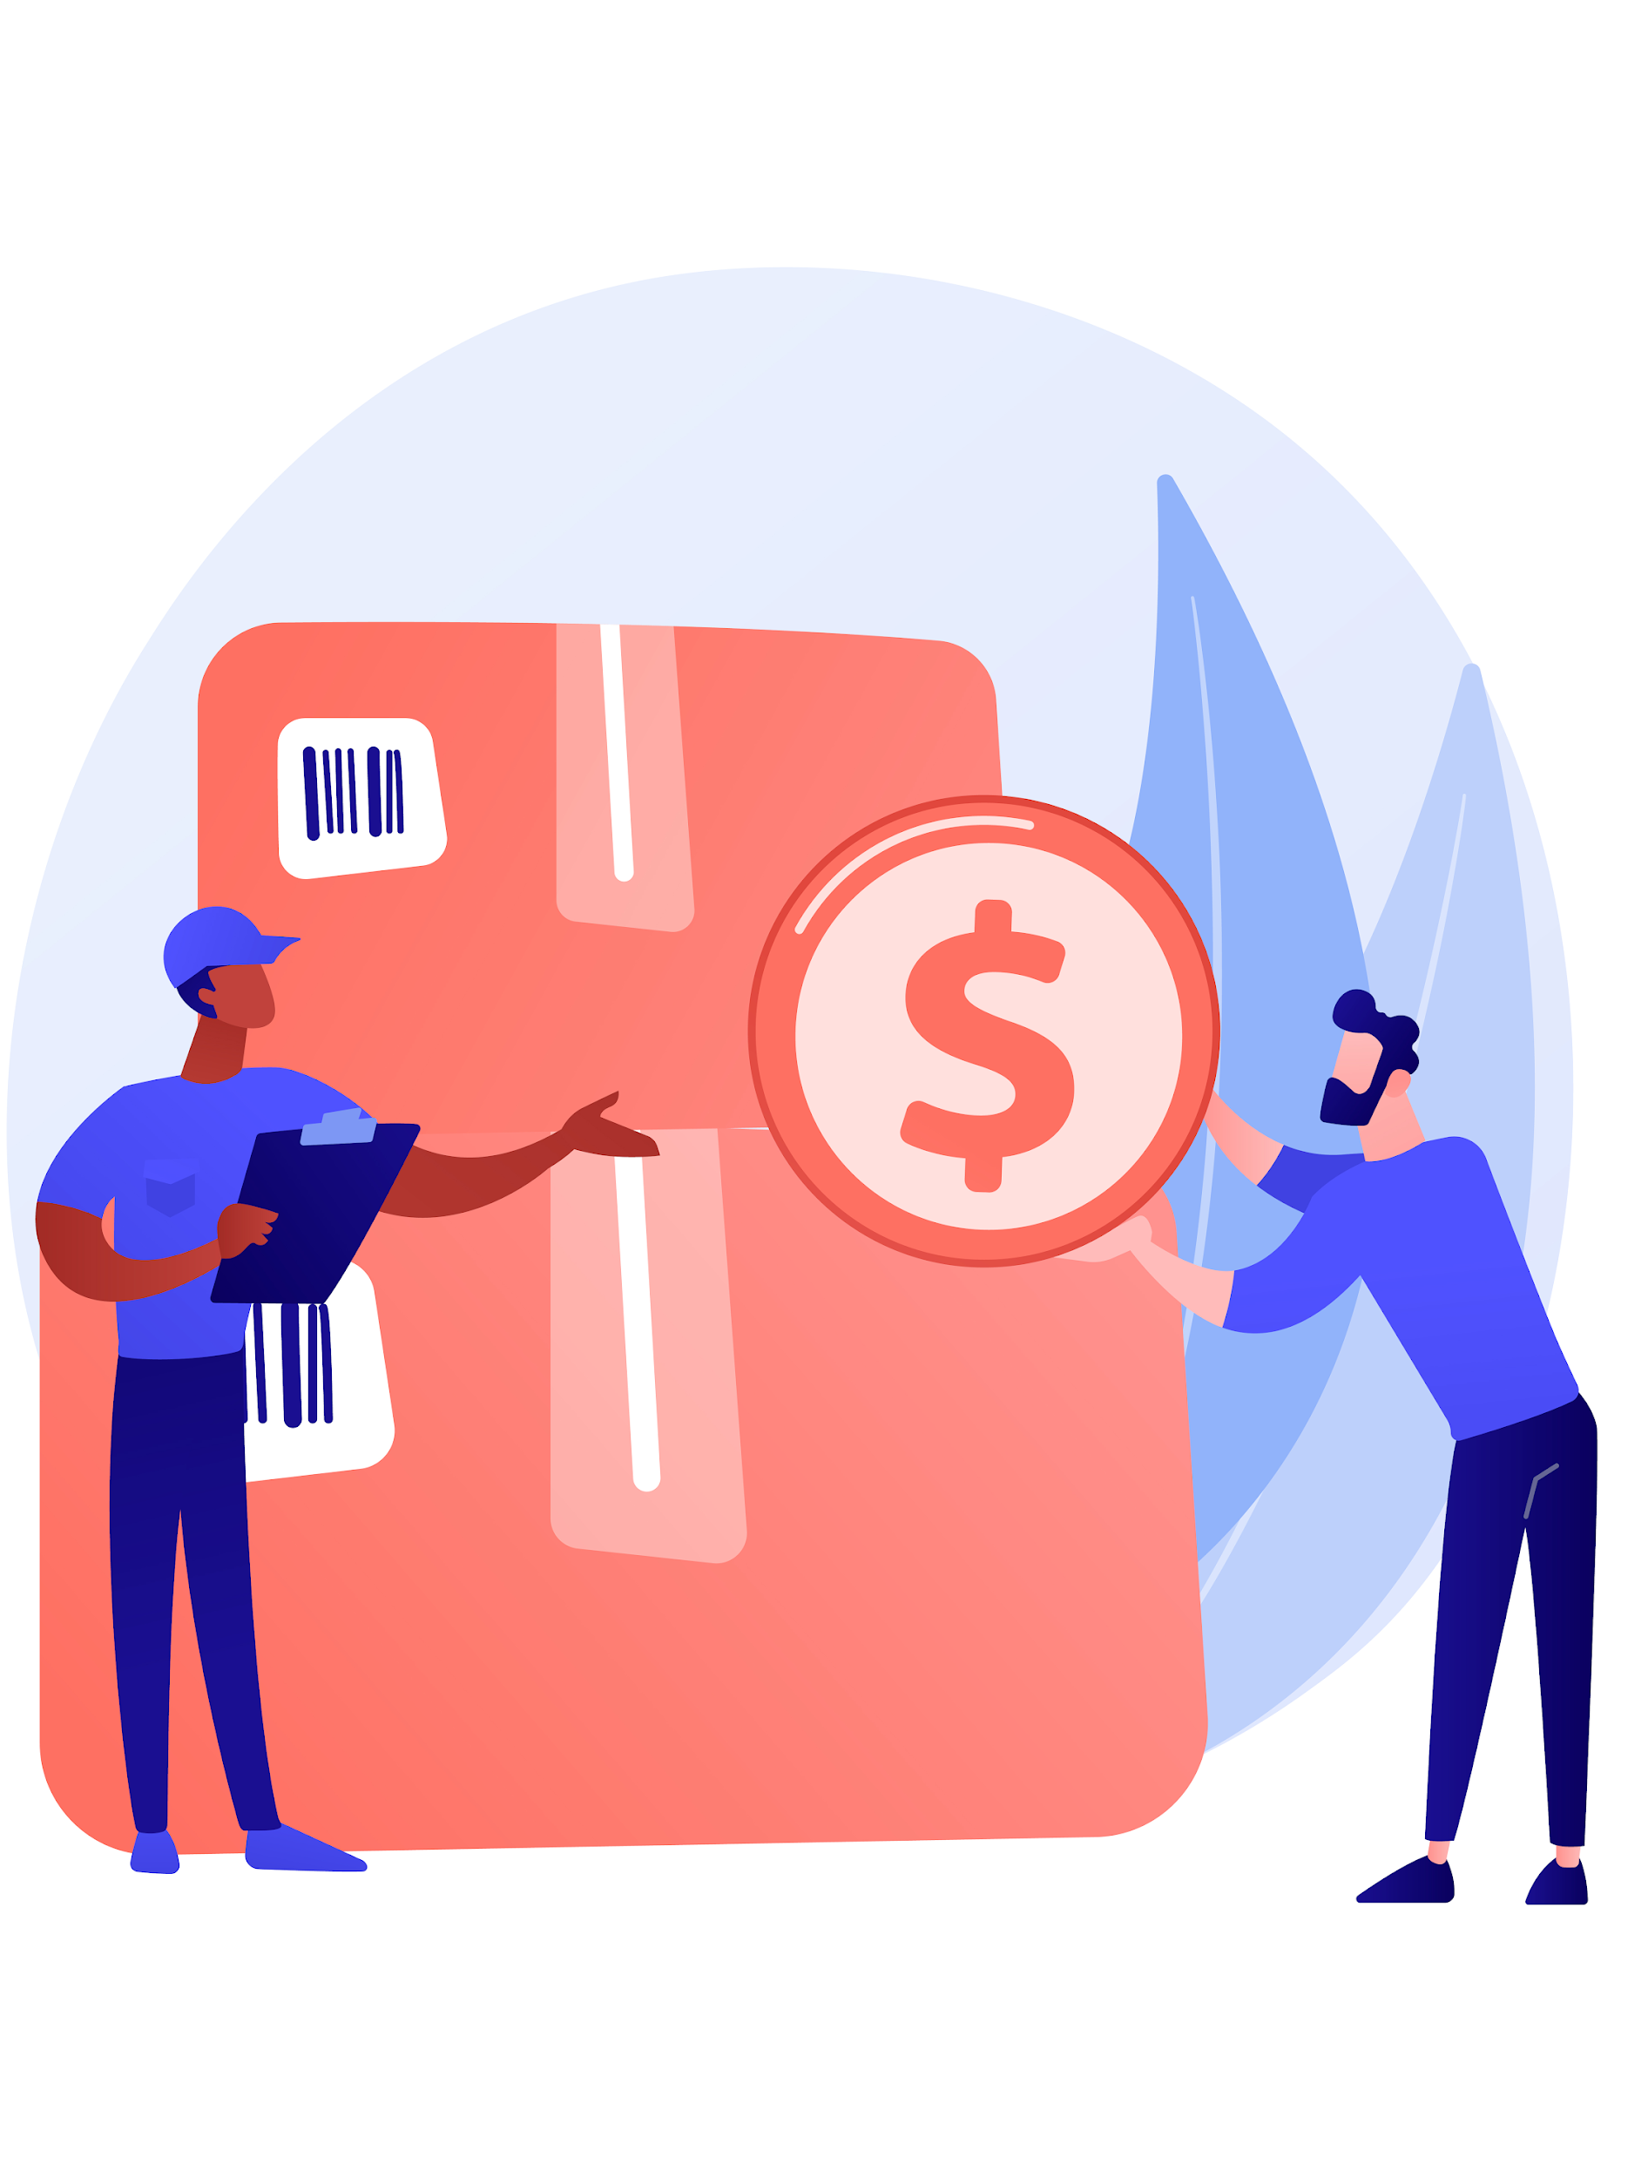
Why is it important?
4.6 Accessing and Understanding Transaction History
Verification of Transactions
  Confirm that payments have been sent or received successfully
Proof of Payment
  Use transaction history as evidence for completed payments or receipts when needed
Financial Tracking
  Monitor your spending and income to better manage your budget
Error Resolution
  Quickly identify discrepancies or unauthorized transactions for prompt resolution.
Image by vectorjuice on Freepik

Slide 31
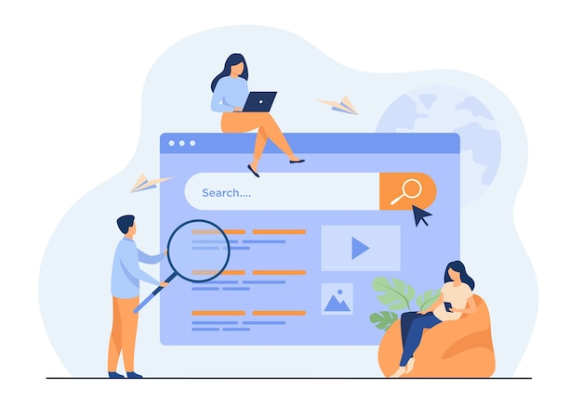
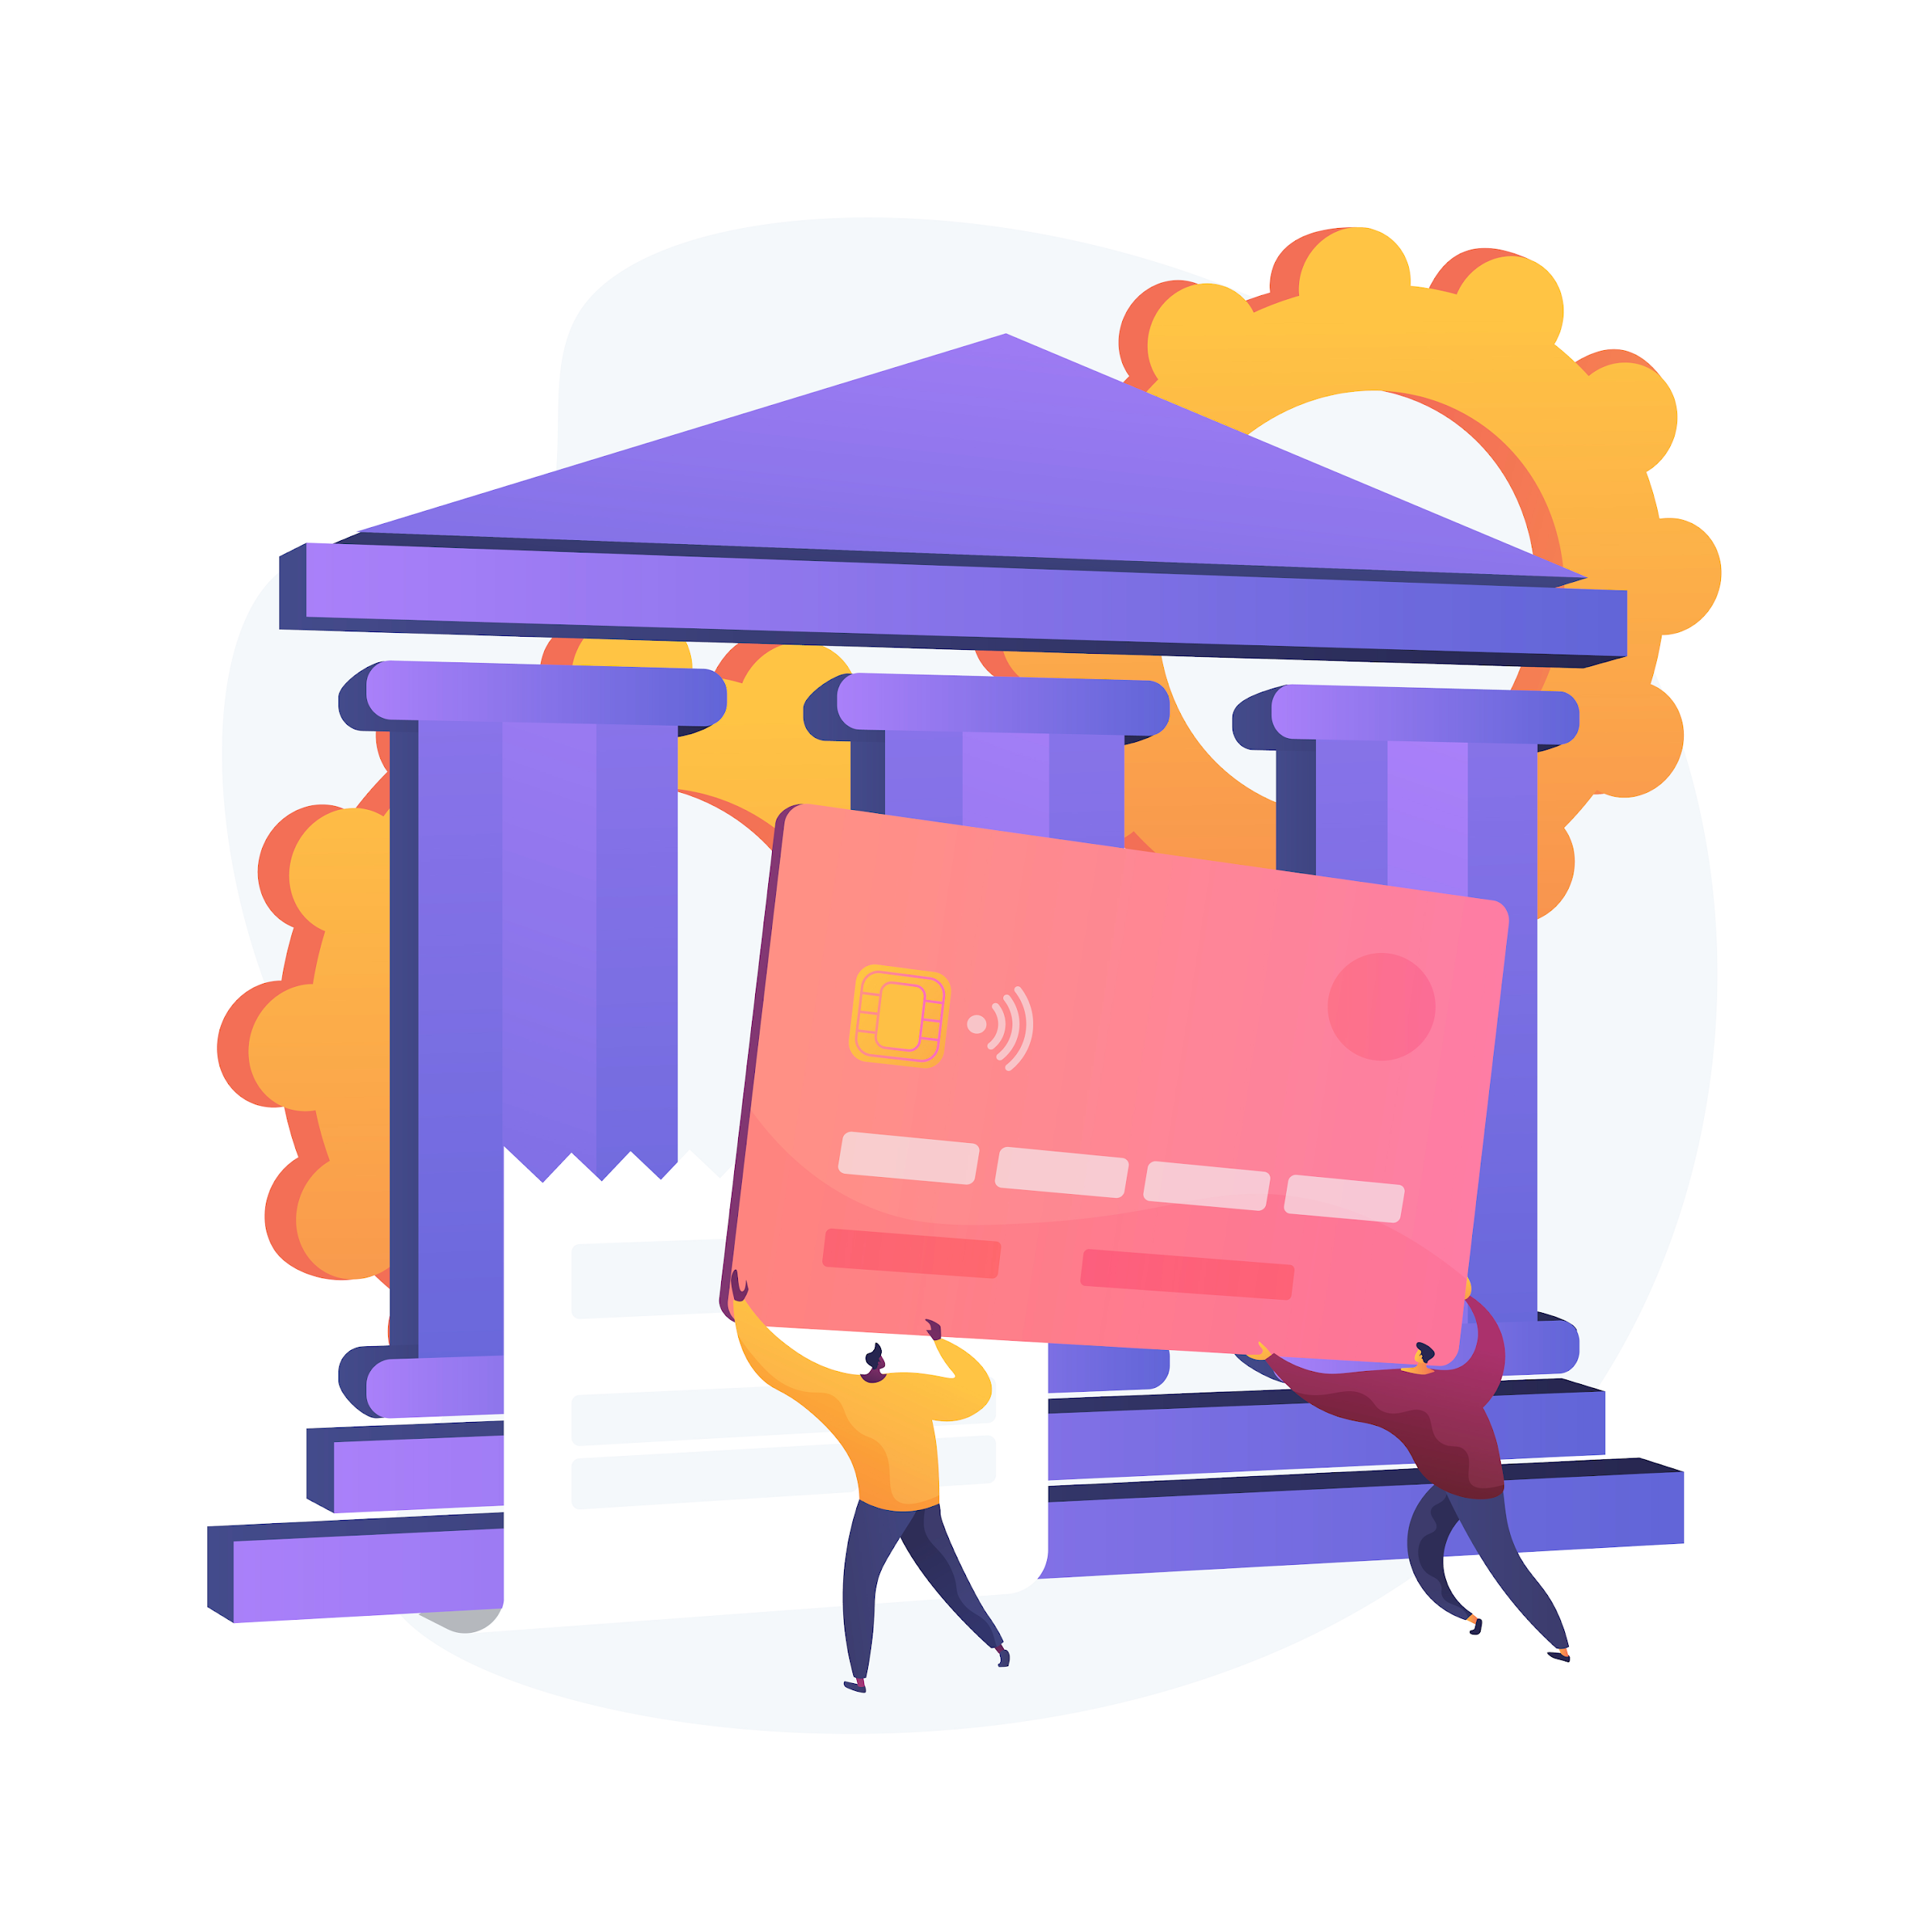
Activity: Identify your IBAN (1)
Decide, what is the best path to know your IBAN.
You will identify the steps needed to find your IBAN using your bank's app, website, or printed account statements. Share the steps you followed with the group to help everyone understand the different methods available.
Image by pch.vector on Freepik
Image by vectorjuice on freepik

Slide 32

Activity: Identify your IBAN (2)
Questions for the group
  What tools or resources did you use to find your IBAN?
  Were there any challenges you faced while locating your IBAN, and how did you overcome them?
  What steps would you take to share your IBAN securely if someone wants to send you money?
Image by vectorjuice on freepik

Slide 33
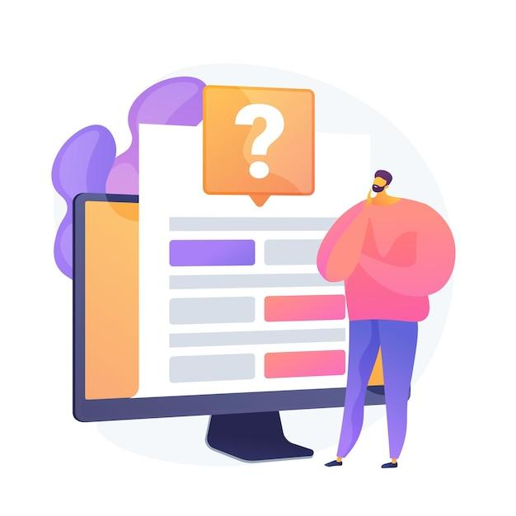
Check your knowledge!
Image by vectorjuice on Freepik

Slide 34
1. What should you do if you receive an email requesting your account details?
Only one answer is correct!
A. Reply immediately
with your details
B. Click the link in the email to verify your account
C. Ignore the email and delete it
D. Share your IBAN securely
via the email
Notes:
The correct answer is C

Slide 35
2. Which of the following is an example of a multi-factor authentication method?
Only one answer is correct!
A. Using only a password
B. Receiving an SMS code after entering your password
C. Accessing your account
on public Wi-Fi
D. Logging in without a PIN
Notes:
The correct answer is B

Slide 36
3. What should you do before confirming a money transfer?
Only one answer is correct!
A. Do it directly
B. Double-check the recipient's details
C. Ask the app to save your password automatically
D. Transfer without reviewing
the amount
Notes:
The correct answer is B

Slide 37
4. Why is it unsafe to use public Wi-Fi for digital money transfers?
Only one answer is correct!
A. It is too slow for large transactions
B. It allows unauthorized access to your sensitive data
C. It requires a password to connect
D. It doesn’t support online payments
Notes:
The correct answer is B

Slide 38
5. What should you do if you notice a discrepancy in your transaction history?
Only one answer is correct!
A. Ignore it and wait for it to resolve itself
B. Delete the app and reinstall it
C. Contact your bank or app support immediately
D. Try to reverse the transaction yourself
Notes:
The correct answer is C

Slide 39
6. Which of the following is a key feature of transaction history?
Only one answer is correct!
A. Sending money to multiple recipients
B. Viewing details like date, amount, and reference numbers
C. Depositing cash into an account
D. Adding new payment methods
Notes:
The correct answer is B

Slide 40
7. Which of the following is a sign of a phishing attempt?
Only one answer is correct!
A. An email with urgent language asking for personal details
B. A secure website with a padlock icon in the address bar
C. A notification from your banking app about a recent transaction
D. A message from a known contact without any suspicious links
Notes:
The correct answer is A

Slide 41



Congratulations!
You have completed this module!
Funded by the European Union. Views and opinions expressed are however those of the author(s) only and do not necessarily reflect those of the European Union or the European Education and Culture Executive Agency (EACEA). Neither the European Union nor EACEA can be held responsible for them. Project number: 2023-1-RO01-KA220-ADU-000157797

