Slide 1
1
2
Module 6 Processing online payments for taxes and bills
3
4
5
6
Funded by the European Union. Views and opinions expressed are however those of the author(s) only and do not necessarily reflect those of the European Union or the European Education and Culture Executive Agency (EACEA). Neither the European Union nor EACEA can be held responsible for them. Project number: 2023-1-RO01-KA220-ADU-000157797

Slide 2
Asociatia Four Change, Romania
Partners
Zavod IZRIIS, Slovenia
E-SENIORS: INITIATION DES SENIORS AUX NTIC ASSOCIATION, France
GUnet, Greece
Asociatia Niciodata Singur – Prietenii Varstnicilor, Romania
Fundació Gesmed Fundació de la Comunitat Valenciana, Spain

Slide 3
Modules
1. Basic digital literacy skills
2. Security & Prevention
3. Managing a bank account online
4.. Online solutions for receiving and sending money
5. Using a Credit Card to Purchase from Online Goods and Services
6. Processing online payments for taxes and bills

Slide 4
Unit 1 Introduction
Objectives
On completion of this unit, you will be informed about
The learning objectives and training content of this module
The training methodology used and the duration of this module
Image by vectorjuice on Freepik

Slide 5
Competences
On completion of this module, you will be able to:
Online payment confidence - be able to securely access and use government and utility websites to pay bills, taxes and other government fees.
Account Management Skills - the ability to create, log in and manage online accounts, including updating personal information and payment methods.
Digital security awareness - understanding how to identify safe websites, avoid scams and protect sensitive financial and personal information.
Problem solving and troubleshooting - the ability to deal with common issues such as password resets, failed payments, and contacting customer service when needed.

Slide 6
Training content
Introduction: duration, objectives, content and methodology, competences
Become familiar with Tax Payment Portals
Become familiar with Utility Portals
Navigate Tax and Utility Payment Portals
Make Secure Online Transactions
Check your knowledge

Slide 7
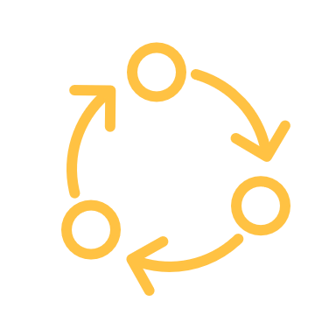
Unit 1
Training methodology and duration
Methodology
Active and participative
Face to face training:
Dialogue ✔ Role playing or Stimulation ✔ Teamwork
Online training:
Selected videos
Practical implementation of the tips agreed in the classroom
Some collaborative work
Simulation
Duration: 4 hours (indicative)
Face to face session:2 hours
Online training: 2 hours

Slide 8
Unit 2 Become familiar with tax payment portals
Objectives
On completion of this unit, you will be able to:
Understand the benefits of tax payment portals
Learn about taxes you can pay online
Image by vectorjuice on Freepik

Slide 9
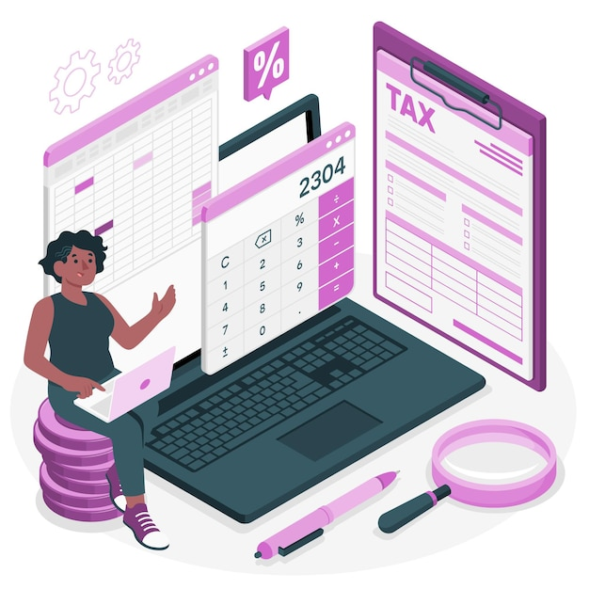
Understanding Tax Payment Portals
6.2 Become familiar with Tax Payment Portals
A tax portal is an official website provided by national or local tax authorities where taxpayers can file their tax returns, make payments, and manage their tax accounts.
TYPES OF Tax Payment Portals
National tax portals: used to file income taxes, view tax histories and make payments.
Local tax portals: used for local or regional taxes, such as property tax, local business tax, or municipal levies.
Image by storyset on Freepik

Slide 10
Online tax examples
6.2 Become familiar with Tax Payment Portals
Income Tax - Pay your income tax easily through secure websites. You can use your bank account, credit/debit cards or even digital wallets to make payments. Assistance is often available if you need help filing or paying.
Property Tax - Many local authorities allow you to pay your property tax online. Payments are based on the value of your property (house, car, land) and you can often pay in instalments. You can track your payments and set reminders to avoid missing due dates.

Slide 11
Unit 3 Become familiar with utility payment portals
Objectives
On completion of this unit, you will be able to
Understand the benefits of utility payment portals
Understand the types of utilities you can pay online
Image by vectorjuice on Freepik

Slide 12
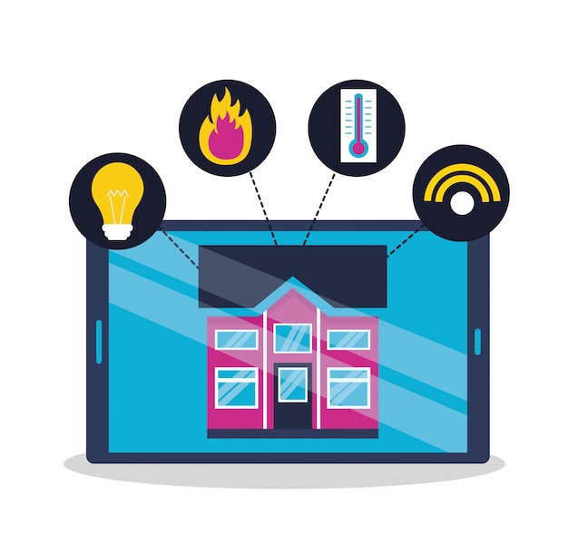
Understanding Utility Payment Portals
6.3 Become familiar with utility payment portals
What Are Utility Portals?
Secure online platforms where you can pay for services like electricity, water, gas, internet, and phone bills.
Accessible via official websites or mobile apps.
Features of Utility Portals
Bill Tracking: View past and upcoming bills in one place.
Usage Monitoring: Track energy, water, or internet usage.
Alerts and Reminders: Get notifications for due dates and payments.
Downloadable Receipts: Keep digital records for future reference.
Image by gstudioimagen on Freepik

Slide 13
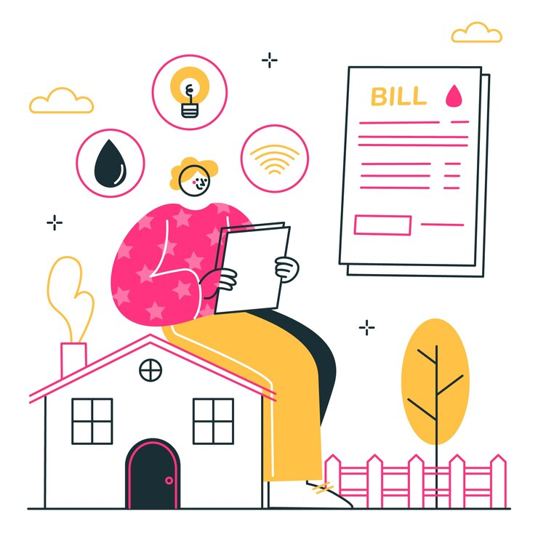
Types of Utilities Paid Online (1/2)
6.3 Become familiar with utility payment portals
Electricity Bills - Pay for household or business electricity usage. Some portals offer energy-saving tips and usage reports.
Water Bills - Manage and pay water service fees for your home or business. View detailed usage reports to track consumption.
Gas Bills - Pay for natural gas supply used for heating and cooking. Some providers offer budget plans to spread payments over time.
Image by storyset on Freepik

Slide 14
Types of Utilities Paid Online (2/2)
6.3 Become familiar with utility payment portals
Internet and Cable Bills -Pay for broadband, fiber, or cable TV services online. Options for upgrading plans or changing services directly through the portal.
Phone Bills (Landline & Mobile) - Easily pay for mobile and home phone services. Set up auto-pay to avoid service interruptions.
Waste Management Bills - Pay for garbage collection and recycling services. Some portals allow scheduling bulk pickups or additional services.
Image by storyset on Freepik

Slide 15
Unit 4 Navigate tax and utility payment portals
Objectives
On completion of this unit, you will be able:
Learn how to access official government websites to pay taxes and utility websites to pay bills.
Understand how to securely log in and manage payments through encrypted government and utility portals.
Discover features such as tax filing, payment history tracking, and service-related updates.
Image by vectorjuice on Freepik

Slide 16
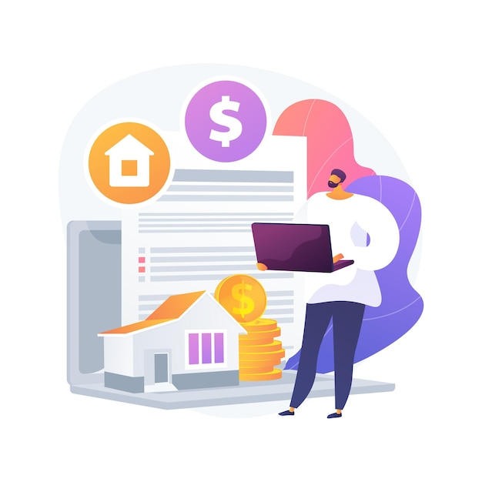
Navigating steps
6.4 Navigate tax and utility payment portals
An online payment portal is a secure platform, accessible via a website or app, that allows users to pay taxes and services directly from their mobile phones or other digital devices.
Locate the Login Section – Find and enter your credentials on the official government or utility website.
Explore the Main Menu – Identify key sections such as "Payments," "Billing," "Account Settings," and "Support.„
Access Transaction History – Navigate to the payment history or billing section to review past transactions and receipts.
Find Support and Help Features – Locate FAQs, chat support, or customer service contact details for assistance.
Image by vectorjuice on Freepik

Slide 17
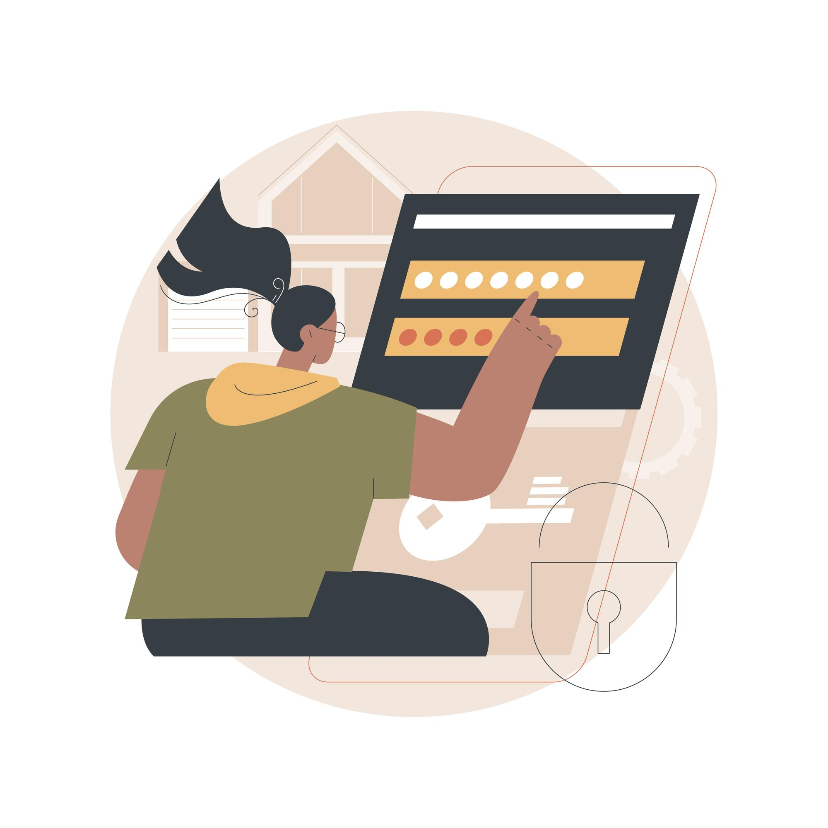
Setting Up and Managing Your Account (1/2)
6.4 Navigate tax and utility payment portals
Visit the Official Website – Go to the government or utility provider's official website and look for the "Sign Up" or "Register" option.
Create an Account – Enter your personal details (name, email, phone number) and set a strong password.
Verify Your Identity – Complete any verification steps, such as email confirmation, phone OTP (One-Time Password), or security questions.
Link a Payment Method – Add a bank account, debit/credit card, or set up an online wallet for transactions.
Image by vectorjuice on Freepik

Slide 18
Setting Up and Managing Your Account (2/2)
6.4 Navigate tax and utility payment portals
Set Up Security Features – Enable two-factor authentication (2FA), set up alerts for transactions, and use strong passwords.
Manage Account Preferences – Update contact details, set up auto-pay if you want, and customize notification settings for payment reminders.
Test Your Account – Make a small payment or check your billing details to ensure everything is set up correctly.
Image by vectorjuice on Freepik

Slide 19
Unit 5 Make secure online transactions
Objectives
On completion of this unit, you will be able to:
Make secure online transactions
Practise making payments, receiving funds and recognising scams or fraud to use online payment portals confidently and safely.
Image by vectorjuice on Freepik

Slide 20
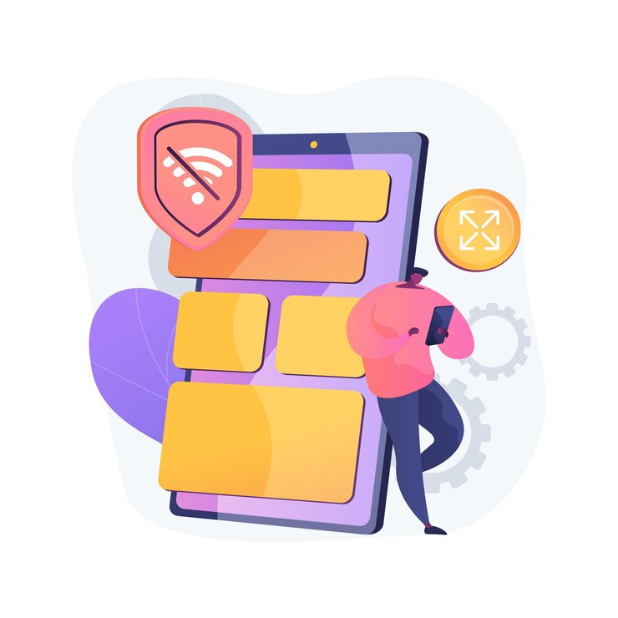
Benefits of secure online transactions (1/3)
6.5 Make secure online transactions
Convenient and Secure: Pay bills, make purchases, and manage finances online without needing to visit physical locations.
Encrypted and Secure Portals: Payments are processed through secure, encrypted websites or mobile apps.
Multiple Payment Options: Link bank accounts, credit/debit cards, or digital wallets for quick transactions.
Image by vectorjuice on Freepik

Slide 21
Benefits of secure online transactions (2/3)
6.5 Make secure online transactions
Automatic Payments: Set up recurring payments for added convenience.
Transaction Tracking: Keep track of transactions and digital receipts for easy management.
Hassle-Free Experience: Enjoy a smooth, efficient payment process.
Image by vectorjuice on Freepik

Slide 22
Benefits of secure online transactions (3/3)
6.5 Make secure online transactions
Examples:
Paying utility bills (electricity, water, gas).
Subscriptions (TV, internet, streaming services).
Insurance payments, loans, or credit card bills.

Slide 23
Main steps (1/2)
6.5 Make secure online transactions
Log in to the Official Website – Ensure you are on the correct government or utility website (check for "https://" and official domains).
Navigate to the Payment Section – Locate the "Pay Bill," "Make a Payment," or "Billing" tab on the website.
Select Payment Method
Credit/Debit Card: enter your card number, expiry date, security code (CVV), and billing address.
Bank transfer: provide your bank account number and routing number to complete a direct payment from your bank.
Mobile Money (if available): input your mobile money account number and confirm the transaction via your phone.

Slide 24
Main steps (2/2)
6.5 Make secure online transactions
Enter Payment Details – Input the amount, billing period, and any required reference numbers.
Verify Transaction Details – Double-check the payment summary for accuracy before proceeding.
Confirm and Complete Payment – Submit the payment and wait for a confirmation message or email receipt.

Slide 25
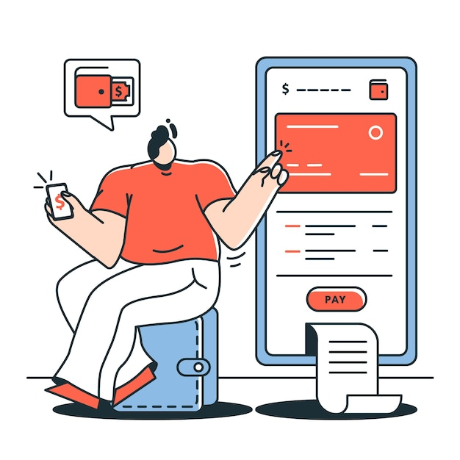
Downloading and storing receipts
6.5 Make secure online transactions
Download the receipt:
After submitting your tax return or payment, the portal will usually provide an option to download a PDF receipt or email you a copy.
Click on the “Download Receipt” button and save the file to your computer or mobile device.
Email confirmation:
Most tax portals will automatically send a confirmation email with a digital copy of your receipt. Be sure to check your inbox and save this email for your records.
Image by storyset on Freepik

Slide 26
Monitor for Fraud or Errors
6.5 Make secure online transactions
Recognizing Payment Errors
Identifying Fraudulent Activity
Protecting Your Information
Steps to Take If You Spot an Issue

Slide 27
1 Recognizing Payment Errors
6.5 Make secure online transactions
Double Charges: Check for duplicate transactions in your payment history.
Incorrect Amounts: Ensure the billed amount matches your actual usage.
Failed Transactions: If a payment fails, confirm it wasn’t deducted from your account before retrying.

Slide 28
2 Identifying Fraudulent Activity
6.5 Make secure online transactions
Unauthorized Transactions: Regularly review statements for any unfamiliar charges.
Phishing Scams: Avoid clicking on suspicious emails or links pretending to be from utility providers.
Fake Websites: Always use the official website or app to make payments.

Slide 29
3 Protecting Your Information
6.5 Make secure online transactions
Enable Alerts: Set up email or SMS notifications for transactions.
Use Secure Connections: Avoid making payments on public Wi-Fi networks.
Two-Factor Authentication (2FA): Add extra security by requiring a code in addition to your password.

Slide 30
4 Steps to Take If You Spot an Issue
6.5 Make secure online transactions
Report Suspicious Transactions: Contact your utility provider or bank immediately.
Request a Refund: If an error occurs, check the portal for dispute options.
Update Your Credentials: Change passwords if you suspect unauthorized access.

Slide 31
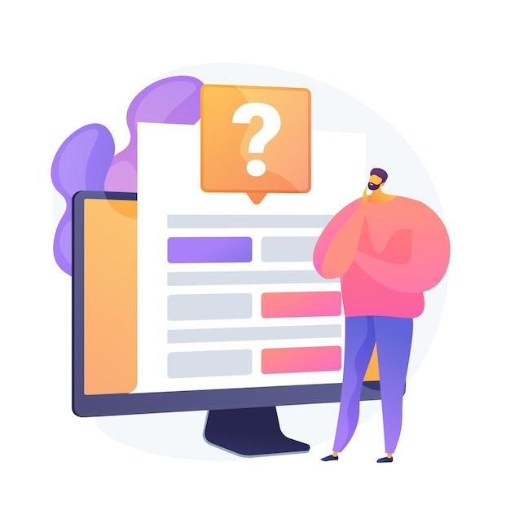
Check your knowledge!
Image by vectorjuice on Freepik

Slide 32
1. Which of the following taxes can typically be paid online?
Only one answer is correct!
A. Parking Ticket Fee
B. Grocery Fee
C. Sports Subscription Fee
D. Income Tax
Notes:
The correct answer is D

Slide 33
2.What is an online payment portal?
Only one answer is correct!
A. A government office where you can pay your taxes in person
B. A bank’s website where you can check your balance
C. A secure website or app that allows users to pay for goods and services electronically
D. A software used by accountants to calculate taxes
Notes:
The correct answer is C.

Slide 34
3. What is the correct sequence for making an online payment?
Only one answer is correct!
A. Log in to the portal → Enter payment details → Select payment method → Confirm payment → Save receipt
B. Enter payment details → Log in to the portal → Select payment method → Confirm payment → Save receipt
C. Confirm payment → Enter payment details → Log in to the portal → Save receipt → Select payment method
D. Save receipt → Log in to the portal → Select payment method → Confirm payment → Enter payment details
Notes:
The correct answer is A.

Slide 35
4. Which of the following is NOT a common method for paying taxes and utility bills online?
Only one answer is correct!
A. Credit/debit card payments
B. Cash payment at a local store
C. Bank transfers
D. Mobile Money (if available)
Notes:
The correct answer is B.

Slide 36
Congratulations! You have completed this module!
Funded by the European Union. Views and opinions expressed are however those of the author(s) only and do not necessarily reflect those of the European Union or the European Education and Culture Executive Agency (EACEA). Neither the European Union nor EACEA can be held responsible for them. Project number: 2023-1-RO01-KA220-ADU-000157797

