Slide 1




1
2
Module 1
Basic digital literacy skills
3
4
5
6
Funded by the European Union. Views and opinions expressed are however those of the author(s) only and do not necessarily reflect those of the European Union or the European Education and Culture Executive Agency (EACEA). Neither the European Union nor EACEA can be held responsible for them. Project number: 2023-1-RO01-KA220-ADU-000157797

Slide 2







Asociatia Four Change, Romania
Partners
Zavod IZRIIS, Slovenia
E-SENIORS: INITIATION DES SENIORS AUX NTIC ASSOCIATION, France
GUnet, Greece
Asociatia Niciodata Singur – Prietenii Varstnicilor, Romania
Fundació Gesmed Fundació de la Comunitat Valenciana, Spain

Slide 3
Modules
1. Basic digital literacy skills
2. Security & Prevention
3. Managing a bank account online
4.. Online solutions for receiving and sending money
5. Using a Credit Card to Purchase from Online Goods and Services
6. Processing online payments for taxes and bills

Slide 4
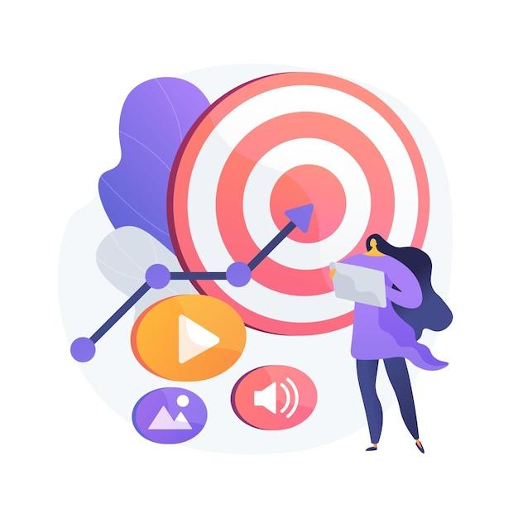
Unit 1
Introduction
Objectives
On completion of this unit, you will be informed about
The learning objectives and training content of this module
The training methodology used and the duration of this module
Image by vectorjuice on Freepik

Slide 5

Competences
1
Basic digital literacy skills
After completing this module, you will:
Acquire necessary skills to use mobile money solutions safely and with confidence:
  Using ICT devices and keep them up to date
  Managing an email account: sending, receiving, replying to, organizing emails, attaching files and managing contacts
  Navigating online
  Basic file management (creating, saving, organizing files and folders)
  Setting privacy parameters
Becoming familiar with smartphones:
  Understanding basic terminology
  Navigating mobile interfaces and menus
  Using touchscreen and buttons
  Being able to download and update mobile apps
  Explore different features of the mobile app

Slide 6

Training content
1
Basic digital literacy skills
Introduction of the session: duration, objectives, content, and methodology
Basic terminology of smartphones
Basic settings
Navigating interfaces and menus
Navigation & search online
6. Managing an email account
7. Searching and Downloading apps
8. Keeping ICT devices up to date
9. Quiz: Check your knowledge

Slide 7

Unit 1
Training methodology and duration
1
Basic digital literacy skills
Methodology
Active and participative
Face to face training:
  Dialogue ✔ Role playing or Stimulation ✔ Teamwork
Online training:
  Selected videos
  Practical implementation of the tips agreed in the classroom
  Some collaborative work
  Simulation
Duration: 4 hours (indicative)
  Face to face session:2 hours
  Online training: 2 hours

Slide 8
Unit 2
Basic terminology
Objectives
On completion of this unit, you will be able to:
Know the different types of digital equipment
Choose the right type of device according to your needs
Use with confidence your device
Image by vectorjuice on Freepik

Slide 9
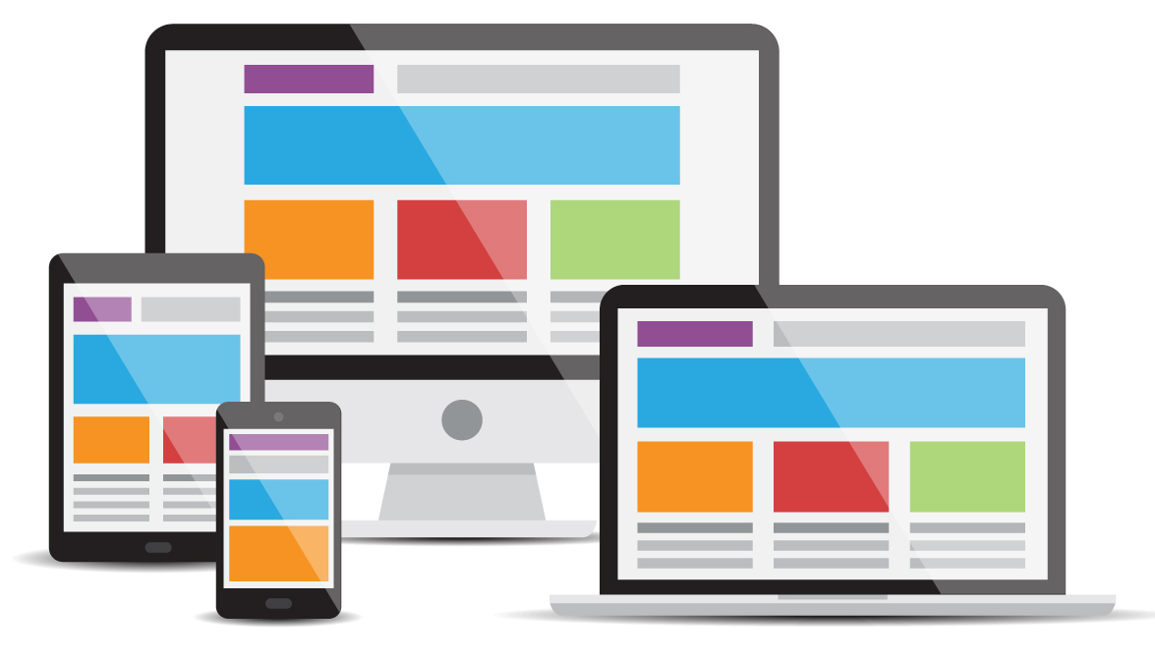
Digital Devices
1.2 Basic terminology
To work in the digital environment, you need a digital device. There are many different types of digital devices.
Each device has its pros and cons.
Therefore, we will discuss which device is useful for which specific activity and how we should protect it.
Image by cornecoba on Freepik

Slide 10
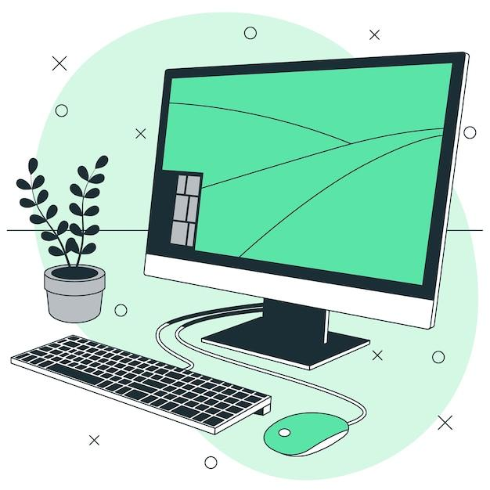
Personal Computer
1.2 Basic terminology
Description: A Personal Computer (PC), desktop or laptop, is an electronic device used for a variety of purposes, such as, browsing the Internet, writing documents, playing video games, etc.
Useful for: Advanced web research, writing long texts, writing emails, shopping online goods, e-banking.
Not useful for: Internet research or writing short texts on the move.
Image by storyset on Freepik

Slide 11
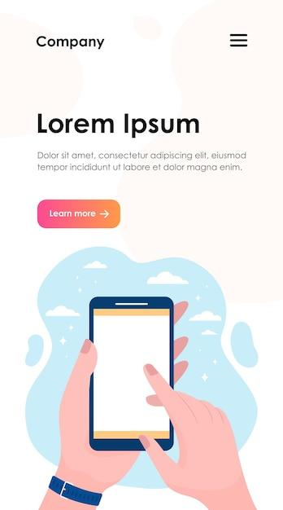
Smartphone
1.2 Basic terminology
Description: A smartphone is a mobile phone that can do much more than just make phone calls. For example, smartphones can connect to the Internet, and can take photos or videos. It can also be thought of as a small computer. The screen on a smartphone is a touch screen.
Useful for: Writing short messages, doing a little internet research, using social media like WhatsApp, Instagram, checking emails, e-banking, shopping online etc.
Not useful for: Writing long texts or doing extensive internet research.
Image by pch.vector on Freepik

Slide 12
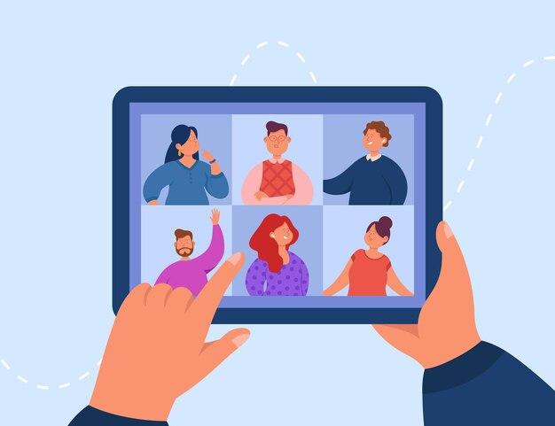
Tablet
1.2 Basic terminology
Description: A tablet is smaller than a computer or laptop but larger than a smartphone. It has a touch screen but, unlike a laptop, no keyboard.
Useful for: Doing light search activities, downloading and reading books, playing games, watching videos, checking emails, e-banking, shopping online.
Not useful for: Writing long emails or other texts, extensive searching activities.
Image by pch.vector on Freepik

Slide 13
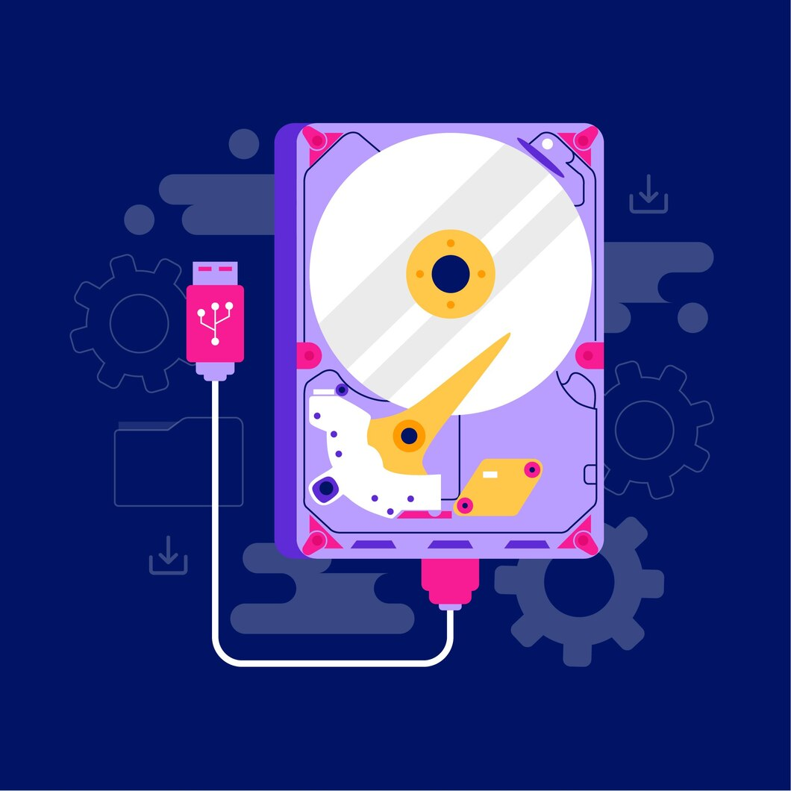
Memory & Storage: what is the difference?
1.2 Basic terminology
Imagine your computer is like a desk you use for work.
Memory (RAM) is like the top of your desk where you temporarily place papers and tools you're working with. When you clean it up, elements disappear. Memory is temporary and works fast, but it doesn't keep things forever.
Storage (Hard Drive or SSD) is like a filing cabinet near your desk. This is where you keep your papers, photos, and important documents when you're not using them. The filing cabinet keeps everything safe until you need it again.
So, memory is for "right now" tasks, and storage is for "long-term" keeping. Both are important, but they do different jobs.
Image by pch.vector on Freepik

Slide 14
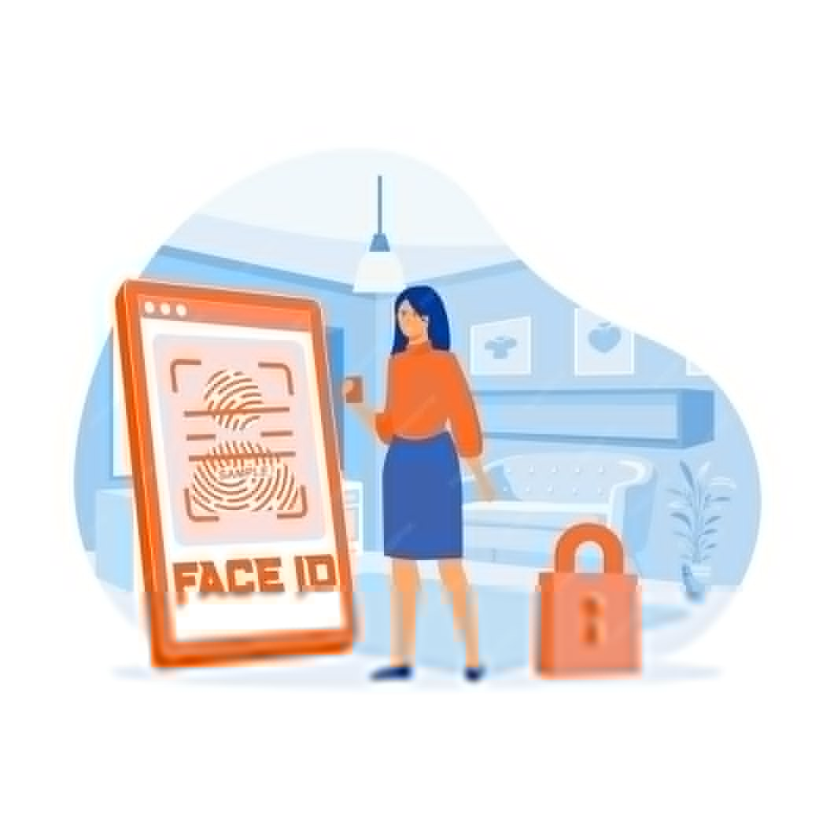
Fingerprint and facial recognition : what is the difference?
1.2 Basic terminology
Fingerprint Recognition
Imagine your fingerprint is like a unique stamp that only you have.
You place your finger on a special sensor, and the device checks the pattern of lines and ridges on your fingertip.
It’s like the device saying, “Ah, yes, this is your unique stamp. You’re allowed in!”
Facial Recognition
This works like the device "looking" at your face, much like a friend recognizing you when they see you.
It uses the camera to scan the shape of your face, including features like your nose, eyes, and jawline.
The device then says, “Yes, this is your face! Welcome!”
Image by pch.vector on Freepik

Slide 15
Unit 3
Basic Settings
Objectives
On completion of this unit you will be able to:
Know what are the different settings you can adjust
Recognize the different setting buttons
Adapt the settings of your devices to your needs
Image by vectorjuice on Freepik

Slide 16

What are settings?
1.3 Basic settings
Think of the settings button like the control panel for your device, just like the dials on your washing machine or TV remote. It’s where you go to adjust how things work to suit your needs.
How to Recognize the Settings Button : Look for a symbol that looks like a gear (⚙️).
What can you adjust in settings?
  Brightness: Adjust the screen brightness
  Volume: Turn the sound up or down
  Wi-Fi: Connect to the internet
  Language: Change the language if you prefer reading things in another language.
Image by Freepik

Slide 17
Unit 4
Navigating interfaces and menus
Objectives
On completion of this unit you will be able to:
Recognize the main functionalities symbols
Master different gestures on tactile devices
Be confident in using different interfaces by recognizing common patterns.
Image by vectorjuice on Freepik

Slide 18
Functionalities & Symbols (1/2)
1.4 Navigating interfaces and menus
Home Button
Symbol: ⭕ or a square/line at the bottom of the screen.
What it does: Takes you back to the main screen.
Back Button
Symbol: ◀️ or an arrow pointing left.
What it does: Goes back to the previous screen.
Wi-Fi
Symbol: 📶 or curved lines.
What it means: Shows if you’re connected to the internet.
Battery
Symbol: 🔋
What it means: Displays how much charge is left. A lightning bolt (⚡) shows it’s charging.

Slide 19
Functionalities & Symbols (2/2)
1.4 Navigating interfaces and menus
Camera
Symbol: 📷 or a camera icon.
What it does: Opens the camera to take pictures or videos.
Gallery/Photos
Symbol: 🖼️ or a colorful flower/icon.
What it does: Lets you view your saved pictures.
Internet/Browser
Symbol: 🌐 or a compass/blue circle.
What it does: Opens a web browser to access the internet.
Email
Symbol: 📧
What it does: Opens your email to read or send messages.
Volume/Sound
Symbol: 🔈, 🔉, 🔊, or 🔇
What it means: Adjust or mute sound levels.

Slide 20

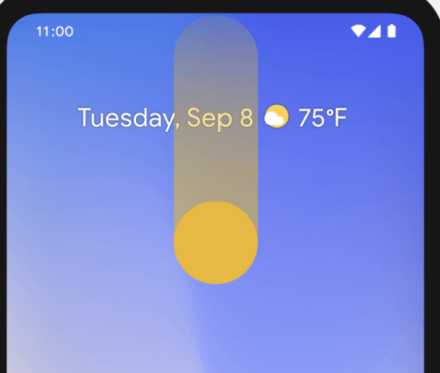
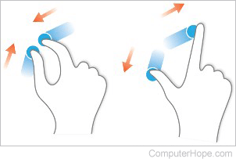
Gestures
1.4 Navigating interfaces and menus
Swipe Up: Go to the home screen.
Swipe Down: See notifications or quick settings.
Pinch to Zoom: Use two fingers to zoom in or out on pictures or text.

Slide 21
Unit 5
Navigation & search online
Objectives
On completion of this unit you will know:
What is the difference between a browser and a search engine
How to use search engines to find websites and information about them
When a website is safe and secure to visit
Image by vectorjuice on Freepik

Slide 22





Web browsers
1.5 Navigation & search online
To search for information on the Web, you need to open a web browser (step 1). A web browser is usually already available on your device.
Some of the most popular web browsers include
Google Chrome
Mozilla Firefox
Microsoft Edge
Apple Safari
Opera

Slide 23
Finding the right websites
1.5 Navigation & search online
All the information on the Web is available on websites. So, the next step is to connect to the appropriate website that contains the information you are looking for.
To connect to a website, you need to know its domain name, e.g.,
elderlymobilemoney.eu

Slide 24
Domain names
1.5 Navigation & search online
To begin with, we have somehow been informed about a domain name by :
  reading it somewhere,
  being told by someone,
  finding it on another website with related content, or
  using a search engine to find the domain name of the website.
Tips:
  If you already know the domain name, you may type it directly into your browser and connect to the website;
  Otherwise, use a search engine to find it.

Slide 25





Search engine
1.5 Navigation & search online
A search engine is a service for finding websites. It collects websites available on the Web and associates them with various tags, which are keywords related to the main category of information of the website.
Steps:
Enter the URL of the search engine
Enters the keywords
The search engine returns a list of websites related to the keywords
The user chooses to visit one or more of the websites

Slide 26
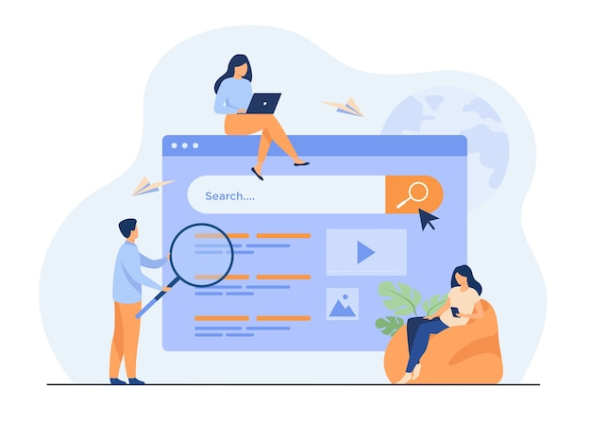
Activity: Finding information about "Paying online”
1.5 Navigation & search online
1.4 Online navigation
Open your browser and connect to one of the following search engines:
  Yahoo.com
  Bing.com
  Google.com
Enter your keywords: Paying online
The search results are displayed as a list of links, accompanied by a title and a paragraph, divided into several pages.
View the results on the first page, then browse through the following pages of results. Find something interesting?
Move your mouse over a link that interests you, right click, go to the “Open link in new tab” option and click on it.
A new tab will appear in your browser containing the link page. Go to that tab and read the page.
Repeat this again with other keywords.
Paying online
Image by pch.vector on Freepik

Slide 27
Is the Website Secure?
1.5 Navigation & search online
A secure website has a link in which:
The https protocol is used, where “s” means secure.
An original website, for example a bank website, has a link in which:
The domain name contains its official name (be careful about)
It is relatively short

Slide 28



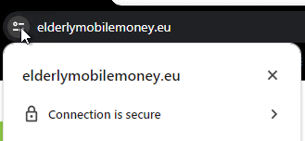
How can I check if "https" is being used?
1.5 Navigation & search online
1.4 Online navigation
The link contains https.
When a browser connects to a secure website, a padlock icon appears next to the link.
This indicates that the website is secure.

Slide 29
Unit 6
Managing an email account
Objectives
On completion of this unit you will be able to:
Get an email account
Send an email, reply to an email and attach files
Organize your email account
Search for emails
Image by vectorjuice on Freepik

Slide 30
What is an email?
1.6 Managing an email account
The exchange (sending and receiving) of email is a formal written communication with friends and peers.
Email communication can be:
Informal, like the way we communicate with people we are very close to;
Formal, which includes a formal way of communicating with organisations and people we do not know or have a professional relationship with;
Semi-formal, which is between informal and formal, e.g., you may consider using this type for sending email to your doctor.
Finally, emails can be archived, electronically or printed, and provide proof of communication. You can also always read them to remember details.

Slide 31

Email Account
1.6 Managing an email account
For email-based communication, you need an email account:
If you use a mobile smartphone, you probably already have a personal email account.
If you have an Internet provider, you may already have an email address.
If you don’t have an email account, it is time to get one!
To send and receive email you must have access to an online email service through your browser, or use:
  an email client software on your desktop/laptop, e.g., Thunderbird, Outlook;
  a mobile email app on your smartphone or tablet, e.g., Gmail app, etc.
=> Refer to Activity 2 ‘Creating an email account’, which you can do during a training session or on your own at home.
Image by vectorjuice on Freepik

Slide 32

Compose and Send an email
1.6 Managing an email account
To write an email, click on the ‘New message’ or ‘Compose’ button, depending on the online email service you are using.
Add all the information you need to send the email:
  in the ‘To’ field, add recipients, i.e. the email addresses of the people you want to write to. You can also add people in copy of your email by adding their email addresses in the ‘Cc’ and ‘Bcc’ fields (in the Bcc field, no-one but you will see the emails added in this section).
  in the “Subject” field, add a subject for your email.
  Write your message.
To send your email, click on the send icon at the top of the page.
Image by rawpixel.com on Freepik

Slide 33
Unsend a message and attach files
1.6 Managing an email account
If you have sent a message too quickly, you can unsend the message to modify it:
  When you send your message, you will see the message ‘Sent’ and the option to Undo.
  Tap Undo, and your email will reappear in the form of a message in the process of being written, and will not be received by the recipient until you resend it.
Please note that you can normally only do this within a few seconds of sending the email, but you can extend this period in your email settings.
To add attachments to your email :
  Click on the Attach icon (paperclip symbol, at the top of the screen).
  In the menu, select the type of attachment you want to send.
  Then choose the document(s) you want to send from those in the new window that will open on your smartphone.
  To remove an attachment, tap the attachment and tap the button Remove.

Slide 34

Read and reply to email
1.6 Managing an email account
To read an email, simply click on it. The title of an email you have never read will appear in bold on the homepage of your email account.
To reply to an email:
  Open the email you want to reply to.
  Click on the ‘Reply’ button to reply to the sender of the email only, or ‘Reply to all’ to reply to all recipients. Depending on your email service, this button may be at the bottom of the email, or in the drop-down menu to the right of the sender's name.
Image of storyset on Freepik

Slide 35
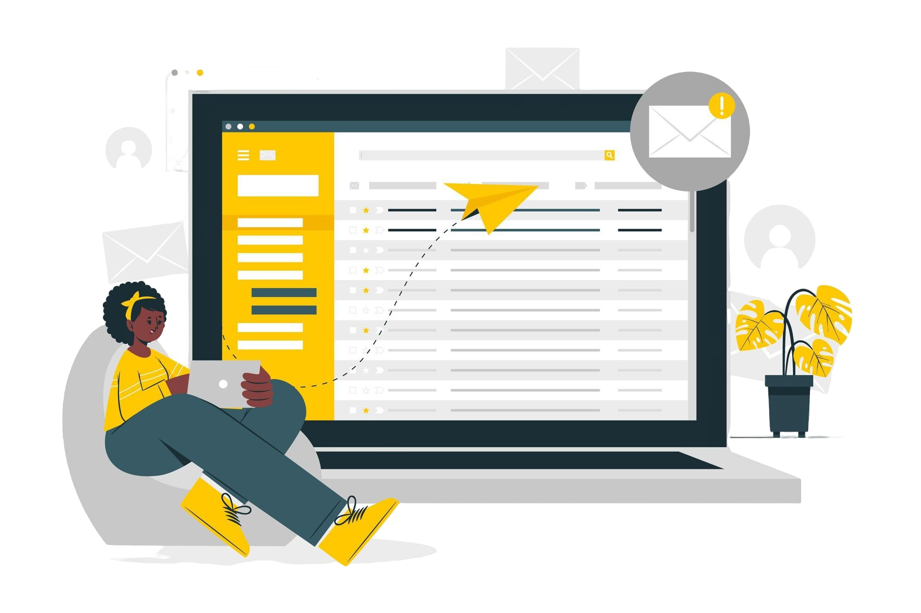
Organise your email inbox
1.6 Managing an email account
To help you find your way around your inbox, you can organise it by creating subsections and sorting your emails within them. Depending on your email service, this may be called ‘labels’ or ‘folders’.
When you only want to search for emails that you have labelled in a specific sub-section, click on the Menu button in your mailbox, then choose the section you want to appear. To return to the general view, click on the Menu button again.
Please note: the use of this organisation system varies depending on the email service. If you are in any doubt, check the service user guide first.
Image of storyset on Freepik

Slide 36
Activity: Create a new label to organise your emails
1.6 Managing an email account
Try creating a label (or equivalent) to sort your emails:
In your mailbox menu, look for the ‘Labels’ section (or equivalent), and click on ‘Create new’.
Personalise it, by giving it a name and a colour for example.
Click on ‘Done’.
Next, open an email that you want to add under this label.
Click on the mail options button, and click on ‘Change label’.
Choose the right label for this email, and click ‘Apply’.
View the results on the first page: Do you see the label symbol appearing next to your email?
Try a second method: drag and drop a second email into the label you've created, visible on the left-hand side of your email (depending on your type of email, only one of these methods may be available).

Slide 37
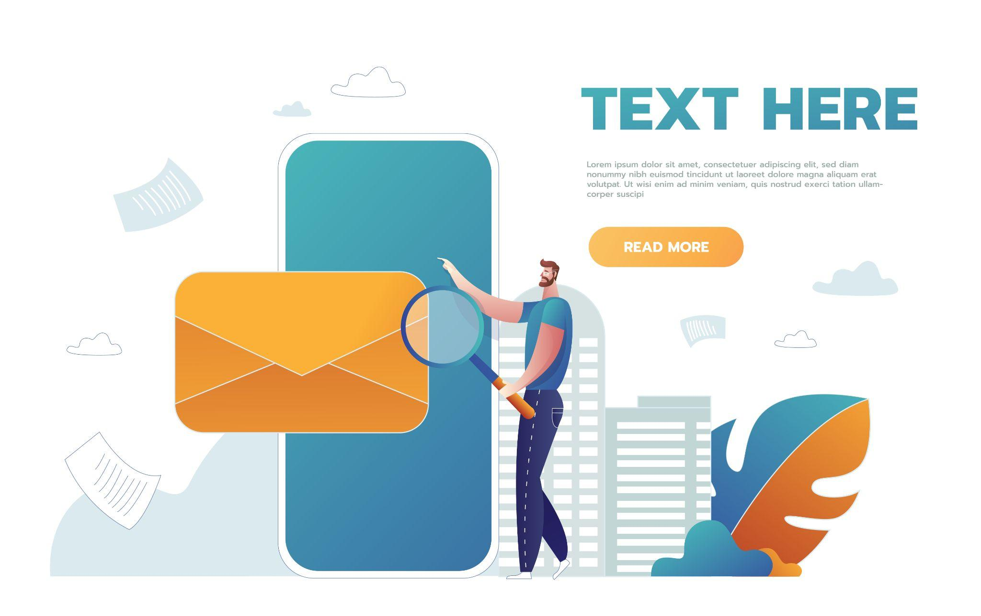
Search a specific email
1.6 Managing an email account
To find an email easily, you can also filter your mailbox:
Click on the search bar at the very top of the home page.
Several drop-down menus will appear below (From, To, Date, etc).
Enter your search criteria.
The corresponding emails will then be displayed directly.
If not, click on Search to display the emails.
Image of benzoix on Freepik

Slide 38
Unit 7
Searching and downloading apps
Objectives
On completion of this unit you will be able to:
Find an application on your device dedicated platform or “store”
Install an application
Image by vectorjuice on Freepik

Slide 39


Search and download apps
1.7 Searching and Downloading apps
To download an application, always use the online shop accessible from your smartphone, to make sure you only download safe applications:
Android – Google Play Store Iphone – Apple’s App Store
On these shops, it works in the same way as an internet search. Search directly for an application if you know its name, or for a theme that interests you, and explore the different choices on offer.
Then click on the ‘Install’ or ‘Get’ button (depending on the shop and app) to start the download. Once the download is complete, you can access it directly on your smartphone.

Slide 40
Unit 8
Keeping ICT devices up to date
Objectives
On completion of this unit you will be able to:
Verify if there is any software update
Update installed applications
Protect your data and devices
Image by vectorjuice on Freepik

Slide 41

Tips for protecting your data and devices
1.8 Keeping ICT devices up to date
Software updates are supplied to apply fixes to known application, browser, and operating system security vulnerabilities. They also deploy new or enhanced features, remove outdated features, and improve software stability.
Use the latest versions of an operating system, install anti-virus and firewall software and check for updates regularly.
Avoid downloading free software from unknown or untrusted websites. Only download software from known and trusted companies, as soon as possible.
Image by storyset on Freepik

Slide 42
How to check for apps and system updates
1.8 Keeping ICT devices up to date
Check for Updates:
Open the Apple’s App Store (for iOS devices) or Google Play Store (for Android devices).
Tap on your profile icon or menu, usually found in the top right corner.
Look for an option that says "Updates" or "Manage Apps & Device."
Update Apps:
In the Updates section, you’ll see a list of apps that have available updates.
You can choose to update individual apps by tapping "Update" next to each app, or update all apps at once by tapping "Update All."
System Updates:
System updates are updates to the entire operating system of your device, not just individual apps. These updates are important for keeping your device secure and running well.
To check for system updates, go to "Settings," scroll down to "System" or "Software Update," and tap to check if an update is available. Follow the on-screen instructions to download and install the update.

Slide 43
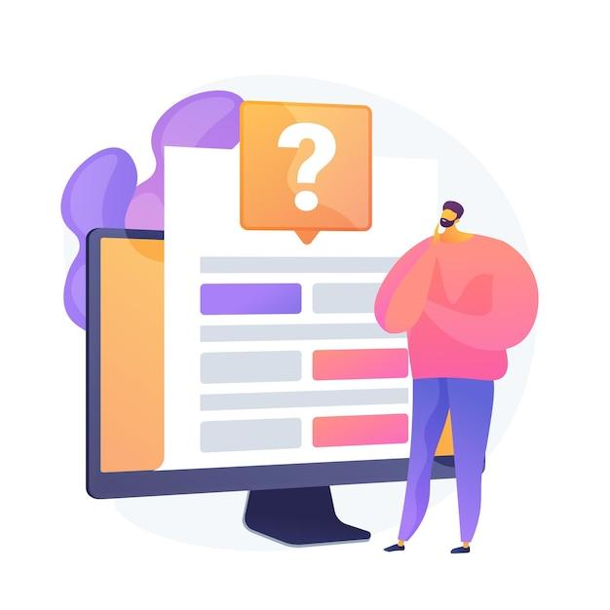
Check your knowledge!
Image by vectorjuice on Freepik

Slide 44
1.9 Check your knowledge!
1. How does facial recognition work?
Only one answer is correct!
A. By creating an artistic representation of your face
B. By analyzing the unique shapes and features of your face
C. By detecting the unique pitch of your voice
D. By scanning the pattern of lines of your fingertips
Notes:
Answer B is correct

Slide 45
1.9 Check your knowledge!
2. Which of the following is NOT a search engine
Only one answer is correct!
A. Google
B. Yahoo
C. Chrome
D. Ecosia
Notes:
Answer C is correct

Slide 46
1.9 Check your knowledge!
3. The “s” at the end of the https means
Only one answer is correct!
A. Simple
B. Secure
C. Super
D. Sensitive
Notes:
The correct answer is B

Slide 47
1.9 Check your knowledge!
4. Your software and applications are automatically updated
on your devices.
Yes, the statement is correct.
No, the statement is wrong.

Slide 48

Congratulations!
You have completed this module!
Funded by the European Union. Views and opinions expressed are however those of the author(s) only and do not necessarily reflect those of the European Union or the European Education and Culture Executive Agency (EACEA). Neither the European Union nor EACEA can be held responsible for them. Project number: 2023-1-RO01-KA220-ADU-000157797

