Slide 1




1
2
Topic 1
Basic digital literacy skills
3
4
5
6
Funded by the European Union. Views and opinions expressed are however those of the author(s) only and do not necessarily reflect those of the European Union or the European Education and Culture Executive Agency (EACEA). Neither the European Union nor EACEA can be held responsible for them. Project number: 2023-1-RO01-KA220-ADU-000157797

Slide 2







Asociatia Four Change, Romania
Partners
Zavod IZRIIS, Slovenia
E-SENIORS: INITIATION DES SENIORS AUXNTIC ASSOCIATION, France
GUnet, Greece
Asociatia Niciodata Singur – Prietenii Varstnicilor, Romania
Fundació Gesmed Fundació de la Comunitat Valenciana, Spain

Slide 3
Topics
1. Basic digital literacy skills
2. Managing a bank account online
3. Online solutions for receiving and sending money
4. Using a Credit Card to Purchase from Online Goods and Services
5. Processing online payments for taxes and bills
6. Security & Prevention

Slide 4

Unit 1
Introduction
Objectives
On completion of this unit, you will be informed about
The learning objectives and training content of this module
The training methodology used and the duration of this module
Source | Pixabay license

Slide 5

Competences
1
Basic digital literacy skills
After completing this module, you will:
Acquire necessary skills to use mobile money solutions safely and with confidence:
  Using ICT devices and keep them up to date
  Managing an email account: sending, receiving, replying to, organizing emails, attaching files and managing contacts
  Navigating online
  Basic file management (creating, saving, organizing files and folders)
  Setting privacy parameters
Becoming familiar with smartphones:
  Understanding basic terminology
  Navigating mobile interfaces and menus
  Using touchscreen and buttons
  Being able to download and update mobile apps
  Explore different features of the mobile app

Slide 6

Training content
1
Basic digital literacy skills
Introduction of the session: duration, objectives, content, and methodology
Keeping ICT devices up to date
Managing an email account
Online navigation
Passwords and privacy parameters
Basic terminology of smartphones
Navigating mobile interfaces and menus, using touchscreen and buttons
Downloading and keeping an app up to date
Exploring different features of a mobile app
Tips & Practical exercises

Slide 7

Training methodology and duration
1
Basic digital literacy skills
Methodology
Active and participative
Face to face training:
  Dialogue ✓ Role playing ✓ Teamwork
Online training:
  Selected or own produced videos
  Practical implementation of some tips agreed in the classroom
  Some collaborative work
  Simulation
Duration: 4 hours
  Face to face session:2 hours
  Online training: 2 hours

Slide 8
Unit 2
Keeping ICT devices up to date
Objectives
On completion of this unit you will be able to
Know the different types of digital equipment
Be able to choose the right type of device for your needs
Understand the basic steps you should take to protect your equipment
Source | Pixabay license

Slide 9
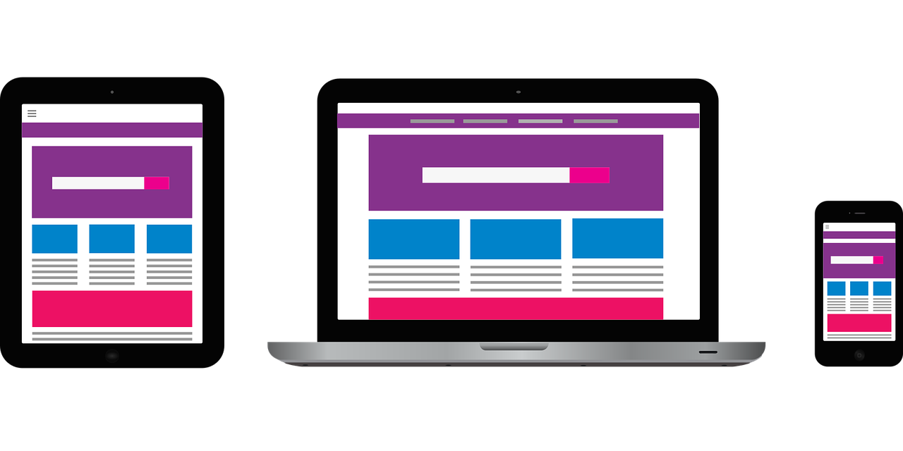
Digital Devices
1.2 Keeping ICT devices up to date
To work in the digital environment, you need a digital device. There are many different types of digital devices.
Each device has its pros and cons.
Therefore, we will discuss which device is useful for which specific activity and how we should protect it.
Source | Pixabay license

Slide 10

Personal Computer
1.2 Keeping ICT devices up to date
Description: A Personal Computer (PC), desktop or laptop, is an electronic device used for a variety of purposes, such as, browsing the Internet, writing documents, playing video games, etc.
Useful for: Advanced web research, writing long texts, writing emails, shopping online goods, e-banking.
Not useful for: Internet research or writing short texts on the move.
Source | Pixabay license

Slide 11
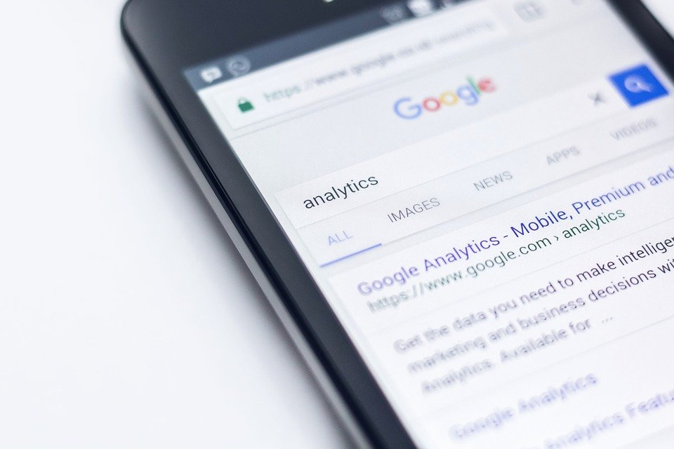
Smartphone
1.2 Keeping ICT devices up to date
Description: A smartphone is a mobile phone that can do much more than just make phone calls. For example, smartphones can connect to the Internet, and can take photos or videos. It can also be thought of as a small computer. The screen on a smartphone is a touch screen.
Useful for: Writing short messages, doing a little internet research, using social media like WhatsApp, Instagram, checking emails, e-banking, shopping online etc.
Not useful for: Writing long texts or doing extensive internet research.
Source | Pixabay license

Slide 12

Tablet
1.2 Keeping ICT devices up to date
Description: A tablet is smaller than a computer or laptop but larger than a smartphone. It has a touch screen but, unlike a laptop, no keyboard.
Useful for: Doing light search activities, downloading and reading books, playing games, watching videos, checking emails, e-banking, shopping online.
Not useful for: Writing long emails or other texts, extensive searching activities.
Source | Pixabay license

Slide 13

Security: Tips for protecting your data and devices
1.2 Keeping ICT devices up to date
Use the latest versions of an operating system, install anti-virus and firewall software and check for updates regularly.
Avoid downloading free software from unknown or untrusted websites. Only download software from known and trusted companies. Many free programs (applications) can deliver adware and spyware to a computer or mobile device.
Use a strong password:
  Long,
  A mix of characters,
  Don't use memorable keystrokes (such as qwerty), names or numbers from relatives' birthdays.

Slide 14
Unit 4
Learn your smartphone
Objectives
On completion of this Unit, you will know:
………………………..
……………..
Source | Pixabay license

Slide 15
Basic terminology
Screen
Central processing Unit (CPU) or processor
Memory (RAM)
Storage
  Internal
  External
Camera
Microphone

Slide 16
Basic terminology
Fingerprint recognition
Facial recognition

Slide 17
Basic settings
Basic settings for Android
  …………..
  ……………….
  …………
Basic settings for Iphone

Slide 18
Using the Mobile device
Navigating mobile interfaces and menus, using touchscreen and buttons
https://guidebooks.google.com/android/usetheappsonyourphone
Navigation buttons
  Home button
  Back button
  Overview button
Quick settings

Slide 19
Gestures
https://guidebooks.google.com/android/getstarted/gesturenavigation?hl=en&sjid=2735699982701396101-EU

Slide 20
Search and download apps
Android – Google Play Store
https://guidebooks.google.com/android/usetheappsonyourphone/downloadapps
Iphone – Apple’s App Store

Slide 21
Browsers
  Chrome, Firefox, ……
Gmail
E-mail clients
  Type..
Google pay

Slide 22
Google account and Google services
https://edu.gcfglobal.org/en/googleaccount

Slide 23
Check for updates

Slide 24
https://www.digitaltrends.com/mobile/guide-to-android/
https://edu.gcfglobal.org/en/androidbasics/getting-started-with-your-device/1/
https://edu.gcfglobal.org/en/androidbasics/
https://support.google.com/android/answer/12761388?sjid=2735699982701396101-EU&hl=en
https://guidebooks.google.com/android/getstarted
  https://guidebooks.google.com/android/getstarted/gesturenavigation?hl=en&sjid=2735699982701396101-EU
  https://guidebooks.google.com/android/getstarted
  https://guidebooks.google.com/get-started-with-google
  https://guidebooks.google.com/get-started-with-google/get-started/icons-on-your-phone
  https://guidebooks.google.com/get-started-with-google/get-started/how-to-get-around-on-your-phone
  https://guidebooks.google.com/online-security
  https://guidebooks.google.com/android/usetheappsonyourphone/addapaymentmethodtogoogleplay
  https://guidebooks.google.com/android/usetheappsonyourphone/protectyourgoogleplaypurchases

Slide 25
Unit 4
Online navigation
Objectives
On completion of this unit you will know how to
How to use search engines to find websites and information about them
When a website is safe and secure to visit
Source | Pixabay license

Slide 26


Devices for Searching
1.4 Online navigation
Click here for some information !
You can search for information on the Internet using any of the devices mentioned above, such as a smartphone, tablet or PC.
Once you have decided which device you want to use, there are a number of different steps you should take when searching.
  Well, the correct phrase is „searching for information on the World Wide Web“, not the Internet. See the next slide.
www

Slide 27





Step 1: Web browsers
1.4 Online navigation
To search for information on the Web, you need to open a web browser (step 1). A web browser is usually already available on your device.
Some of the most popular web browsers include
  Google Chrome
  Mozilla Firefox
  Microsoft Edge
  Apple Safari
  Opera

Slide 28
Step 2: Find the right websites
1.4 Online navigation
All the information on the Web is available on websites. So, the next step (step 2) is to connect to the appropriate website that contains the information you are looking for.
To connect to a website, you need to know its domain name, e.g., elderlymobilemoney.eu
And the next questions are:
  “Which website(s) should I visit to find the information I want?”, and
  “How can I find the domain name of this/these website(s)?”

Slide 29
Websites
1.4 Online navigation
  A search engine is a service for finding websites. It collects websites available on the Web and associates them with various tags, which are keywords related to the main category of information of the website.
  Steps:
  The user logs on via a browser to the search engine.
  Enters the keywords
  The search engine returns a list of websites related to the keywords
  The user chooses to visit one or more of the websites
To begin with, we have somehow been informed about a domain name, e..:
  read it somewhere,
  Been told by someone,
  found it on another website with related content, or
  used a search engine to find the domain name of the website.
Conclusion,
  If you already know the domain name, you may type it directly into your browser and connect to the website;
  Otherwise, use a search engine to find it.
Click

Slide 30
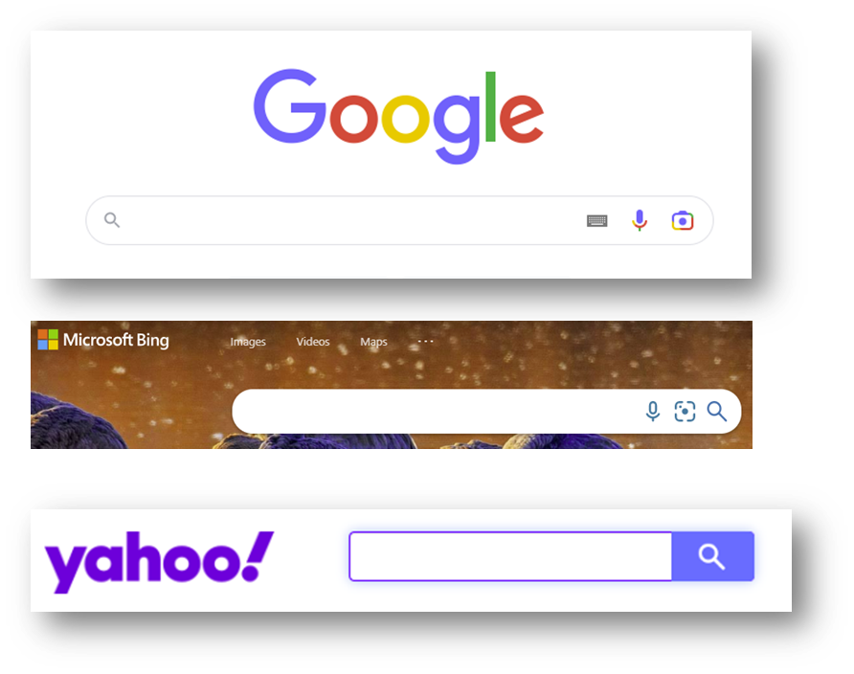
Search Engines
1.4 Online navigation
To search for information on the Internet, you need to connect, with your browser, to one of the search engines available.
Some of the most popular search engines are:
  Google.com: You can differentiate your search between information, photos or use it to navigate.
  Bing.com: The structure and functionality is usually like Google, but the search results may be different.
  Yahoo.com: Very similar to Bing.

Slide 31

How do I find the information I'm interested in?
1.4 Online navigation
Things to consider when creating a search string:
Focus on relevant keywords, especially nouns.
Targeted use of search operators:
  AND: Links two or more search terms;
  OR: The search results will include one or the other, or all of the search terms;
  Brackets [ ] : Brackets can be used to construct queries with the above search operators.

Slide 32

Activity: Finding information about "Paying online”
1.4 Online navigation
Open your browser and connect to one of the following search engines:
  Yahoo.com
  Bing.com
  Google.com
Enter your keywords: Paying online
The search results are displayed as a list of links, accompanied by a title and a paragraph, divided into several pages.
View the results on the first page, then browse through the following pages of results. Find something interesting?
Move your mouse over a link that interests you, right click, go to the “Open link in new tab” option and click on it.
A new tab will appear in your browser containing the link page. Go to that tab and read the page.
Repeat this again with other keywords.
Paying online

Slide 33
Is the Website Secure?
1.4 Online navigation
Click here for more information about the https protocol
A secure website has a link in which:
  The https protocol is used, where “s” means secure.
An original website, for example a bank website, has a link in which:
  The domain name contains its official name, or it is close to it;
  It is relatively short.
  Hypertext Transfer Protocol Secure (HTTPS) is an extension of the Hypertext Transfer Protocol (HTTP). It is used for secure communication over a computer network and is widely used on the Internet.
  The https protocol ensures that
              data is encrypted during transmission over the Internet, and cannot be read by anyone (encryption)
          the receiver is really the receiver and not someone pretending to be (authentication)
          More information is available at https://en.wikipedia.org/wiki/HTTPS

Slide 34



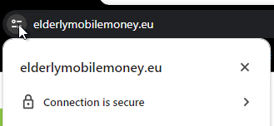
How can I check if "https" is being used?
1.4 Online navigation
The link contains https.
When a browser connects to a secure website, a padlock icon appears next to the link.
This indicates that the website is secure.

Slide 35



Unsecure websites or links
1.4 Online navigation
The link contains http, without s.
When a browser connects to an insecure website, the following will appear:
  … a “padlock with a red line” symbol, or
  … a triangle with a warning sign, and
  … the message “Not secure” appears next to the link.
These symbols and messages indicate that the website or link is not safe to visit!
!

Slide 36


Is a link safe to visit?
1.4 Online navigation
Case 1: If https is used in a link but the domain name is not close to the official name, then
  the website may be a fake clone of the original with the intention of stealing your personal information.
Case 2: If http is used in a link, instead of https, althought the domain name seems to be official, then
  the transmission of personal information over the Internet is not secure, so you should not use this website to submit any personal information.
Source | Pixabay license

Slide 37
Activity: Is the link safe to visit?
1.4 Online navigation
Decide, if the link is safe to visit:
Link: https://europa.eu/youreurope/citizens/consumers/financial-products-and-services/payments-transfers-cheques/index_en.htm
Is this link safe to visit?
Think about the reasons!

Slide 38
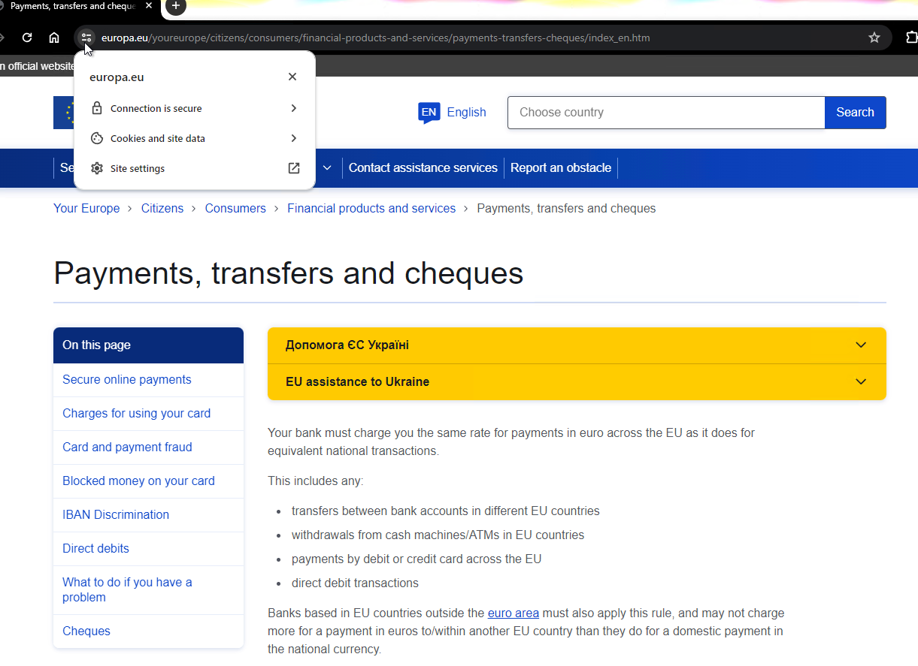

Activity: Is the link safe to visit? (2)
1.4 Online navigation
Answer: Yes, the link is safe to visit.
Reasons:
  It uses the https protocol;
  The padlock icon is displayed in the browser;
  The domain name is not an unknown name or name with random characters but is the domain name of a well-known and trusted institution.

Slide 39
Unit 3
Managing an e-mail account
Objectives
Know how to get e-mail account
Managing an email account:
  sending
  receiving
  replying to
  organizing emails
  attaching files and
  managing contacts
Source | Pixabay license

Slide 40
Using Email
1.3 Managing an e-mail account
The exchange (sending and receiving) of email is still popular for formal written communication with your professional peers.
Emails can be archived, electronically or printed, and provide proof of communication. You can also always read them to remember details.
We can say that the email communication could be:
  Informal, like the way we communicate with people we are very close to, such as our family members and friends;
  Formal, which includes a formal way of communicating with organisations and people we do not know or have a professional relationship with;
  Semi-formal, which is between informal and formal, e.g., you might may consider using this type for sending email to your doctor.

Slide 41
Email Account
1.3 Managing an e-mail account
For email-based communication you need an email account:
If you use a mobile smartphone, you probably already have a personal email account.
If you have an Internet provider, you may already have an email address.
If you don’t have an email account, it is time to get one.

Slide 42
Activity: Set up an email account
1.3 Managing an e-mail account
Case A: You do not have an email account.
Decide on which email provider you want to use to create a professional email account.
  yahoo.com; gmail.com; outlook.com, etc.
Search and find online guides on how to set up an email account with the specific provider.
  Remember to use the keyword phrase “How to create email account?”;
  Use a reputable name for your email account:
  For example, first name and surname: john.smith@gmail.com instead of besthusbund@gmail.com).
Create a secure password:
  Make it long;
  Use a mix of characters;
  Don’t use memorable keyboard paths (like qwerty) or your birthday or the names of relatives.

Slide 43
Activity: Find Your email account
1.3 Managing an e-mail account
Case B: You already have an email account.
If you have a mobile smartphone, then you already have an email account. Check the Settings of your mobile smartphone in the Users and/or Accounts sections.

Slide 44
How do I send / receive an email?
1.3 Managing an e-mail account
To send and receive email you must have access to an online email service through your browser, e.g., gmail or use:
  an email client software on your desktop/laptop, e.g., Thunderbird, Outlook;
  a mobile email app on your smartphone or tablet, e.g., Gmail app, Type App, etc.
Steps:
  Search and find on the Web how to set up the email client or app with your email account.
  Search and find on the Web how to write, send, receive, delete emails and attach files.

Slide 45
Activity: Find information on how to set up your email client with your email account
1.3 Managing an e-mail account
Remember how to do a keyword search in your browser?
Open your browser and connect to one of the following search engines:
  Yahoo.com
  Bing.com
  Google.com
Enter as keywords: how to set up Thunderbird with a Gmail account.
View the results on the first page, then browse through the next pages of results. Did you find the information you were looking for?
How to set up Thunderbird with a Gmail account?

Slide 46
Activity: Find information about setting up an email application with your email account
1.3 Managing an e-mail account
Open your browser and connect to one of the following search engines:
  Yahoo.com
  Bing.com
  Google.com
Enter as keywords: how to set up TypeApp with an email account
View the results on the first page, then browse throught the next pages of results. Did you find the information you were looking for?
How to set up TypeApp with an email account?

Slide 47
Activity: Find information on how to send an email using your email account
1.3 Managing an e-mail account
Open your browser and connect to the following search engine:
  Google.com
Enter as keywords: How to send an email with Gmail?
View the results of the first page, then, click on the option Video.
Browse the result pages and look for a video demonstration.
Repeat the same with the phrases:
  How to read an email with Gmail?
  How to attach a file to an email with Gmail?
  How to delete an email in Gmail?
How to send an email with Gmail?

Slide 48
Compose and Send an e-mail
Write (compose) an email
Send an e-mail
  https://support.google.com/mail/answer/2819488?hl=en&ref_topic=3395756&sjid=2735699982701396101-EU
  Add attachment https://support.google.com/mail/topic/7280128?hl=en&ref_topic=3394151&sjid=2735699982701396101-EU
  https://support.google.com/mail/answer/6584?hl=en&ref_topic=7280128&sjid=2735699982701396101-EU
Send an e-mail and attachments confidentially
  https://support.google.com/mail/answer/7674059?hl=en&ref_topic=3395756&sjid=2735699982701396101-EU

Slide 49
Reply to e-mail
https://support.google.com/mail/answer/6585?hl=en&ref_topic=3395756&sjid=2735699982701396101-EU

Slide 50
Read & organize emails
Read
  https://support.google.com/mail/topic/3394652?hl=en&ref_topic=3394150&sjid=2735699982701396101-EU
Open & download attachments in Gmail
  https://support.google.com/mail/topic/3394652?hl=en&ref_topic=3394150&sjid=2735699982701396101-EU
  Mark messages as read or unread
  Report spam in Gmail
  Delete or recover Gmail messages

Slide 51
  https://support.google.com/mail/?hl=en&sjid=2735699982701396101-EU#topic=3394150
  organizing emails
  managing contacts

Slide 52
Unit 4
Introduction to Online Safety, Personal Data and Privacy
Objectives
On completion of this unit, you will know:
What are the personal data?
Understand the concepts of privacy and security
What email spamming and phishing are and how to respond to them?
Criteria for deciding which links are safe to visit
What is the General Data Protection Regulation (GDPR)?
Source | Pixabay license

Slide 53
2.4 Introduction to Online Safety, Personal Data and Privacy
Online Safety
Being online exposes Internet users to online security threats. Once a user sends data over the Internet (video or voice call packets, chat, email or credit card numbers, websites) they have no control over who can access the data. Data passes through many servers, routers, and devices where any hacker, service provider or government agent can access and read it.
It is therefore of the utmost importance for Internet users to take steps to:
  Protect of their sensitive personal data;
  Use online tools and services, such as, data encryption, that ensure the privacy and security of their customers’ information when communicating with them online.

Slide 54

What is Personal Data?
2.4 Introduction to Online Safety, Personal Data and Privacy
Personal data is any information relating to aliving, identified or identifiable individual.
Various pieces of information that together can be used to identify a specific individual, are also personal data.
Source | Pixabay license

Slide 55
Examples of Personal Data
2.4 Introduction to Online Safety, Personal Data and Privacy
Examples of personal data are as follows:
  Name and surname;
  Home address;
  Email address such as
    name.surname@company.com;
  Location data, such as the location data function on a mobile phone);
Identification card number;
Internet Protocol (IP) address;
A cookie ID;
Your phone’s advertising ID;
Data held by a hospital or doctor, which may be a symbol that uniquely identifies a person.

Slide 56
What Personal Data is considered sensitive?
2.4 Introduction to Online Safety, Personal Data and Privacy
Sensitive personal data
The following personal data are considered ‘sensitive’ and are subject to specific processing conditions:
  Personal data revealing racial or ethnic origin, political opinions, religious or philosophical beliefs;
  Photos, videos;
  Trade union membership;
  Genetic data, biometric data processed solely for the purpose of identification of a human being;
  Data concerning health;
  Data concerning the sex life or sexual orientation of a person.

Slide 57
Sensitive financial data
Account and password for an e-banking system
The CCV, date of expiry of a credit or debit card
The PIN code of your mobile phone

Slide 58

What is Privacy?
2.4 Introduction to Online Safety, Personal Data and Privacy
Privacy is about:
  How we control our personal data, and
  how they are used by the third parties who have received it, in a secure manner.
Think about the privacy policies you’re asked to read and agree to when you visit a website or download a new smartphone app.
Source | Pixabay license

Slide 59

What is Security?
2.4 Introduction to Online Safety, Personal Data and Privacy
Security is about how to secure, protect your personal data from unauthorized access, whether on your device, on the remote web server or during communication over the Internet.
We use security controls at a technical level to limit who can access the information. These controls are in place:
  On our devices (PC, tablet, mobile phone), i.e., applying operating system and software updates, using strong passwords;
  On the remote web server, i.e., use strong passwords;
  When submitting information over the Internet, i.e., use the secure https protocol.
Source | Pixabay license

Slide 60
Security and Privacy
2.4 Introduction to Online Safety, Personal Data and Privacy
Security is about protecting data, while privacy is about protecting the identity of users.
  For example, hospital and clinic staff use secure systems to communicate with patients about their health, rather than sending information via personal email accounts. This type of communication is an example of security.
On the other hand, privacy policy and provision might limit access to patient’s health records to certain hospital staff members, such as doctors, nurses, and medical assistants.
It is possible to have security without privacy.
  Indeed, for example, personal data can be securely transmitted and stored on a website securely, but the website can still sell it.
It not possible to have privacy without security.
  Indeed, for example, a hacker could gain unauthorized access to your device, web server or transmitted data and steal your personal data

Slide 61

Spam and phishing
2.4 Introduction to Online Safety, Personal Data and Privacy
  You may have received annoying emails from an unknown sender, usually of a commercial nature.
  In addition, emails can be dangerous because they may contain links that lead to phishing websites or websites that host malware or contain malware as an attachment.
  So, do not open any attached files or click on any links. And never, give out your personal data, e-banking account details (any username, password), or details of your credit/debit card, such as the expiry date and the 3-digits CCV.
  This, is called phishing: criminals send official-looking emails to trick you into revealing details that can be used for identity theft.

Slide 62

How do I identify spam?
2.4 Introduction to Online Safety, Personal Data and Privacy
  An email is suspicious if it contains one or more of the following
  Grammar and spelling errors
  Mails in a foreign language
  The sender's name is missing
  Urgent need for action - especially in combination with a threat
  Prompt to enter personal data (e.g., PIN or TAN)
  Request to open a file
  Never received any emails from the bank or a customer
Source | Pixabay license
Notes:
https://pixabay.com/de/photos/sicherheit-alarm-monitor-cyber-5043368/

Slide 63
What to do or not to do?
2.4 Introduction to Online Safety, Personal Data and Privacy
  Avoid opening attachments unless they have been scanned by an anti-virus programme.
  Remember to log out, especially if you are using a shared public computer.
  Delete all emails from unknown people.
  Never reply to spam!
  Do not click on links in spam emails.

Slide 64
Activity: Is the link safe to visit?
2.4 Introduction to Online Safety, Personal Data and Privacy
Decide, if the link is safe to visit:
Suppose you receive an email from a bank asking you to click on a link like the one below, and submit personal data, such as username, passwords, and credit card details.
  http://url5423.eka.de/ls/click?upn=V1OaWNMSPs2Lb0JqHpnyTLRlk2703ToIFpo2vd2MKt5gB6dYAUvw1B-2FnC6T5iVsCdbcug7l6pkTad-2FBfACSlC-2BKw-3D-3DhmuAs-OaWNMSPs2Lb0JqHpn-asDvdva
Do not hurry, think twice, and decide if this link is safe to visit.
Think about the reasons.

Slide 65
Activity: Is the link safe to visit? (2)
2.4 Introduction to Online Safety, Personal Data and Privacy
The answer. This link is not secure for a number of reasons:
  It uses http instead of https.
  The domain name is not related to the official name of the bank.
  The link is suspiciously long.
  The domain name of the link is different from the domain name of the sender's email address.
  A real bank will never ask for usernames, passwords or credit card details.

Slide 66

What is GDPR and who needs to comply with it?
2.4 Introduction to Online Safety, Personal Data and Privacy
What is GDPR?
The General Data Protection Regulation is a European Union law that was implemented on May 25, 2018, that requires organizations to protect personal data and uphold the privacy rights of everyone in EU territory.
Who needs to comply with the GDPR?
Any organization that processes personal data of individuals in the EU must comply with the GDPR.
“Processing” is a broad term that covers almost about anything you can do with data: collecting, storing, transferring, analysing, etc.
“Personal data” is any information that relates to an individual, such as a name, email address, IP address, eye color, political beliefs, and etc.
Even if an organisation has no connection to the EU itself, but processes personal data of people in the EU (for example, through tracking on its website), it still needs to comply with the GDPR. The GDPR is also not limited to for-profit companies.
Source | Pixabay license

Slide 67

2
Digital Skills for Improving the Agricultural Business
Check your knowledge!

Slide 68
1. Which of the following passwords is stronger?
Only one answer is correct!
A. John1234
B. John1990
C. John051190
D. J0Hn!2nO

Slide 69
2. Which of the following is personal data
Only one answer is correct!
A. IP address
B. E-mail address
C. All of them
D. Cookies IDs in the browser

Slide 70
3. The “s” at the end of the https means
Only one answer is correct!
A. Simple
B. Secure
C. Super
D. Sensitive

Slide 71
4. When the lock symbol appears in the browser it means that the browser has locked the page because it is not secure.
Yes, the statement is correct.
No, the statement is wrong.

Slide 72
5. Which of the following is NOT sensitive personal data
Only one answer is correct!
A. Photos
B. Home address
C. Health related data
D. Political opinions

Slide 73
6. Can the sender be an indicator of whether an email is spam?
Yes
No

Slide 74
7. What should you never do if you receive a supposed spam-mail?
Only one answer is correct!
A. Delete the e-mail
B. Check the sender
C. Check the reference line
D. Reply and ask if it is a spam-mail

Slide 75
Suggestions for further reading (in English)
DigComp 2.2: The Digital Competence Framework for Citizens, Joint Research Centre (of EU) Publications. Link
E-mail spam, Wikipedia. Link
Get started with Gmail for Google Workspace - What you can do with Gmail, Google Workspace Learning Center. Link
Business Email, HP Life. Link
Working with Computers and Devices, LinkedIn Learning. Link

Slide 76
Congratulations!
You have completed this topic!
Funded by the European Union. Views and opinions expressed are however those of the author(s) only and do not necessarily reflect those of the European Union or the European Education and Culture Executive Agency (EACEA). Neither the European Union nor EACEA can be held responsible for them. Project number: 2023-1-RO01-KA220-ADU-000157797

