Slide 1
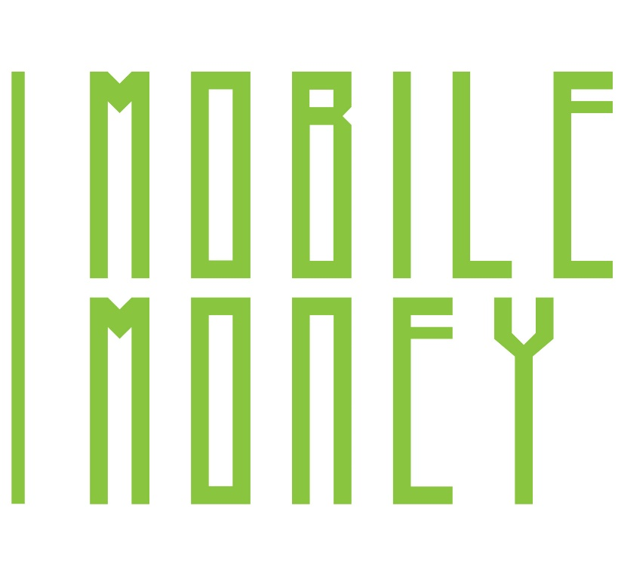
1
2
Module 2 Security & Prevention
3
4
5
6
Funded by the European Union. Views and opinions expressed are however those of the author(s) only and do not necessarily reflect those of the European Union or the European Education and Culture Executive Agency (EACEA). Neither the European Union nor EACEA can be held responsible for them. Project number: 2023-1-RO01-KA220-ADU-000157797

Slide 2
Asociatia Four Change, Romania
Partners
Zavod IZRIIS, Slovenia
E-SENIORS: INITIATION DES SENIORS AUXNTIC ASSOCIATION, France
GUnet, Greece
Asociatia Niciodata Singur – Prietenii Varstnicilor, Romania
Fundació Gesmed Fundació de la Comunitat Valenciana, Spain

Slide 3
Modules
1. Basic digital literacy skills
2. Security & Prevention
3. Managing a bank account online
4.. Online solutions for receiving and sending money
5. Using a Credit Card to Purchase from Online Goods and Services
6. Processing online payments for taxes and bills

Slide 4
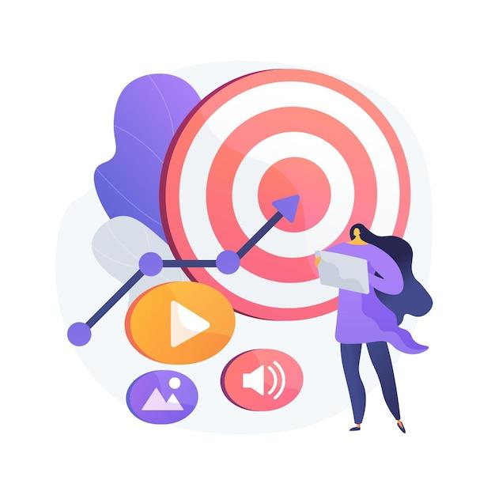
Unit 1 Introduction
Objectives
On completion of this unit, you will be informed about
The learning objectives and training content of this module
The training methodology used and the duration of this module
Image by vectorjuice on Freepik

Slide 5
Competences
After completing this module, you will:
Acquire the skills necessary to use mobile money solutions safely and confidently:
Understand what online security is.
Understand what is personal and sensitive data.
Understand the concepts of privacy and security.
Know what email spamming and phishing are and how to respond to them
Know the criteria for deciding which links are safe to visit
Know your online rights
Understand what GDPR is and why we need it
Know how to apply security and preventative measures

Slide 6
Training content
Introduction of the session: duration, objectives, content and methodology
Online safety, personal data, sensitive data, privacy and security
Recognizing spam and phishing and what to do about them
Knowing your online rights, the example of GDPR
Protecting yourself online
Quiz: check your knowledge

Slide 7
Training methodology and duration
Methodology
Active and participative
Face to face training:
Dialogue ✔ Role playing ✔ Teamwork
Online training:
Selected or own produced videos
Practical implementation of some tips agreed in the classroom
Some collaborative work
Simulation
Duration: 4 hours
Face to face session:2 hours
Online training: 2 hours

Slide 8
Unit 2 Online Safety and Personal Data
Objectives
On completion of this unit, you will know:
What is online safety
What is personal data and examples of them
Image by vectorjuice on Freepik

Slide 9
2.2 Online Safety and Personal Data
Online Safety
Being online exposes Internet users to online security threats. Once a user sends data over the Internet (video or voice call packets, chat, email or credit card numbers, websites) they have no control over who can access the data. Data passes through many servers, routers, and devices where any hacker, service provider or government agent can access and read it.
It is therefore of the utmost importance for Internet users to take steps to:
Protect of their sensitive personal data;
Use online tools and services, such as, data encryption, that ensure the privacy and security of their customers’ information when communicating with them online.

Slide 10
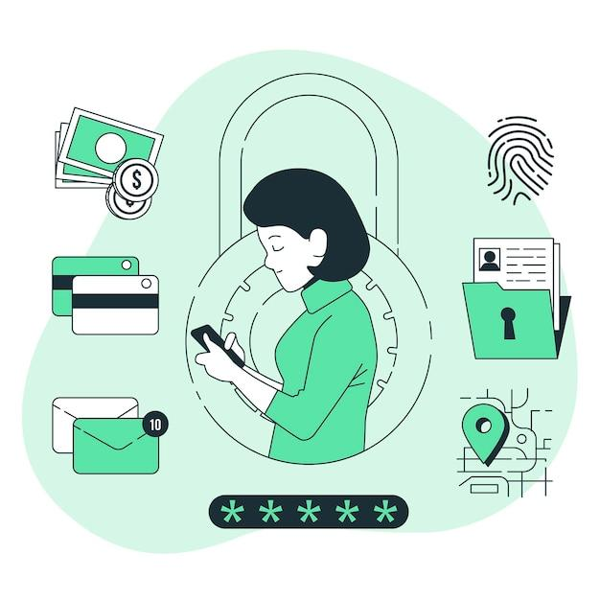
What is Personal Data?
2.2 Online Safety and Personal Data
Personal data is any information relating to a living, identified or identifiable individual.
Various pieces of information that together can be used to identify a specific individual, are also personal data.
Image by storyset on Freepik

Slide 11
Examples of Personal Data
2.2 Online Safety and Personal Data
Examples of personal data are as follows:
Name and surname;
Home address;
Email address such as
name.surname@company.com;
Location data, such as the location data function on a mobile phone);
Identification card number;
Internet Protocol (IP) address;
A cookie ID;
Your phone’s advertising ID;
Data held by a hospital or doctor, which may be a symbol that uniquely identifies a person.

Slide 12
Unit 3
Sensitive data, privacy and security
Objectives
On completion you will know:
What personal data is considered sensitive.
What is sensitive personal and financial data.
Understand the concepts of privacy and security
What is online privacy and how to be secure online
Image by vectorjuice on Freepik

Slide 13
What Personal Data is considered sensitive?
2.2 Sensitive data, privacy and security
Sensitive personal data
The following personal data are considered ‘sensitive’ and are subject to specific processing conditions:
Personal data revealing racial or ethnic origin, political opinions, religious or philosophical beliefs;
Photos, videos;
Trade union membership;
Genetic data, biometric data processed solely for the purpose of identification of a human being;
Data concerning health;
Data concerning the sex life or sexual orientation of a person.

Slide 14
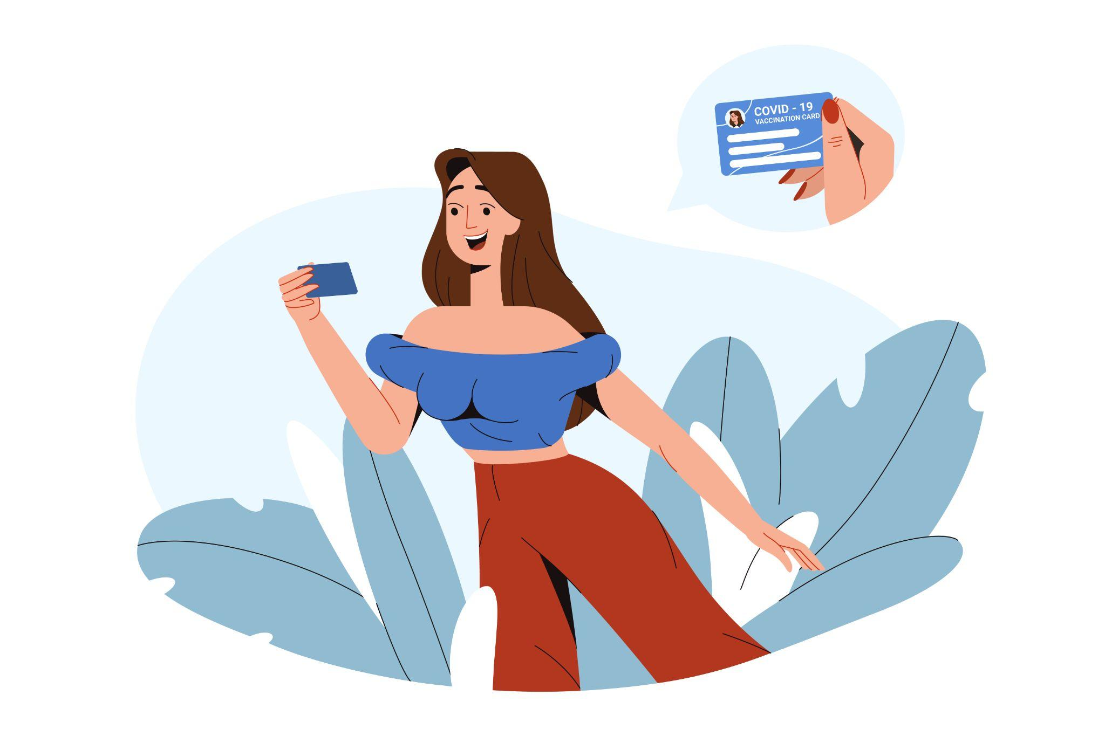
Sensitive financial data
2.2 Sensitive data, privacy and security
Account and password for an e-banking system
The CCV, date of expiry of a credit or debit card
The PIN code of your mobile phone
Examples and exercise
Image by redgreystock on Freepik

Slide 15
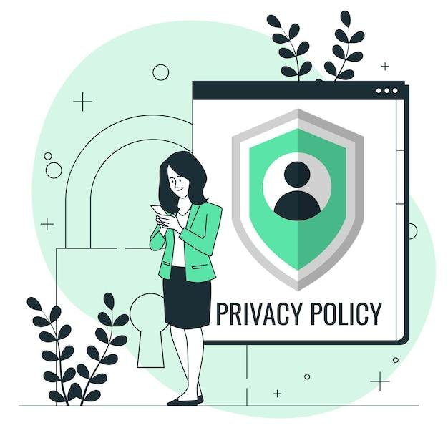
What is Privacy?
2.2 Sensitive data, privacy and security
Privacy is about:
How we control our personal data, and
how they are used by the third parties who have received it, in a secure manner.
Think about the privacy policies you’re asked to read and agree to when you visit a website or download a new smartphone app.
Image by storyset on Freepik

Slide 16
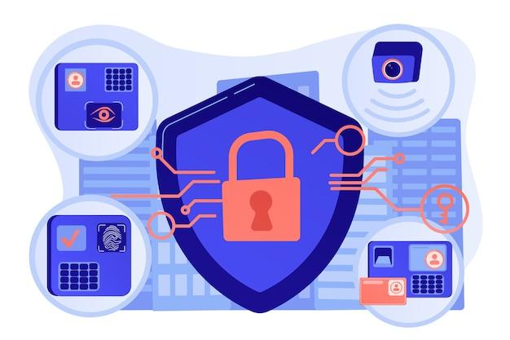
What is Security?
2.2 Sensitive data, privacy and security
Security is about how to secure, protect your personal data from unauthorized access, whether on your device, on the remote web server or during communication over the Internet.
We use security controls at a technical level to limit who can access the information. These controls are in place:
On our devices (PC, tablet, mobile phone), i.e., applying operating system and software updates, using strong passwords;
On the remote web server, i.e., use strong passwords;
When submitting information over the Internet, i.e., use the secure https protocol.
Image by vectorjuice on Freepik

Slide 17
Security and Privacy
2.2 Sensitive data, privacy and security
Security is about protecting data, while privacy is about protecting the identity of users.
For example, hospital and clinic staff use secure systems to communicate with patients about their health, rather than sending information via personal email accounts. This type of communication is an example of security.
On the other hand, privacy policy and provision might limit access to patient’s health records to certain hospital staff members, such as doctors, nurses, and medical assistants.
It is possible to have security without privacy.
Indeed, for example, personal data can be securely transmitted and stored on a website securely, but the website can still sell it.
It not possible to have privacy without security.
Indeed, for example, a hacker could gain unauthorized access to your device, web server or transmitted data and steal your personal data.

Slide 18
Unit 3
Spam and phishing
Objectives
On completion you will know:
What is spam and phishing
How to identifying spam
When a link is safe to visit
Image by vectorjuice on Freepik

Slide 19
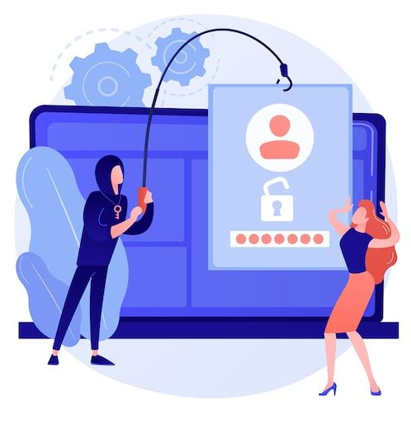
What is spam and phishing
2.3 Spam and phishing
You may have received annoying emails from an unknown sender, usually of a commercial nature.
In addition, emails can be dangerous because they may contain links that lead to phishing websites or websites that host malware or contain malware as an attachment.
So, do not open any attached files or click on any links. And never, give out your personal data, e-banking account details (any username, password), or details of your credit/debit card, such as the expiry date and the 3-digits CCV.
This, is called phishing: criminals send official-looking emails to trick you into revealing details that can be used for identity theft.
Image by vectorjuice on Freepik

Slide 20
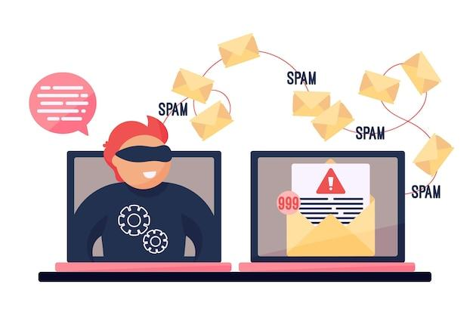
How do I identify spam?
2.3 Spam and phishing
An email is suspicious if it contains one or more of the following
Grammar and spelling errors
Mails in a foreign language
The sender's name is missing
Urgent need for action - especially in combination with a threat
Prompt to enter personal data (e.g., PIN or TAN)
Request to open a file
Never received any emails from the bank or a customer
Image by freepik
Notes:
https://pixabay.com/de/photos/sicherheit-alarm-monitor-cyber-5043368/

Slide 21
What to do or not to do?
2.3 Spam and phishing
Avoid opening attachments unless they have been scanned by an anti-virus programme.
Remember to log out, especially if you are using a shared public computer.
Delete all emails from unknown people.
Never reply to spam!
Do not click on links in spam emails.

Slide 22
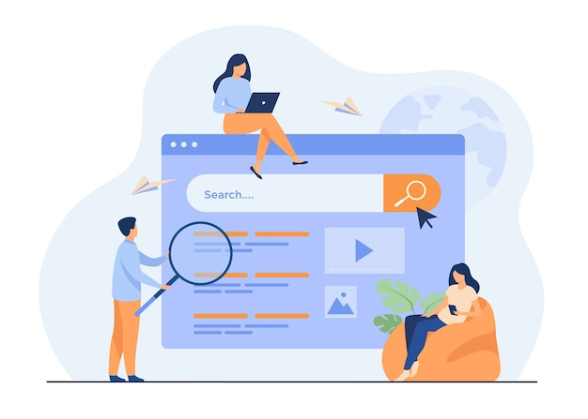
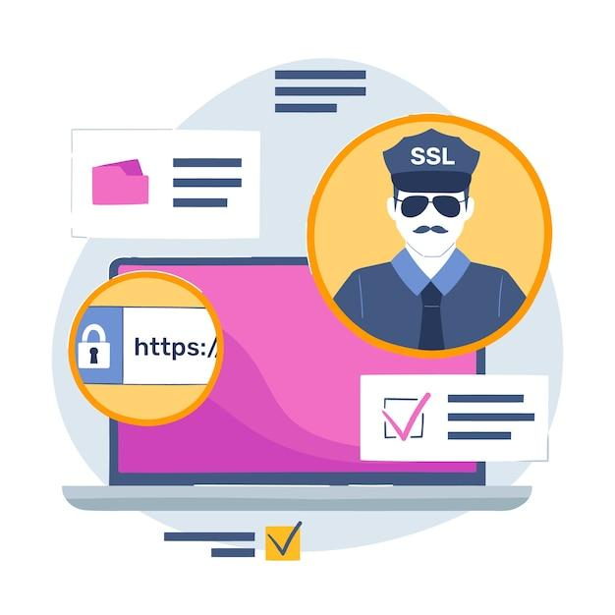
Activity: Is the link safe to visit?
2.3 Spam and phishing
Decide, if the link is safe to visit:
Suppose you receive an email from a bank asking you to click on a link like the one below, and submit personal data, such as username, passwords, and credit card details.
http://url5423.eka.de/ls/click?upn=V1OaWNMSPs2Lb0JqHpnyTLRlk2703ToIFpo2vd2MKt5gB6dYAUvw1B-2FnC6T5iVsCdbcug7l6pkTad-2FBfACSlC-2BKw-3D-3DhmuAs-OaWNMSPs2Lb0JqHpn-asDvdva
Do not hurry, think twice, and decide if this link is safe to visit.
Think about the reasons.
Image by pch.vector on Freepik
Image by freepik

Slide 23
Activity: Is the link safe to visit? (2)
2.3 Spam and phishing
The answer. This link is not secure for a number of reasons:
It uses http instead of https.
The domain name is not related to the official name of the bank.
The link is suspiciously long.
The domain name of the link is different from the domain name of the sender's email address.
A real bank will never ask for usernames, passwords or credit card details.
Image by pch.vector on Freepik

Slide 24
Unit 4
What are your online rights
Objectives
On completion you will know:
What are your digital rights and obligations
What is GDPR and why do we need it
Image by vectorjuice on Freepik

Slide 25
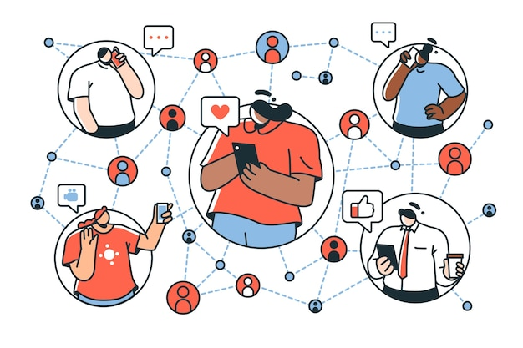
We are digital citizens
2.4 Online rights
Digital citizens can enjoy rights of privacy, security, access and inclusion, freedom of expression and more.
However, with those rights come certain responsibilities, such as ethics and empathy and other responsibilities to ensure a safe and responsible digital environment for all.
We are all now connected by the Internet, like neurons in a giant brain.
Stephen Hawking
Image by storyset on Freepik

Slide 26
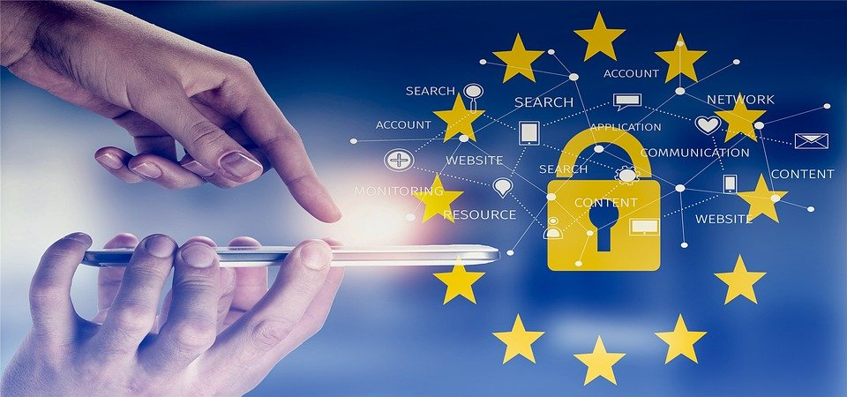
What is GDPR and who needs to comply with it?
2.4 Online rights
What is GDPR?
The General Data Protection Regulation is a European Union law that was implemented on May 25, 2018, and requires organizations to safeguard personal data and uphold the privacy rights of anyone in EU territory.
Who must comply with GDPR?
Any organization that processes personal data of individuals in the EU must comply with the GDPR.
“Processing” is a broad term that covers just about anything you can do with data: collection, storage, transmission, analysis, etc.
“Personal data” is any information that relates to a person, such as names, email addresses, IP addresses, eye color, political beliefs, and etc.
Source | Pixabay license

Slide 27
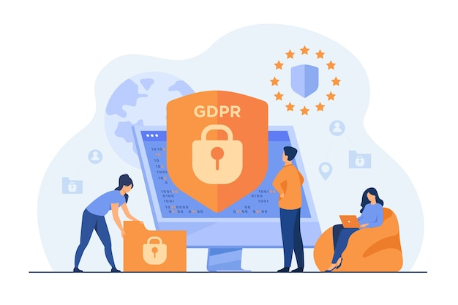
Who needs to comply with it?
2.4 Online rights
Even if an organisation has no connection to the EU itself but processes personal data of people in the EU (for example, through tracking on its website), it still needs to comply with the GDPR.
The GDPR is not limited to for-profit companies.
What is GDPR?
The General Data Protection Regulation is a European Union law that was implemented on May 25, 2018, that requires organizations to protect personal data and uphold the privacy rights of everyone in EU territory.
Who needs to comply with the GDPR?
Any organization that processes personal data of individuals in the EU must comply with the GDPR.
“Processing” is a broad term that covers almost about anything you can do with data: collecting, storing, transferring, analysing, etc.
“Personal data” is any information that relates to an individual, such as a name, email address, IP address, eye color, political beliefs, and etc.
Image by pch.vector on Freepik

Slide 28
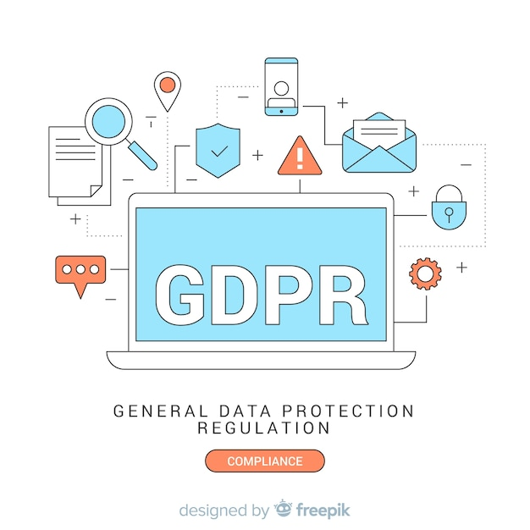
Is GDPR something positive?
2.4 Online rights
GDPR is there to protect your rights as a user.
It's good to know what you're consenting to and what cookies mean.
Managing vulnerable customers well is not only something the law expects, but also the right thing to do socially and a smart business move.
What is GDPR?
The General Data Protection Regulation is a European Union law that was implemented on May 25, 2018, that requires organizations to protect personal data and uphold the privacy rights of everyone in EU territory.
Who needs to comply with the GDPR?
Any organization that processes personal data of individuals in the EU must comply with the GDPR.
“Processing” is a broad term that covers almost about anything you can do with data: collecting, storing, transferring, analysing, etc.
“Personal data” is any information that relates to an individual, such as a name, email address, IP address, eye color, political beliefs, and etc.
Image on Freepik

Slide 29
Unit 5
How you can protect yourself in advance
Objectives
On completion you will know:
How you can protect yourself by identifying safe sites, links, cookies, consents
Image by vectorjuice on Freepik

Slide 30
Some examples for you to be safe (1/3)
2.5 How you can protect yourself in advance
Avoid paying anyone through wire transfer, Western Union, money order, or gift cards. Scammers often ask for these types of payments since they do not leave a traceable paper trail.
Never share your passwords with anyone online. Only with the trusted person like a daily member.
Be skeptical of anything urgent. Scammers often want you to act before you have time to think critically about the situation. Remember to pause and perhaps walk away from the computer instead of panicking if you think something is suspicious and you’re not sure how to proceed.
Immediately click the X or No to close any websites or pop-ups about viruses or sweepstakes.

Slide 31
Some examples for you to be safe (2/3)
2.5 How you can protect yourself in advance
Call a loved one or search online for advice (e.g., typing “We need support urgently..”
Check in Google to see if other people have reported such scams.
Ensure that websites have https:// listed in front of them. The “s” indicates that the site is secure. The name should also have a little lock next to it.
Be wary of anything that seems too good to be true.
Consider turning on multi-factor authentication. This requires you to either enter a code (sent via text or email) or use an app to log in to some of your accounts, including social media or banking portals. This can prevent hackers from signing in.

Slide 32
Some examples for you to be safe (3/3)
2.5 How you can protect yourself in advance
More precautions can be taken to avoid scams.
No one needs to be fearful of continuing to use the internet, so long as they are equipped with the knowledge of how to use it safely.
Find a safe space in your community or social circle where you can feel comfortable discussing these issues without fear of being judged.
If a scam has already taken place, here are some actionable steps that you can take:
Call your bank. They can freeze your account so that no one can access your funds and also issue you a new debit card. If money has already been stolen, you can see if the bank can void those transactions and return your funds.
Consider filing a police report.

Slide 33
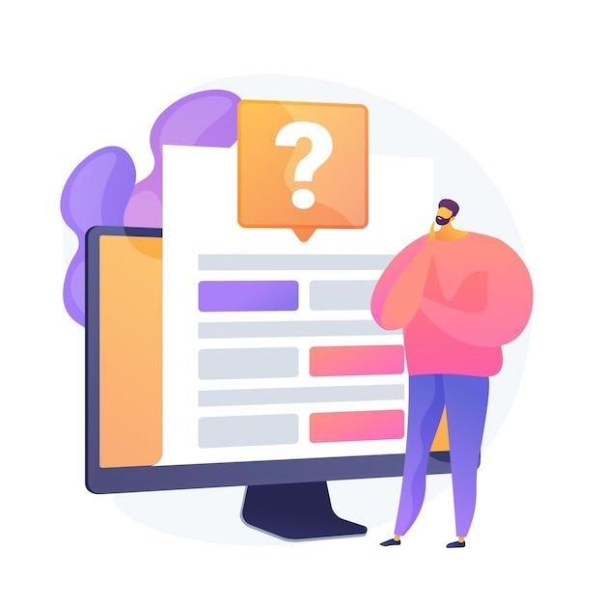
Check your knowledge!
Image by vectorjuice on Freepik

Slide 34
1. Which of the following passwords is stronger?
Only one answer is correct!
A. John1234
B. John1990
C. John051190
D. J0Hn!2nO
Notes:
The correct answer is D.

Slide 35
2. Which of the following is personal data
Only one answer is correct!
A. IP address
B. E-mail address
C. All of them
D. Cookies IDs in the browser
Notes:
The correct answer is C.

Slide 36
1.9 Check your knowledge!
3. When the lock symbol appears in the browser it means that the browser has locked the page because it is not secure.
Yes, the statement is correct.
No, the statement is wrong.
Notes:
The correct answer is No.

Slide 37
4. Which of the following is NOT sensitive personal data
Only one answer is correct!
A. Photos
B. Home address
C. Health related data
D. Political opinions
Notes:
The correct answer is B

Slide 38
5. Can the sender be an indicator of whether an email is spam?
Yes
No
Notes:
The correct answer is Yes

Slide 39
6. What should you never do if you receive a supposed spam-mail?
Only one answer is correct!
A. Delete the e-mail
B. Check the sender
C. Check the reference line
D. Reply and ask if it is a spam-mail
Notes:
The correct answer is D.

Slide 40
Congratulations! You have completed this topic!
Funded by the European Union. Views and opinions expressed are however those of the author(s) only and do not necessarily reflect those of the European Union or the European Education and Culture Executive Agency (EACEA). Neither the European Union nor EACEA can be held responsible for them. Project number: 2023-1-RO01-KA220-ADU-000157797

