Slide 1
1
2
Module 5 Using a credit card to purchase from online goods and services
3
4
5
6
Funded by the European Union. Views and opinions expressed are however those of the author(s) only and do not necessarily reflect those of the European Union or the European Education and Culture Executive Agency (EACEA). Neither the European Union nor EACEA can be held responsible for them. Project number: 2023-1-RO01-KA220-ADU-000157797

Slide 2
Asociatia Four Change, Romania
Partners
Zavod IZRIIS, Slovenia
E-SENIORS: INITIATION DES SENIORS AUX NTIC ASSOCIATION, France
GUnet, Greece
Asociatia Niciodata Singur – Prietenii Varstnicilor, Romania
Fundació Gesmed Fundació de la Comunitat Valenciana, Spain

Slide 3
Modules
1. Basic digital literacy skills
2. Security & Prevention
3. Managing a bank account online
4.. Online solutions for receiving and sending money
5. Using a Credit Card to Purchase from Online Goods and Services
6. Processing online payments for taxes and bills

Slide 4
Unit 1 Introduction
Objectives
On completion of this unit, you will be informed about
The learning objectives and training content of this module
The training methodology used and the duration of this module
Image by vectorjuice on Freepik

Slide 5
Competences
After completing this module, you will:
Acquire the following skills to use mobile money solutions safely and with confidence:
The ability to perform online transactions securely, using protective measures, website security verification, and responsible management of card data
The knowledge to easily navigate in e-shops
The proficiency in online shopping techniques and tools
Logistical skills
Marketing and merchandising insights
Communication with customer support services

Slide 6
Training content Units
Introduction: duration, objectives, content and methodology, competences
Structure and navigation of e-shop websites
Online shopping accounts – create, manage and payment with credit cards
Common online payment methods
Risk prevention skills for safe online shopping
Marketing and merchandising insights
Understanding shipping goods & tracking orders
How to communicate with customer service
Quizzes

Slide 7
Training methodology and duration
Methodology
Active and participative
Face to face training:
Dialogue ✔ Role playing or Stimulation ✔ Teamwork
Online training:
Selected videos
Practical implementation of the tips agreed in the classroom
Some collaborative work
Simulation
Duration: 4 hours (indicative)
Face to face session:2 hours
Online training: 2 hours

Slide 8
Unit 2 Structure and navigation of e-shop websites
Objectives
On completion of this unit, you will be able:
To understand and become familiar with the structure of e-shop webpage
To navigate in e-shops
Image by vectorjuice on Freepik

Slide 9
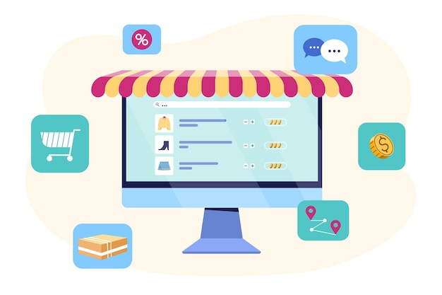
Structure of e-shop websites
Most e-commerce (e-shop) websites have a simple structure:
Homepage: This is the starting point. It usually features promotions, popular products, and categories.
Menu: It contains links to different product categories.
Product Pages: These provide details about individual items, including pictures, descriptions, prices, and options to add items to your shopping cart.
Image by redgreystock on Freepik

Slide 10
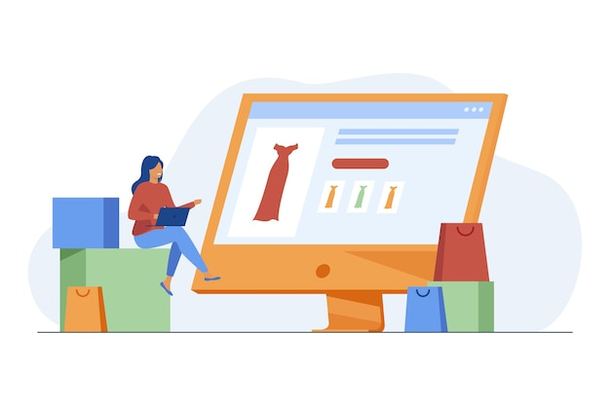
Navigating e-shop websites
Steps for navigation:
Identify the menu: Look for the menu bar with categories.
Explore categories: Click on a category to see sub-categories.
Product browsing: Within each category, scroll through the products or use search and filtering options for a more targeted search.
Select a category: On the website's menu, choose a main category.
Use sub-categories: Within the main category, you’ll often find sub-categories. Click on these to narrow down your search.
Explore products: The sub-category will show a list of products. You can scroll through these to find what you’re looking for.
Image by pchvector on Freepik

Slide 11
Unit 3 Online shopping accounts – create, manage and payment with credit cards
Objectives
On completion of this unit, you will be able:
to create an account on an e-shop platform
to login and manage the online shopping account
Using a Credit Card for Online Purchases
Image by vectorjuice on Freepik

Slide 12
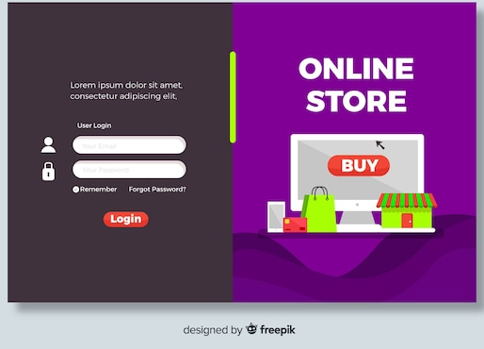
Creating an account
For creating an account, you have to:
Sign Up: Look for a "Sign Up" or "Create Account" button on the website.
Click on it to start the registration process.
Fill in Details: Enter your information, such as name, email address, and password. Some websites may require additional details like phone number and address.
Set a Strong Password: Use a combination of letters, numbers, and symbols for security.
Image from Freepik

Slide 13
Managing the account
For managing an account, you have to:
Logging In: Use your email and password to log in to the website.
Profile Settings: Within your account, you can update your personal details, such as shipping address, phone number, and preferred payment method.
Image by studiogstock on Freepik

Slide 14
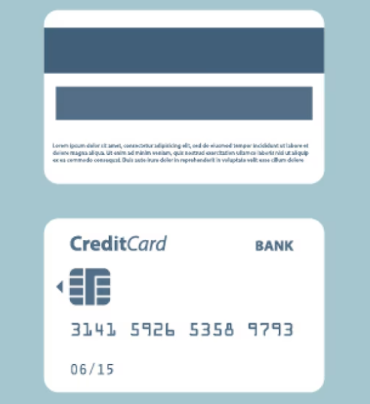
Using a Credit Card for Online Purchases
Shopping online is easy and convenient! Follow these simple steps to use your credit card safely.
Where to Enter Credit Card Details
When you are ready to pay, you will be asked to enter your credit card information:
Card Number: 16-digit number on the front of your card.
Expiry Date: The month and year your card expires (MM/YY).
CVV (Security Code): 3-digit number on the back of your card.
Never sharing credit card details over the phone or email.
Image by ikatod on Freepik

Slide 15
Reviewing the Total Amount
Before you confirm your purchase with your credit card, always check:
The price of the item(s).
Any additional charges like taxes or shipping fees.
The final total amount before clicking "Place Order" or "Confirm Purchase.„
Check Your Statements Regularly
Review your credit card statements for any suspicious charges.
Report any unauthorized transactions to your bank immediately.

Slide 16
Unit 4 Common online payment methods
Objectives
On completion of this unit, you will be able to:
Understand different payment options – Learn about various online payment methods, including credit/debit cards, PayPal, digital wallets, and more.
Learn how to use each method – Gain confidence in entering payment details, using secure checkout options, and managing payments safely.
Practice safe online payments – Recognize secure websites, avoid scams, and protect personal financial information while shopping online.
Image by vectorjuice on Freepik

Slide 17
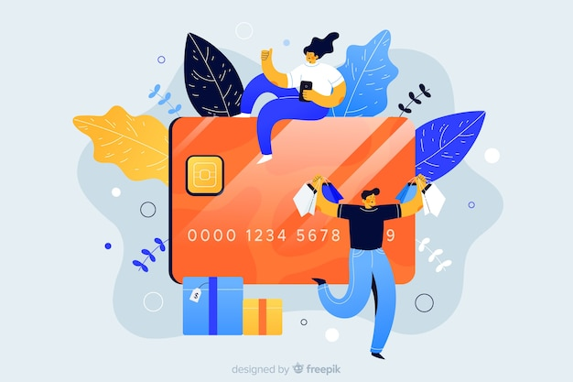
CREDIT AND DEBIT CARDS
How They Work: Enter your card number, expiration date, and security code (CVV) during checkout. Many websites allow you to save card details for future use.
Security Features: Most credit cards offer fraud protection. Look for websites that use SSL (Secure Socket Layer) encryption (indicated by "https" in the URL) to ensure your card details are transmitted securely.
Image by pickysuperstar on Freepik

Slide 18
PayPal
How It Works: PayPal acts as a trader between your bank or card and the seller. You only need to enter your PayPal login and password to make a payment.
Security Features: PayPal keeps your card and bank information secure by not sharing them with sellers. It also offers purchase protection, which can refund you if there’s an issue with your order.
Image by vectorjuice on Freepik

Slide 19
Digital Wallets (e.g., Apple Pay, Google Pay)
How They Work: Store your card information in a digital wallet on your smartphone. During checkout, you can use the wallet to pay with a single tap.
Security Features: Digital wallets use tokenization (replacing card details with a unique identifier) and biometric authentication (fingerprint, facial recognition) to secure transactions.
Image by Freepik

Slide 20
Other ways of payments
Bank Transfers
Some websites allow you to pay directly from your bank account.
You may need to enter your online banking details to complete the purchase.
Only use this on trusted websites.
Buy Now, Pay Later (Afterpay, Klarna)
Lets you buy something now and pay in small amounts over time.
You may need to sign up and link your card or bank account.
Be sure to pay on time to avoid extra charges.
Gift Cards & Store Credit
Some websites let you pay with a gift card or store credit.
Enter the gift card number and PIN at checkout.

Slide 21
Latest trend: Payment via POS at Easybox
How to Pay: At the Easybox, use your debit or credit card to make a payment directly at the Point of Sale (POS) terminal. Simply insert, swipe, or tap your card, and follow the prompts on the screen.
Confirm Payment: After entering your payment details, the system will confirm your transaction with a receipt. Make sure to keep the receipt as proof of your payment.
Image by Freepik

Slide 22
Unit 5 Risk prevention skills for safe online shopping
Objectives
On completion of this unit, you will be able to:
Recognize and avoid scams – Learn how to identify fake websites, phishing emails, and fraudulent sellers to prevent falling for scams.
Protect personal and payment information – Understand safe online payment practices, the importance of strong passwords, and when to share or avoid sharing personal details.
Verify website security and purchase safely – Learn to check for secure websites (https://, padlock symbol), read reviews, and use trusted payment methods for a safe shopping experience.
Image by vectorjuice on Freepik

Slide 23
Recognize and avoid scams
✅ Check Website Legitimacy – Look for “https://” and a padlock in the web address. Avoid unknown sites with poor design or too-good-to-be-true deals. ✅ Beware of Phishing Emails & Calls – Never click on suspicious links in emails or text messages asking for personal details. "Unsubscribe„ from unwanted newsletters. ✅ Avoid Fake Sellers – Read product reviews and check seller ratings before making a purchase.
✅Use an alias email for shopping – Consider using a separate email address solely for online shopping. This helps keep your primary email private and reduces the risk of phishing attacks.
Image by pikisuperstar on Freepik

Slide 24
Protect personal and payment information
✅ Use Strong Passwords – Create unique passwords with a mix of letters, numbers, and symbols. Avoid using personal details like birth dates. ✅ Never Share Credit Card Details – Legitimate companies will never ask for card details via phone, email, or text. ✅ Enable Two-Step Verification – Add an extra layer of security by using a code sent to your phone when logging in.
Image by vectorjuice on Freepik

Slide 25
Verify website security and purchase safely
✅ Check for Secure Payment Methods – Use trusted payment options like credit cards, PayPal, or digital wallets instead of direct bank transfers. ✅ Review Return Policies – Read return and refund policies before purchasing to avoid issues with faulty or incorrect items. ✅ Monitor Your Bank Statements – Regularly check your credit card or bank statements for unauthorized transactions and report suspicious activity immediately.

Slide 26
Unit 6 Marketing and merchandising insights
Objectives
On completion of this unit, you will be able to:
Comparing products: Learn to compare products based on features, benefits, and prices for smarter buying decisions.
Understanding reviews and ratings: Understand how to use online reviews and ratings to assess product quality.
Finding discounts: Discover how to find discounts, promotions and sales to save money when shopping.
Managing a budget: Learn to manage a budget, set spending limits, and track purchases for financial control.
Image by vectorjuice on Freepik

Slide 27
How to compare products
Price comparison:
When looking at products, check their prices across different websites or apps. Some online stores may have discounts or promotions that others do not.
Use price comparison websites or browser extensions (e.g. Google Shopping) to view prices for the same product from various sellers. This can help you find the lowest price.
Quality evaluation:
Product descriptions: Read the product details provided on the website, including specifications, materials, and features.
Brand reputation: Consider the brand’s reputation. Well-known brands often have higher quality standards. Check if the brand has official websites or social media pages for more information about their products.

Slide 28
Understanding reviews and ratings
Look at customer reviews on the product page. Reviews provide insights into the real-life experiences of people who have already used the product.
Ratings: Most products have a star rating system (e.g., out of 5 stars). A higher average rating generally indicates a better product.
Focus on both positive and negative reviews to get a balanced understanding of the product’s pros and cons.
Image by pikisuperstar on Freepik

Slide 29
Finding discounts
Keep an eye out for promotions like "Black Friday," or end-of-season sales. Many websites offer significant discounts during these periods.
Subscribe to newsletters from online stores to receive updates on upcoming sales and exclusive discount codes.
The common types of discounts are:
Percentage off
Fixed amount off
Buy one get one free
Free shipping
Coupons and promo codes
Coupons
Promo codes
Sales events
Bundle deals
Image by Freepik

Slide 30
Other types of benefits
Loyalty programs
Points-based programs
Membership and subscription services
Common marketing strategies
Limited-time offers
Personalized recommendations
Free shipping thresholds
Email newsletters and notifications
Social media and influencer marketing

Slide 31
Managing a budget
Managing a budget for online shopping tracking expenses and avoiding overspending.
Creating and sticking to a budget is crucial for responsible online shopping. This involves setting spending limits, tracking purchases, and making informed decisions to avoid impulse buying.
How to manage your online shopping budget:
set a monthly or weekly budget
track your expenses
avoid impulse buying
use alerts and notifications
understanding various online payment methods and their security features

Slide 32
Unit 7 Understanding shipping goods & tracking orders
Objectives
On completion of this unit, you will be able to:
Common shipping methods: Learn how to choose the right shipping options for your orders.
Track your shipment: Understand how to track orders online and check delivery status.
Resolving Shipping Issues: Gain skills in addressing shipping delays or problems with orders.
Legal and ethical awareness: Know your rights and your products
Image by vectorjuice on Freepik

Slide 33
Common shipping methods
Standard Shipping: A regular, cost-effective shipping option with a longer delivery time, typically 5-7 business days.
Expedited Shipping: Faster than standard shipping, delivering within 2-3 business days, usually at a higher cost.
Overnight Shipping: Delivers the next day, offering the fastest service for urgent shipments, but often more expensive.
Two-Day Shipping: Guarantees delivery within two business days, often available for a premium fee.
International Shipping: Ships products to other countries, which may take several days or weeks depending on the destination.
Flat Rate Shipping: A shipping option where the cost stays the same regardless of the weight or size of the item, as long as it fits within the provided packaging.
Free Shipping: Often offered as a promotion, where the seller absorbs the shipping cost, usually with a minimum purchase requirement.

Slide 34
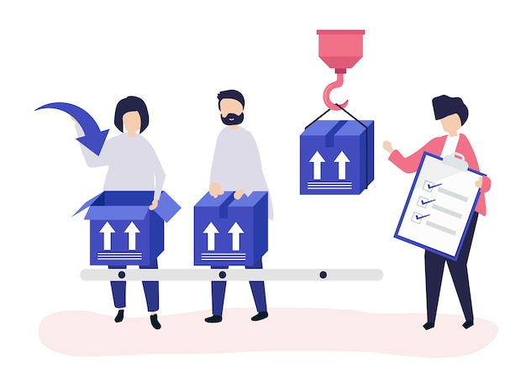
Track your shipment
How to track your shipment
Get the tracking number
Visit the shipping carrier’s website
Use the retailer’s tracking feature
Enable notifications
Interpreting tracking information:
In transit
Out for delivery
Delivered
Image by rawpixel on Freepik

Slide 35
Resolving shipping issues
Check the tracking information
Use your tracking number to verify the status of your order. Learn how to identify if there’s been a delay or change in delivery date.
Contact the carrier for updates
If there’s a delay, contact the shipping carrier (e.g., UPS, FedEx) to get more detailed information and resolve any delivery issues.
Reach out to customer service
Learn how to effectively contact the retailer’s customer service to report problems like missing or damaged items and get a quick solution.

Slide 36
Legal and ethical awareness
Legal awareness
Key consumer rights
Right to information
Right to cancel (Cooling-Off Period)
Right to a refund
Right to data privacy
Right to secure transactions
Ethical considerations
Supporting fair-trade products
Choosing sustainable brands
Avoiding fast fashion
Considering animal welfare
Recognizing greenwashing

Slide 37
Unit 9 How to communicate with customer service
Objectives
On completion of this unit, you will be able to:
Contact customer service: Learn how to find the correct contact information and reach the right department for assistance.
Describe your issue clearly: Understand how to explain the problem in detail, including relevant information like order numbers, tracking numbers, and dates.
Know your desired outcome: Be clear about what you want as a resolution (refund, replacement, or alternative solution) to guide the conversation and get the best outcome.
Image by vectorjuice on Freepik

Slide 38
Contact customer service
Find customer support contact options, most online stores offer multiple ways to contact customer service, including:
Live chat: Typically found on the website or app for instant messaging with a representative.
Email: Use the website's “Contact Us” section to find the customer support email address.
Phone support: Some stores provide a phone number for direct contact.
Social media: Some companies offer support through their social media accounts (e.g., Facebook, Twitter).
Image by Freepik

Slide 39
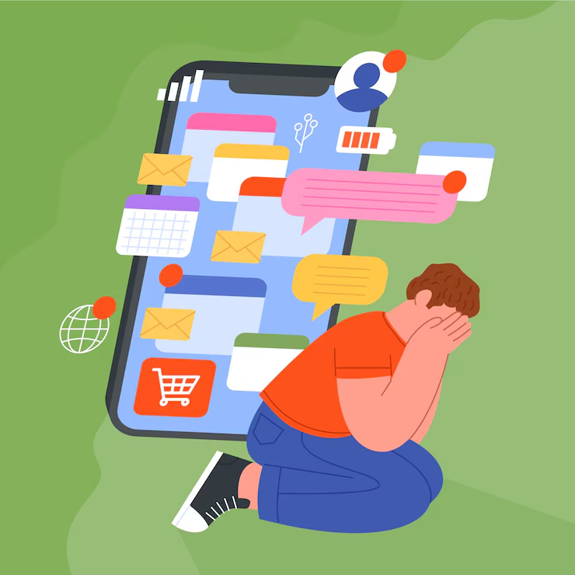
DESCRIBE YOUR ISSUE CLEARLY!
Be specific: When contacting customer service, explain your problem in detail. Include relevant information like:
Order number
Product name and description
Date of purchase
A clear explanation of the issue (e.g., "The product arrived damaged," "Received the wrong size")
Image by Freepik

Slide 40
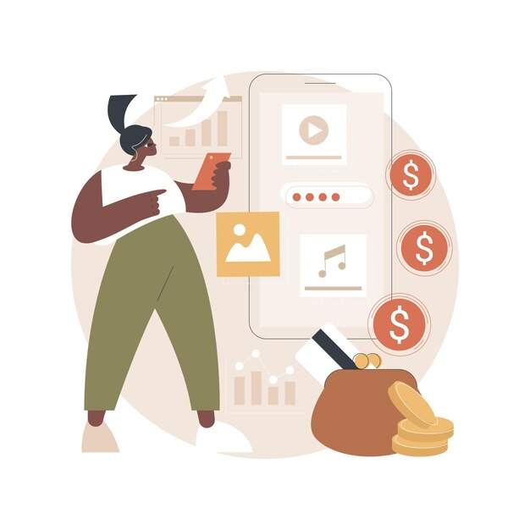
Know your desired outcome
Before contacting customer support, decide what you want as a resolution. Common options include:
A refund
A replacement product
Store credit
Return instructions
Image by vectorjuice on Freepik

Slide 41
Refund methods
Understand how the store processes refunds.
Common options include:
Original payment method: The refund will go back to your credit card, PayPal, or bank account.
Store credit: Some stores only offer store credit instead of a direct refund.
Image by vectorjuice on Freepik

Slide 42
Check your knowledge!
Image by vectorjuice on Freepik

Slide 43
1. How do you create a strong password ?
Only one answer is correct!
A. Use your name and birthdate
B. Use only numbers
C. Use only capital letters
D. Use a combination of letters, numbers, and symbols for security.
Notes:
The correct answer is D.

Slide 44
2. What is the most common online payment method?
Only one answer is correct!
A. Cash on delivery
B. Payment via POS at Easybox
C. Credit/debit card and PayPal
D. Payment using gift cards or vouchers
Notes:
The correct answer is C.

Slide 45
3. Which of the following is a sign of a potential scam?
Only one answer is correct!
A. An email offering a free prize, asking for personal details to claim it
B. A phone call from a local store confirming a delivery
C. A website with a secure "https://" in the URL
D. An email from your bank with your account balance update
Notes:
The correct answer is A.

Slide 46
4. What should you do to ensure your credit card information is safe when making online purchases?
Only one answer is correct!
A. Share your credit card details over the phone with customer support
B. Use a website with a secure "https://" and a padlock symbol before entering payment details
C. Use public Wi-Fi to complete the payment process
D. Provide your credit card number to random websites for discounts
Notes:
The correct answer is B.

Slide 47
Congratulations! You have completed this module!
Funded by the European Union. Views and opinions expressed are however those of the author(s) only and do not necessarily reflect those of the European Union or the European Education and Culture Executive Agency (EACEA). Neither the European Union nor EACEA can be held responsible for them. Project number: 2023-1-RO01-KA220-ADU-000157797

